Slide 1
Digital Wellbeing
Building Digital Resilience by Making Digital Wellbeing and Security Accessible to All 2022-2-SK01-KA220-ADU-000096888

Slide 2
DIGITAL WELL-BEING: The Impact of Technology on Digital Wellbeing
CONTENT
“Digital Wellbeing” Concept
Why Does it Matter for Adults?
Digital Wellbeing and Technology
Excessive Screen Time and Exposure to Technology
Social Media
Information Overload and Stress
Reminder(s)

Slide 3
“Digital Wellbeing” Concept
The following three definitions¹ complement each other:
It is the ability of a person to effectively manage the negative impacts of technology on their professional and personal lives.
A state of being personally in the good condition experienced through the healthy use of digital technology.
It spans the ways technology can help people live healthy lives.
As seen, Digital Wellbeing can be considered as an ability, a state or a pathway, all of which refers to people’s being in or going for a favorable condition in their relationship with technology.
DigiWELL Project Output: Digital Resilience Building Manual & Methodology

Slide 4
“Digital Wellbeing” Concept
It can be considered as an ability; because it is a competence to be able to benefit from technology and to manage its negative impacts conveniently.
It can be considered as a state; as it reflects the results of true and appropriate use of technology (in favorable connotation).
It can be considered as a pathway or process; as it is related to discovery of potential and appropriate uses to contribute people’s lives.

Slide 5
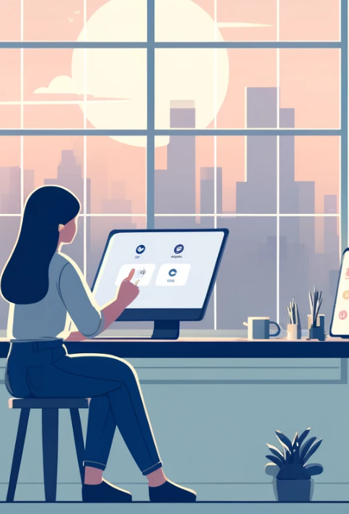
Journey to Digital Wellbeing
In the vibrant city of Digiton, Ava, a graphic designer, found herself overwhelmed by her constant engagement with digital devices. Her productivity and creativity initially soared, but soon, the endless notifications and screen time began taking a toll on her health and happiness.
Realizing the need for change, Ava enrolled in a digital wellbeing course. She learned that digital wellbeing involves managing technology's negative impacts, maintaining a healthy relationship with her devices, and using them to enhance her life, not detract from it.
Ava implemented what she learned: she set boundaries for screen time, used apps to promote healthier habits, and scheduled regular digital detoxes. Gradually, she regained balance, transforming her relationship with technology into one that supported her well-being and professional growth.
Through Ava's story, we see digital wellbeing as an ability to manage technology, a state of personal health, and a pathway to discovering technology’s positive contributions to our lives. Ava’s journey inspires us to make technology work for us, ensuring a favorable condition in our relationship with digital tools.

Slide 6
Digital Wellbeing: Why Does it Matter for Adults?
It is essential for adults to have a healthy, balanced, fulfilling, and sustainable way of life in the digital world. More specifically:
It is an important human need in the digital age.
It contributes to physical, psychological, and social health and wellbeing of people.
It refers to people’s having control over their life.
It promotes forming healthy habits in navigating the digital world.
It is the process to develop mindful and responsible manner in digital environments.
It is the key component of building digital resilience.

Slide 7
Disconnected to Reconnect
One morning, something unusual happened. Tom received an email from an unknown sender titled "Take Control." Curious, Tom opened the email to find a simple message: "Notice what's important. Disconnect to reconnect." Puzzled yet intrigued, Tom decided to take up the challenge. He began by leaving his phone behind during a walk in the park. As he strolled through the greenery, he noticed the laughter of children playing and the serene sound of a nearby fountain—sounds and sights he usually missed.
Inspired by the experience, Tom set on an adventure to rediscover his city and himself, visiting museums, local markets, and cafes, all without the constant pinging of his phone. He started reading books in quiet corners of libraries, striking up conversations with strangers, and attending community events, finding joy in real, unfiltered experiences. As days turned into weeks, Tom realized that his digital habits had been controlling him, and it was time to reverse that.
He implemented rules for himself, limiting screen time, turning off notifications after work, and engaging more in face-to-face interactions. Slowly, he regained control over his digital life, choosing when and how he connected online. In the end, Tom's life was transformed. The email that once seemed like a small ripple had become a wave of change, leading him to a life where technology was a tool, not a tyrant. He learned to control technology, ensuring it enhanced his life without dominating it. Tom's adventure, sparked by a mysterious email, taught him the invaluable lesson of being present in the moment and mastering the digital world on his own terms.

Slide 8
Digital Wellbeing and Technology
Technology, either intentionally or unintentionally, is now part of most majority of our ours’ lives. It is mostly inevitable part of our work and professional life, our teaching and learning experiences and/our daily social interactions and communications. It has a connection with many people either through hardware (e.g., PC, tablets, smart phones…) or through web tools, social media, apps etc.
It is evident that technology has been and will be deeper connection with people. Digital Growth in the use of Connected Devices and Services changed based on January 2024 data as follows²:
+ 0,9 % Technology Involvement of Total Population (Year-on-Year Change + 74 Million People)
+ 2,5 % Unique Mobile Phone Subscribers (Year-on-Year Change + 138 Million People)
+ 1,8 % Individuals Using Internet (Year-on-Year Change + 97 Million People)
+ 5,6 % Social Media User Identities (Year-on-Year Change + 266 Million People)
2. Digital 2024: Global Overview Report. DATAREPORTAL. https://datareportal.com/reports/digital-2024-global-overview-report

Slide 9
Digital Wellbeing and Technology
Considering the increase in technology involvement and its potential outcomes, it is required to understand the impacts of technology and to manage its impact on overall wellbeing and digital wellbeing.
Digital Wellbeing encompass three main components:
To understand and recognize the impact of technology. (You will discover this in this current section)
To have positive relationship with technology by forming healthy digital habits. (You will discover this in the next sections)
To implement best practices to ensure an overall wellbeing. (You will discover this in the next sections)

Slide 10
The Impact of Technology on Digital Wellbeing
It is evident that the use of technology has not only positive but also negative impacts on people.
The distinction in between – being positively or negatively impacted by technology – depends on the degree to which individuals:
have an awareness on digital wellbeing,
have an overall understanding of these impacts, and
form healthy habits and develop mindful and responsible manners while using technology.

Slide 11
The Impact of Technology on Digital Wellbeing
Main Positive Impacts of Technology
Access to Information: It enables quick access to information and resources and help people to make decisions and solve problems.
Simplification of Main Tasks: It presents tools to simplify main daily tasks in various areas such as shopping and banking.
Higher Connectivity: It helps people to connect each other online regardless of distance.
Network Development: It contributes establishing network for various purposes such as advertisement, education and learning, job-seeking or information sharing.

Slide 12
The Impact of Technology on Digital Wellbeing
Main Positive Impacts of Technology
Expression: It provides platforms for expressing ideas and for self-reflection.
Contribution to Education and Learning: It helps providing education and training, supplementing face-to-face education and enabling self-paced learning.
Health and Wellness: It provides information for healthcare and tools such as health trackers or apps to contribute health and wellness.
Relaxation: It provides entertainment options and also tools to reduce stress and anxiety.

Slide 13
The Impact of Technology on Digital Wellbeing
Along with its many positive impacts, technology has several and complicated negative impacts for adults.
A concrete way of illustrating the impacts of technology could be to employ the following key drivers as a lens:
Excessive Screen Time and Technology Exposure
Social Media
Information Overload and Technology Related Stress
P.s: It is also possible to address the impacts of technology from different perspectives. The following parts of this slide aims to present a illustration on how technology could impact individuals’ lives and their overall wellbeing.

Slide 14
Excessive Screen Time and Exposure to Technology
Extensive Screen Time and Exposure to Technology has detrimental impacts on Physical Health, Mental Health and Wellbeing, Social Connections, Attention Span and Productivity³.
The overall consequences diminish the wellbeing and digital wellbeing.
3. Screens Steal Time: How Excessive Screen Use Impacts the Lives of Young People. https://zenodo.org/records/10250536

Slide 15
Excessive Screen Time and Exposure to Technology
Digital wellbeing involves managing one's relationship with technology to have a balanced and healthy lifestyle.
Digital wellbeing encourages a holistic approach to technology that requires paying attention to physical health and balancing between screen time and other offline activities.
Excessive Screen Time and Exposure to Technology could have the following significant impacts on Physical Health:
Obesity & Sedentary Lifestyle
Postural Problems
Vision Impairment
Sleep Disturbances
Metabolic Dysfunctions related to Anxiety and Depression
Radiation Exposure
Impacts on Physical Health

Slide 16
Excessive Screen Time and Exposure to Technology
Digital wellbeing requires setting boundaries and establishing healthy habits. If this is not ensured, individuals may experience adverse mental health outcomes associated with excessive technology use.
Excessive Screen Time and Exposure to Technology could have the following significant impacts on Mental Health and Overall Wellbeing:
Depression
Anxiety
Self-Harm and Aggression
Sleep Disturbances
Negative Body Image and Low Self-Esteem
Escapism (avoiding from real-life problems)
Impacts on Mental Health and Wellbeing

Slide 17
Excessive Screen Time and Exposure to Technology
Excessive screen time and exposure to technology may have detrimental effects on social relations, as well, impacting the quality of interactions, communication skills, and sense of connection within interpersonal relationships.
Declining Family Time
Reduced Face to Face Interaction / Eye Contact
Diminished Real-Life Communication Skills
Less Emphatic Understanding
Difficulty in Interpreting Social Clues
Social Isolation
Dependency on Virtual Connections
Less Self-Regulation
Impacts on Social Connections

Slide 18
Excessive Screen Time and Exposure to Technology
Excessive screen time and exposure to technology may have detrimental effects also on attention span and creativity, leading to distractibility, reducing opportunities for deep engagement with tasks, and limiting exposure to activities that foster creative expression and innovation.
Reduced Ability to Focus
Distraction
Reduced Information Processing
Reduced Deep-Thinking
Virtual Environment Dependency and Related Decreased Creativity
Dependency on External Stimulus
Impacts on Attention Span and Creativity

Slide 19
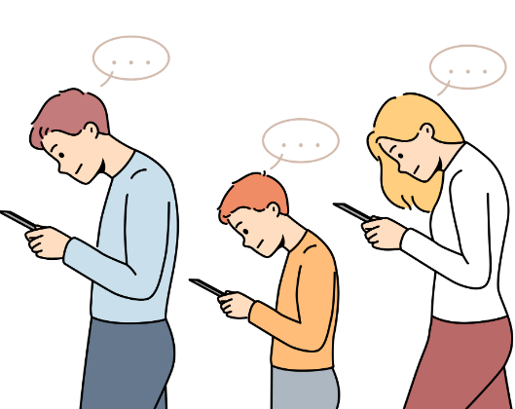
Social Media
The common utilization of social media has created a complicated environment that adults need to manage. It presents many opportunities one hand, while it creates severe risks, hazards or concerns for the wellbeing of adults on the other hand.
Ensuring the digital wellbeing of an individual requires a clear understanding the negative impacts of social media on people’s wellbeing and digital wellbeing as well as considering its potential benefits.

Slide 20
Social Media
Social media can negatively impact the digital wellbeing of individuals in following ways:
Addiction: Higher tendency to spend time online, and neglection of real-life responsibilities.
Mental Issues: Potential to lead anxiety, depression, lower self-esteem due to comparisons with other people.
Cyberbullying: Potential virtual violence with emotional and psychological consequences.
Privacy Issues: Risk of digital security, identity and/or data theft.
Information overload: Possibility of data abundancy and its leading to overwhelming necessary information.
Fear of Missing Out (FOMO): Higher inclination and dependency to follow others, leading to inadequacy.
Reduced Offline Interaction: Decreased face-to-face connections, leading to isolation and loneliness.

Slide 21
Social Media
The impact of the internet and social media on human life is mostly considered based on negative assumptions.⁴ However, adults who can use these technologies correctly and effectively can access many opportunities, including personal development and continuous learning, and can take advantage of opportunities to improve their lives. Purposeful use of social media contributes Digital Wellbeing. Here below are some of its benefits ⁴ :
Enhanced Social Connection: Social media strengthens connections with friends, families, and communities regardless of geographical barriers.
Mental Health Support: Social media raises awareness and provides immediate access to mental health resources, including therapy options, especially in remote areas. Also, it can be used as a tool to screen, treat and prevent some mental health disorders by the help of some machine learning techniques.
4. Gupta, C., Jogdand, S., & Kumar, M., (2022). Reviewing the impact of social media on the mental health of adolescents and young adults. Cureus, 14(10), e30143.

Slide 22
Social Media
Other Benefits
Education: It could be used for educational purposes through resources, tools and discussions on many topics, which is supplementary to traditional learning.
Self-Expression: It offers tools for photography, video and writing, enabling users to express their feelings and perspectives.
Network Development: It facilitates individuals to establish professional contacts and attain job opportunities.
Dissemination: It helps sharing news and information and enables people to stay informed and updated.
Awareness Creation: It helps raising awareness on social issues and making voices heard.

Slide 23
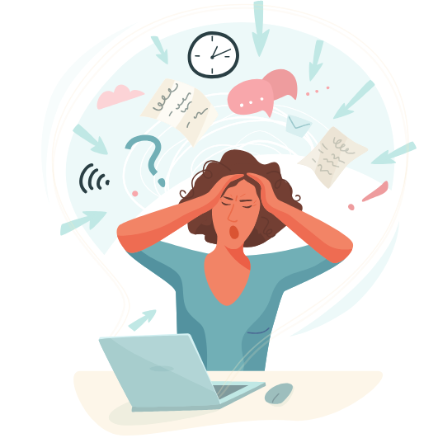
Information Overload and Stress
Information Overload (IO) in digital world is the result of abundant level of information at various online platforms and of high-speed information delivery. Due to speedily improving number of online tools and resources, the amount of information available online increase each passing day.
IO could lead to stress among adults due to the following reasons:
IO may complicate decision making.
IO may foster perceived lack of control of information.
IO may lead to impair attention span and focus.
IO may trigger fear of missing out.
IO may enhance time pressure.

Slide 24
Information Overload and Stress
Information Overload and Stress it could lead to could have some negative impacts on adults’ wellbeing and digital wellbeing.
Difficulty in Decision Making: Adults may have lower possibility of making informed and mindful decisions, leading to problems in different areas of life such as work and social relations.
Lower Productivity: Difficulty in decision making and losing focus may lead to lower productivity, impacting personal and professional life.
Mental & Physical Health Issues: It may lead anxiety, depression, lower life satisfaction or even burnout, which can also lead physical health problems.
Digital Burnout: Continuous exposure to IO and stress may lead to exhaustion and depersonalization, which impairs wellbeing and digital wellbeing.

Slide 25
REMINDERS
Digital Wellbeing is a holistic issue which encompasses individuals’ attempts in establishing healthy relationships with technology and such results of their attempts (their states).
The more adults have digital wellbeing related awareness, understanding and practices, the more they have possibility to truly benefit from technology and eliminate its negative impacts.

Slide 26
Free License
The product developed here as part of the project "Building Digital Resilience by Making Digital Wellbeing and Security Accessible to All 2022-2-SK01-KA220-ADU-000096888" was developed with the support of the European Commission and reflects exclusively the opinion of the author. The European Commission is not responsible for the content of the documents
The publication obtains the Creative Commons License CC BY- NC SA.
This license allows you to distribute, remix, improve and build on the work, but only non-commercially. When using the work as well as extracts from this must:
be mentioned the source and a link to the license must be given and possible changes have to be mentioned. The copyrights remain with the authors of the documents.
the work may not be used for commercial purposes.
If you recompose, convert or build upon the work, your contributions must be published under the same license as the original.
Disclaimer:
Funded by the European Union. Views and opinions expressed are however those of the author(s) only and do not necessarily reflect those of the European Union or the European Education and Culture Executive Agency (EACEA). Neither the European Union nor EACEA can be held responsible for them.

