Slide 1
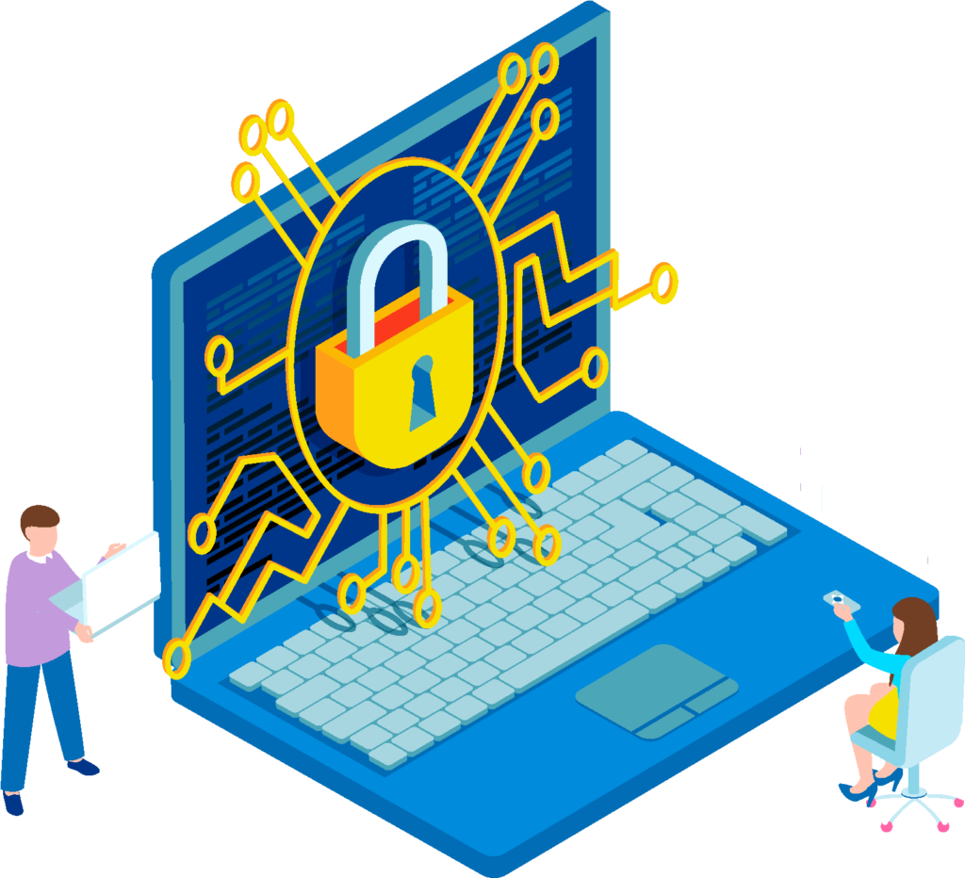
Digital Security - Digital Identity and Digital Footprint
Building Digital Resilience by Making Digital Wellbeing and Security Accessible to All 2022-2-SK01-KA220-ADU-000096888

Slide 2
Sub-section 1: Digital Identity and Digital Footprint
CONTENT
Introduction
Digital Identity
Digital Footprint
Best practices for protecting digital identity and digital footprint

Slide 3
Introduction
Today's world is characterized by a tremendous increase in digitalization in all areas of our lives - more and more services and transactions are moving online.
Traditional services that required personal presence are transformed into digital form and "moved" into the online environment.
They become more accessible and provide individuals with new, time and geographically unlimited access to information, personal development, education, communication and social interaction, collaboration, etc.
An individual's access to these services requires a digital identity that is analogous to their physical identity in the real world.
Our digital presence and activities leave our digital footprint in the online world in the form of various information.

Slide 4
Digital identity - definition
A digital identity is an individual’s digital version of their analog identity.
A digital identity is typically defined as a one-to-one relationship between a human and their digital presence.
A digital presence can consist of multiple accounts, credentials, and entitlements associated with an individual.
Digital identity is the online representation of a person, organization, or entity.
It consists of all the linked digital data and information, such as name, email address, social media profiles, and online behavior.
Digital identity is all digital information that is used to prove the identity of an individual online and that allows users to interact and transact in the virtual world.
This information is non-transferable and reusable.

Slide 5
Digital identity – why is important?
Digital transformation in society creates a robust ecosystem of online services based on digital identity.
Digital identity is playing a foundational role in digital economy.
Digital identities are needed to ensure people's trust in online service providers and vice versa, and each other's digital interactions.
It is closely related to the actual identity of the individual.
It contains sensitive/personal information that can be stolen and misused to commit fraud.
It allows individuals to "take control" of their online data.
It has the potential to be used anywhere in the future.
It is a key component of building an individual's digital resilience and digital security in digital age.

Slide 6
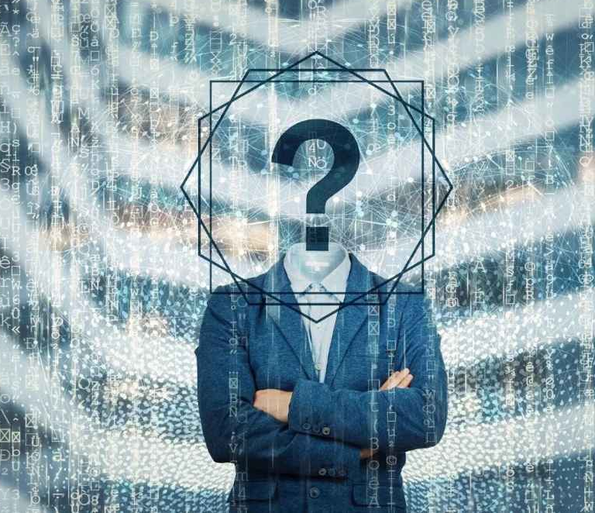
Components of digital identity
Personal information: full name, date and place of birth, marital status, driving license, occupation, place of work, identification number, email, IP address, etc.
User credentials: logins, passwords, profiles, tokens, biometric data, etc.
Attributes of individual's online behavior and interaction: online activity, posts, comments, transactions, photos, videos, browsing history, search queries, social media presence, metadata, geolocation, etc.
Data double: a shadow profile built from the various pieces of digital identity. It contains a comprehensive record of online activities from various sources to create a detailed understanding of digital identity owner.

Slide 7
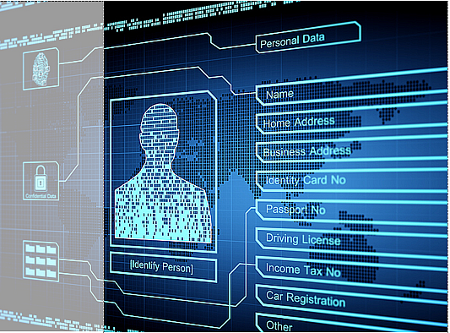
How digital identity information can be exposed?
1. Knowingly exposed digital identity information is publicly available and published by the individual or the platform (service) they used.
Publicly shared information: name, address, email address, profile photo, social media usernames.
Professional information: company name, job title, educational, public profile on professional networking sites (eg. LinkedIn).
Creative Content: anything that was created and shared online by user (comments, likes, photos, videos).
Interests and opinions: public posts about hobbies, social causes or favorite movies.
Engagement online: the way user interacts with others online, the communities he participates in.
Sharing this information online can be an intention of building a digital identity.

Slide 8
How digital identity information can be exposed?
2. Unknowingly exposed digital identity information because of unwanted activities aimed at the unauthorized acquisition of digital identity.
Using of public Wi-Fi networks or unsecured websites.
Data breaches by third parties (providing data is often part of the registration terms or General terms and conditions).
Internet scams: phishing/pharming, email fraud, deepfake videos, voice and graphics.
Digital identity owner carelessness and mistakes: weak passwords, using the same password for different accounts, sharing location or geo-tagging, adding strangers to social media accounts, reading spam messages, fake SMS/calls, etc.
Sharing this information online is often without the user's knowledge.

Slide 9
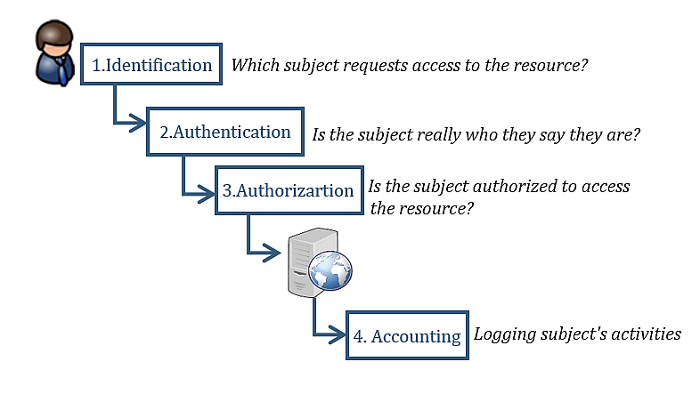
Access control to online services - steps
Access to online services is conditional on three basic steps:
Identification is the step in which a user proves his identity (username, login, email address).
Authentication requires user to prove he is still the person he claimed to be during the identification (using passwords, PINs, biometrics,...).
Authorization determines which resources (e.g., services) an authenticated user is allowed to access (based on assigned rights and privileges).
Identification and authentication are the most important steps - they are based on providing unique user identification data (only the user knows it)

Slide 10
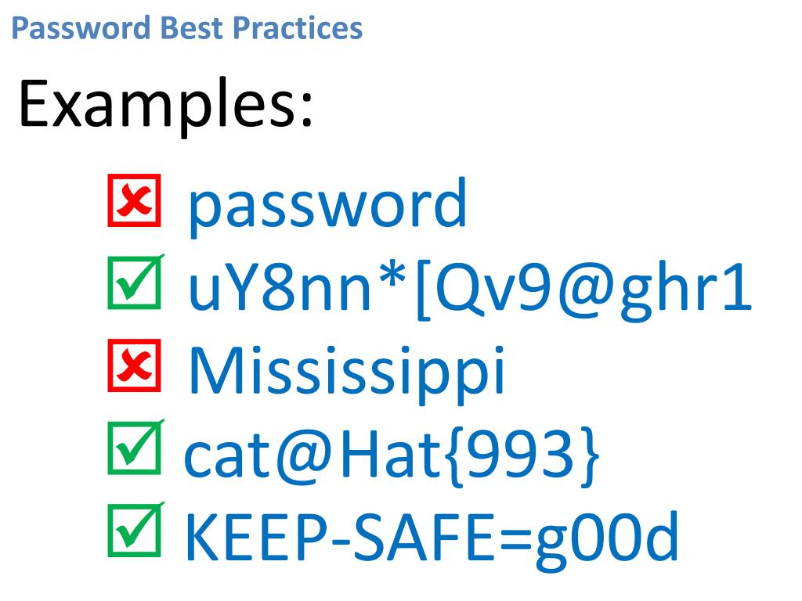
Authentication mechanisms - categories
Authentication is based on the provision of additional information - various authentication elements that supplement the user's identity and that only the user knows:
Something you know: is based on knowledge that only the user should know (i.e., passwords, PIN, security questions).
Something you have: is based on possession, where user possess something physical or digital token (cell phone security token, smart card, cell phone).
Something you are: is based on static biometric elements, i.e., unique physical characteristics of the user (e.g., fingerprint, facial recognition, iris scan).
Something you do: is based on dynamic biometric elements, specifically on the user's behavioral patterns/actions (e.g., typing rhythm, voice pattern, hand signature).

Slide 11
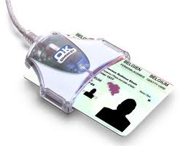
Authentication mechanisms - categories
Authentication is based on the provision of additional information - various authentication elements that supplement the user's identity and that only the user knows:
Something you know: is based on knowledge that only the user should know (e.g., passwords, PIN, security questions).
Something you have: is based on possession, where user possess something physical or digital token (cell phone security token, smart card, cell phone).
Something you are: is based on static biometric elements, i.e., unique physical characteristics of the user (e.g., fingerprint, facial recognition, iris scan).
Something you do: is based on dynamic biometric elements, specifically on the user's behavioral patterns/actions (e.g., typing rhythm, voice pattern, hand signature).

Slide 12
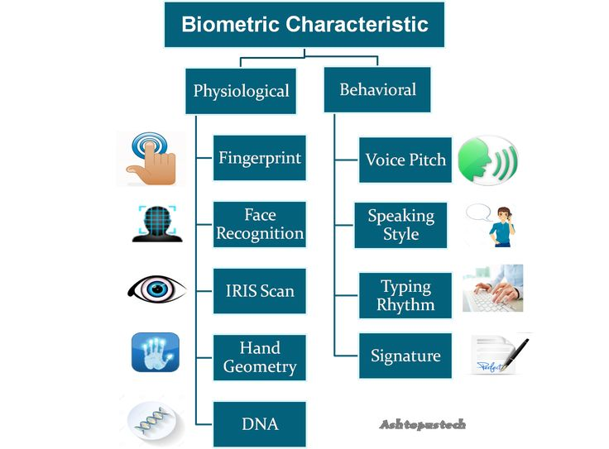
Authentication mechanisms - categories
Authentication is based on the provision of additional information - various authentication elements that supplement the user's identity and that only the user knows:
Something you know: is based on knowledge that only the user should know (e.g., passwords, PIN, security questions).
Something you have: is based on possession, where user possess something physical or digital token (cell phone security token, smart card, cell phone).
Something you are: is based on static biometric elements, i.e., unique physical characteristics of the user (e.g., fingerprint, facial recognition, iris scan).
Something you do: is based on dynamic biometric elements, specifically on the user's behavioral patterns/actions (e.g., typing rhythm, voice pattern, hand signature).

Slide 13
The risks and threats of digital identity abuse
Average Internet user has 150 online
accounts that require a password
Dashlane‘s research, 2017
Identity theft - unauthorized access to personal information or taking over an individual's digital identity can lead to a variety of fraud.
Sharing personal information can lead to security and privacy concerns (users` information is centrally collected on different platform). Disruption of platforms can lead to exposure of sensitive information to unauthorized third parties.
Inaccurate or incomplete digital identity information can lead to problems with authentication and access to services.
Cyberbullying - digital identities can be used for cyberbullying and harassment.
Negative user experience with ineffective identity verification processes and problems accessing services.
The identification people through geolocation (with or without their consent) is a precedent in the monitoring of people (unclear legal aspect and risk of abuse).

Slide 14
Digital footprint – introduction
Facts:
Many online services and activities require you to verify your digital identity, but many of them collect information automatically.
There is an enormous quantity of our personal and professional data out there on the internet.
Through our use of online services and our activities online, we create our digital footprint in the digital space.
A digital footprint is recorded whenever a user uses an online service or completes any traceable online activity.
What to be aware of about your digital footprint:
it's the invisible trail we leave behind,
it's passively generated through online actions,
it is often accumulated/recorded without the user's knowledge.

Slide 15
Digital footprint - definition
A digital footprint is the data that’s left behind whenever you use a digital service, or whenever someone posts information about you onto a digital forum.
A digital footprint (also referred digital shadow) is the traceable data and activity that a user leaves on the internet.
A digital footprint is the data trail created by your online activities and the traces you intentionally or unintentionally leave behind.

Slide 16
Digital footprint – why is important?
The digital footprint is a permanent and indelible part of our online existence - everything you post online stays there forever.
The digital footprint grows up with each online activity/action of user or when websites/apps track a user's activity (with or without consent) and may contribute to building a user's digital identity.
The digital footprint plays a significant role in building user's online reputation (personal/professional).
Online activities/actions contribute to the creation of a digital profile that can be viewed/analyzed by anyone.
Safeguarding and managing the content of the digital footprint provides protection against crime and fraud.

Slide 17
Digital footprint – types
Active digital footprint - data that a user knowingly publishes on the internet. They are the result of targeted online activities by the user:
posting or participating in social networks or online forums,
logging into a website using a registered username/profile,
completing an online form/questionnaire,
subscribing to a newsletter,
accepting browser cookies.
Passive digital footprint - data that is collected about a user/online activities without their knowledge (sometimes without their consent). Data is collected invisibly through the online services used and by monitoring the IP address of the user's PC:
installing cookies,
browsing/purchase history (based on consent to terms of use),
social networks and advertisers who use likes, shares and comments to target specific content to the user,
apps that track a user's digital activity and location.

Slide 18
Digital footprint - examples of collected data
Activity | Collected data
Web browsing | IP address of the connection, browsing history and activity, used device type
Cookies file | login information, search history and preferences, used device type, language preferences
Online shopping | purchase history including purchased/reviewed items, credit card numbers, personal data, newsletter subscriptions, coupon usage, ad clicks
Online banking | payment and account information, transaction history, geolocation data
Download files | file type, origin and metadata, history of downloaded files
Social networks | photos, posts, comments, names of relatives, friends
Email | received/forwarded emails, email addresses (personal or professional contacts), geolocation

Slide 19
The risks and threats of digital footprint abuse
Anything, anywhere, anytime uploaded, transferred, put into cyberspace stays there forever
Identity theft: to create fake IDs, open fraudulent accounts.
Social engineering: spoofed emails (on behalf of an employer, bank) to obtain sensitive information or to click on malicious links.
Phishing attacks: theft of financial information.
Privacy and data breaches: if multiple accounts use the same password, leaked login credentials from one account can be used on all websites.
Cyberbullying or harassment: personal data can be misused for cyberbullying or doxxing (posting private information online with the intent to intimidate).
Targeted advertising: companies/advertisers profile their customers to send personalized ads or campaigns.
Reputational damage: a negative footprint can compromise user's reputation in their personal and professional life.

Slide 20
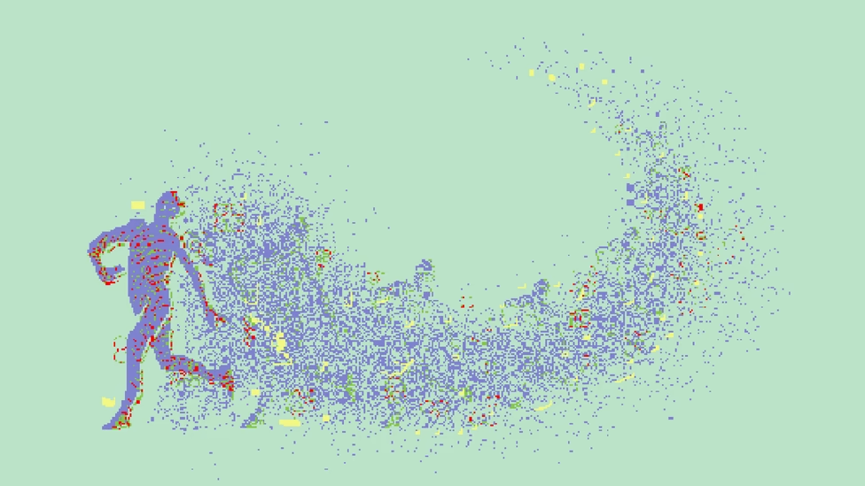
Best practices for protecting digital identity and digital footprint
Common rules
Be mindful in cyberspace and in online interactions.
Be proactive and informed user who is in control of their personal data, digital identity and digital footprint and is aware of privacy best practices.
Follow security measures in the online space (strong passwords, multi-factor authentication, software updates).
Use techniques/tools to protect the user's digital identity and digital footprint:
Techniques for minimizing user personal data provided or requested in online services and interactions.
Techniques to "obfuscate" identity (incognito mode, Privacy Filters, anti-tracking tools from tracking user online activities).

Slide 21
Best practices - digital identity
As digital activity increases, digital identity becomes more complex
General principles for self-management of your digital identity:
Apply unified approach across all online services/platforms.
Delete of unused accounts with consent revocation for personal data processing.
Do not store personal login information on public computers.
Keep track of activity on your accounts.
Secure your devices and keep your software up to date.
Regularly check and adjust your privacy settings.
Stay informed: keep up to date on the latest types of internet scams and identity theft.

Slide 22
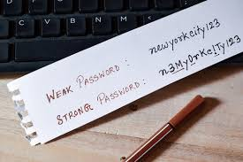
Best practices – user password
General principles for user passwords
Use a strong password: a string of 15 characters and the mix of upper and lowercase letters, numbers, and symbols
Use a passphrase, for example a short text from favorite song (e.g., 5 words) or phrase associated is with personal experience of user, for example: my first bike was blue --> password is: Me1bIk3Wb#u3.
Use a different password, passphrase or PIN for each device, account or service.
Do not use easily guessable passwords, passphrases or PIN.
Use a password generator to create random and strong passwords.
Store your passwords in a secure environment.
Never share your passwords with anyone else.

Slide 23
Best practices – activities in the online space
General principles
Take the opportunity to customize your services/applications.
Limit personal data sharing - share only essential personal information in your online accounts.
Limit interaction with unknown accounts or suspicious links/emails.
Check Privacy policy and terms of use for each service.
Prefer multi-factor authentication and biometric authenticators.
Avoid using unsafe/unknown websites - check the following: padlock, prefix https:// prefix) and security certificate.
Avoid use of public Wi-Fi - limiting their use to activities that do not require digital identity information.

Slide 24
Best practices – digital footprint
General principles for minimizing/eliminating the digital footprint in cyberspace
Take the opportunity to customize your services/applications.
Remove or deactivate of all unused and old accounts.
Unsubscribe from unwanted email newsletters.
Do not log in to other online services using Facebook/Google account.
Clear browsing and searching history.
Adjust privacy settings in online services/applications.
Limit the amount of personal data shared on social media.
Check apps, files and devices regularly.

Slide 25
Recommendation | Tools
Use search engines to check your digital footprint (by your name, accounts, emails) | Set up Google Alerts to track your name. Check your email address in list of data breach on Have I Been Pwned?
Check your online activity | Use the My Activity Google tool to find and manage various aspects of account activity
Removing negative digital footprint from search engines (name, account, email) | Submit Request personal content removal from Google Search
Delete and minimize cookies | Delete cookies on settings of web browsers. Browse the internet in incognito mode to avoid cookies.
Clear search and browsing history | Delete your search and browse history.
Do not store login name and passwords in browser for autofill when log in again | Delete stored passwords on web browsers . Use an offline password manager to store passwords.
Use tools to minimise your digital footprint to obfuscate your identity | Set browser feature Do Not Track . Use incognito mode in web browser. Use anti-track browsers, e.g. DuckDuckGo. Use private browser, e.g. Tor.

Slide 26
Have you been a victim of fraud?
Record information: (type of fraud, exact date/time, what information was stolen, bank account numbers, names and contact details of potential fraudsters, available documentation: emails, chat conversations, screenshots, etc.).
Contact all institutions where the information was stolen (banks, card companies, insurance companies) and ask for your accounts and cards to be blocked.
Change passwords on all online accounts.
Report the fraud to law enforcement: file a criminal report with the police and request a copy of the incident report document. Also report the fraud to other relevant institutions, platforms:
Office for the Protection of Personal Data in your country
European Anti-Fraud Office: https://anti-fraud.ec.europa.eu/olaf-and-you/report-fraud_en

Slide 27
Conclusion
Digital identity and digital footprint has become an integral part of our daily lives.
Digital identity is our online presence we create when we use digital tools.
Digital footprint is "permanent record" of our digital presence and our using of online services.
Knowledge and effective management of digital identity and digital footprint are the key to our digital privacy and digital security in the digital world.

Slide 28
Quiz questions
What is a digital identity?
What information can be part of your digital identity?
What are the risks and threats of misuse of digital identity?
What is a good practice for protecting your digital identity?
What is a digital footprint?
What information is collected/recorded via your digital footprint?
How can you to minimize your digital footprint?
How to proceed when you have become a victim of online fraud?

Slide 29
Free Licence
The product developed here as part of the project "Building Digital Resilience by Making Digital Wellbeing and Security Accessible to All 2022-2-SK01-KA220-ADU-000096888" was developed with the support of the European Commission and reflects exclusively the opinion of the author. The European Commission is not responsible for the content of the documents
The publication obtains the Creative Commons Licence CC BY- NC SA.
This license allows you to distribute, remix, improve and build on the work, but only non-commercially. When using the work as well as extracts from this must:
be mentioned the source and a link to the license must be given and possible changes have to be mentioned. The copyrights remain with the authors of the documents.
the work may not be used for commercial purposes.
If you recompose, convert or build upon the work, your contributions must be published under the same license as the original.
Disclaimer:
Funded by the European Union. Views and opinions expressed are however those of the author(s) only and do not necessarily reflect those of the European Union or the European Education and Culture Executive Agency (EACEA). Neither the European Union nor EACEA can be held responsible for them.

