Slide 1
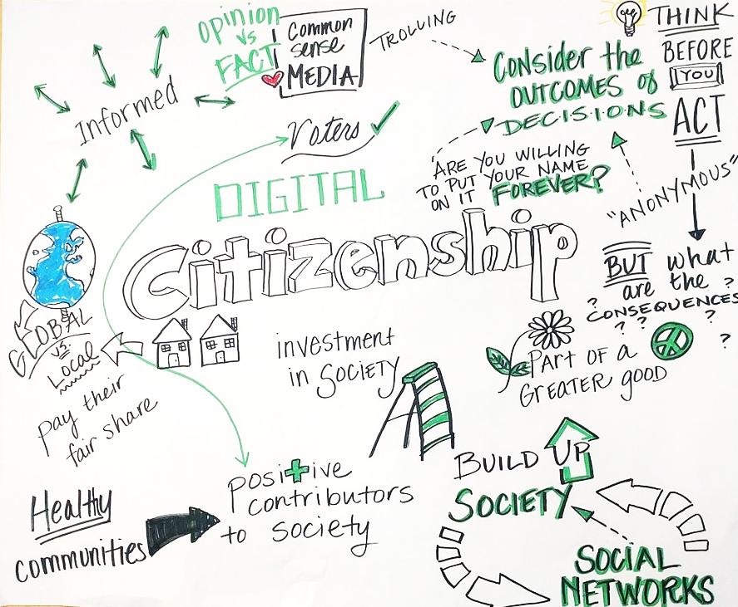
Digital Citizenship – Understanding Digital Citizenship
Building Digital Resilience by Making Digital Wellbeing and Security Accessible to All 2022-2-SK01-KA220-ADU-000096888

Slide 2
Understanding Digital Citizenship
Short Welcome Video
We asked EU citizens about DIGITAL #EUHaveYourSay

Slide 3
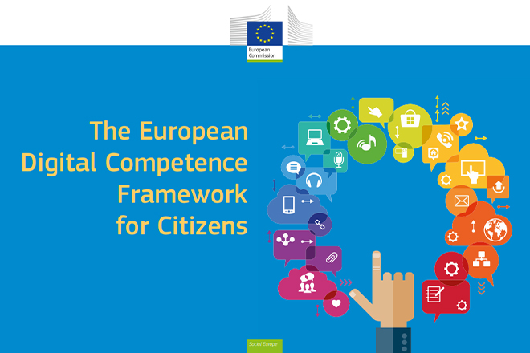
The EU DigComp Framework
The EU Digital Competence Framework for Citizen (DigComp) provides a common understanding of what digital competence is.
Digital competence involves the confident, critical and responsible use of, and engagement with, digital technologies for learning, at work, and for participation in society.
It is defined as a combination of knowledge, skills and attitudes.

Slide 4
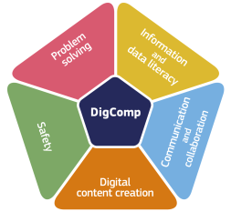
The EU DigComp Framework 5 Competence Areas
Information and Data Literacy
Communication and Collaboration
Digital Content Creation
Safety
Problem Solving

Slide 5
The EU DigComp Framework
Competence Area 2 - Communication and Collaboration: to interact, communicate and collaborate through digital technologies while being aware of cultural and generational diversity. To participate in society through public and private digital services and participatory citizenship. To manage one’s digital presence, identity and reputation.
Sub-Area 2.3 Engaging in Citizenship through Digital Technologies: to participate in society using public and private digital services. To seek opportunities for self-empowerment and for participatory citizenship through appropriate digital technologies.

Slide 6
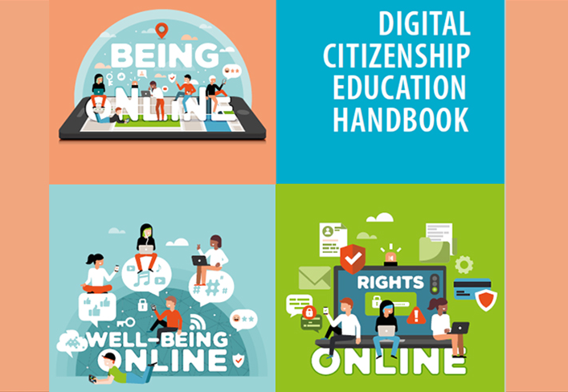
Digital Citizenship Education Handbook by Council of Europe
The Digital citizenship education handbook is intended for teachers and parents, education decision makers and platform providers.
It offers information, tools and good practice to support the development of competences to empower citizens, enabling them to live together as equals in today’s culturally diverse democratic societies, both on- and offline.

Slide 7
Digital Citizenship Education Handbook by Council of Europe
Digital citizenship competences define how we act and interact online. They comprise the values, attitudes, skills and knowledge and critical understanding necessary to responsibly navigate the constantly evolving digital world, and to shape technology to meet our own needs rather than to be shaped by it.
It describes in depth the multiple dimensions that make up each of 10 digital citizenship domains and includes a fact sheet on each domain providing ideas, good practice and further references to support educators in building the competences.

Slide 8
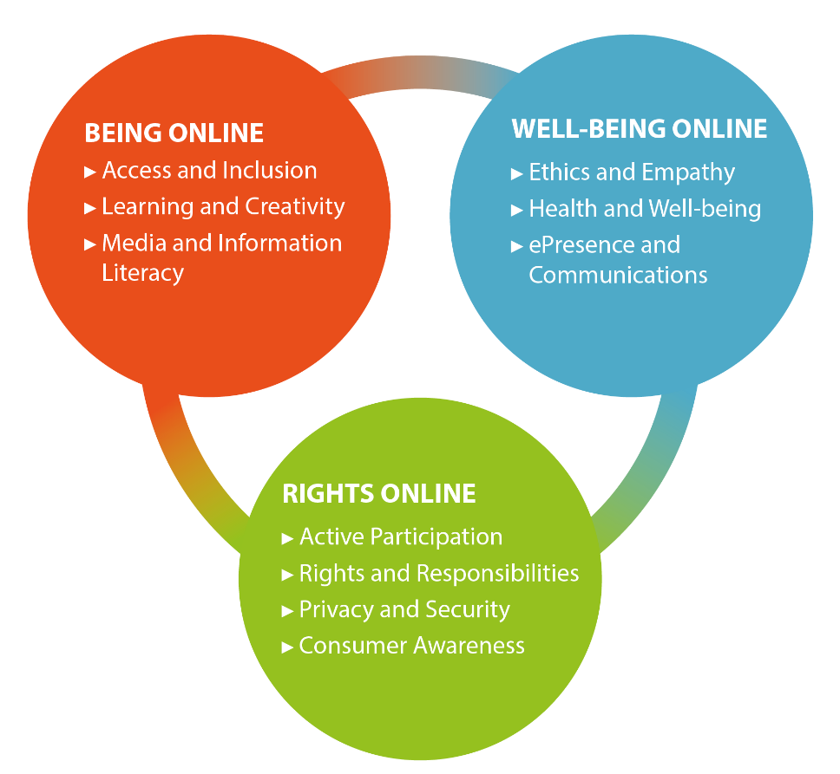
Digital Citizenship Education Handbook by Council of Europe - 3 Groups for 10 Domains
Being Online includes domains that relate to competences needed to access the digital society, freely express oneself, and use digital tools creatively and with a critical mind.
Well-being Online includes domains that relate to competences needed to engage positively in the digital society and develop a healthy relationship with technology.
Rights Online includes domains that relate to competences related to the rights and responsibilities of citizens in complex, diverse societies in a digital context, where privacy is protected, and active participation is empowered.

Slide 9
Embracing Digital Tools for Civic Empowerment
Your Gateway to Digital Citizenship and Democracy

Slide 10
The Digital Citizen's Identity
Digital citizenship begins with a secure digital identity. Tools like SPID in Italy enable citizens to access public services securely online. Similar e-IDs across Europe serve as a model for digital identification and e-governance, setting the foundation for active digital participation in formal democratic processes.

Slide 11
Digital Governance and Bureaucracy
Engaging with e-government platforms streamlines bureaucratic processes. From renewing passports online to accessing health services, these platforms demonstrate the practicality and efficiency of digital tools in formal civic engagement.
Challenge Question: Which aspect of digital governance has the most significant impact on reducing bureaucracy? A) Online voting B) Digital IDs C) Electronic tax filing
"The transition to digital governance offers an unparalleled opportunity to streamline bureaucratic processes, making public services more accessible and efficient for everyone." - Angela Merkel, former Chancellor of Germany.

Slide 12
Engaging in Digital Democracy
Platforms for digital voting and political engagement bring the ballot box to your fingertips. They exemplify how technology is used in formal democratic activities, increasing accessibility and participation in elections and referendums.
Quick Tip: Familiarize yourself with the digital platforms and tools provided by your government for civic engagement. This can range from apps for reporting local issues to platforms for public consultation on new legislation.

Slide 13
Petition Platforms for Change
Change.org and other petition platforms harness the collective power of citizens to propose and support changes in society. This informal digital tool has become a force.
Challenge Question: What makes online petitions a powerful tool for social change? A) They allow for global participation B) They are legally binding C) They automatically lead to policy changes
Expert Opinion: "Online petition platforms democratize activism, giving voice to the voiceless and power to the powerless. They can turn a local cause into a global movement." - Kumi Naidoo, former Secretary General of Amnesty International.

Slide 14
Crowdfunding Democracy
Crowdfunding platforms like Kickstarter have been adapted for civic projects, allowing communities to fund and support initiatives directly, reflecting a new form of no
What If? Scenario: What if your community could fund and launch a project that's been ignored by traditional funding bodies? How would this change the way you view community involvement and empowerment?
Quick Tip: Before contributing to a crowdfunding campaign for a civic project, do your research. Look into the project's goals, the credibility of the organizers, and how the funds will be used to ensure your contribution makes the impact you intend.

Slide 15
Social Media and Activism
Social media platforms are not just for sharing life updates; they are vital tools for activism and non-formal political campaigning. They have been instrumental in movements like #MeToo and #BlackLivesMatter, showcasing their power in mobil
Expert Opinion: "Social media has not just amplified voices; it has amplified activism. Platforms have become spaces where movements are born and nurtured." - Malala Yousafzai, activist for female education and the youngest Nobel Prize laureate.izing for social causes.

Slide 16
Local Digital Forums for Community Voices
Local forums and platforms like Reddit's r/ChangeMyView facilitate democratic discussions, giving communities a voice on local issues. These forums have become digital t
Challenge Question: How can local digital forums transform community engagement compared to traditional town hall meetings? A) They offer real-time feedback B) They limit participation to tech-savvy individuals C) They require physical presence
What If? Scenario: Imagine a city where all community decisions are made through digital forums, with every resident having an equal voice from the comfort of their home. How might this change the dynamics of local governance and civic participation?

Slide 17
Providing Policy Feedback Digitally
Public feedback platforms, such as the EU's "Have Your Say" portal, empower citizens to give input on policies that affect them, illustrating how digital tools are integral to the policy-making process.
Quick Tip: When providing digital feedback on policies, be concise but thorough. Clearly outline your support, concerns, or suggestions and provide specific examples or solutions when possible. This makes it easier for decision-makers to understand and consider your feedback.
Expert Opinion: "Digital platforms for policy feedback are revolutionizing the way we think about democratic participation. They're not just tools for engagement but powerful instruments for direct influence on policymaking." - Cass Sunstein, author and former Administrator of the White House Office of Information and Regulatory Affairs.

Slide 18
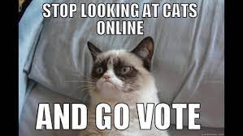
Innovative Technologies in Democracy
Emerging technologies like blockchain for secure voting and AI for analysing public opinion are on the horizon for digital democratic participation. These innovations could further revolutionize how we engage in our civic duties and interact with demo
What If? Scenario: What if blockchain technology was used in the next national election, ensuring that every vote was securely and anonymously recorded? How might this innovation change public trust in the electoral process? Democratic processes.

Slide 19
EU Digital Identity - A Practical Step Towards Digital Citizenship
The EU Digital Identity wallet represents a major stride in digital citizenship within the EU.
It allows citizens and residents to easily access a range of public and private services online and offline across the EU.
For instance, the digital wallet can be used for requesting official documents like birth certificates, filing tax returns, or even proving one's right to reside, work, or study in a Member State.
This initiative is particularly practical for cross-border services, as it facilitates transactions that previously required physical presence or paperwork, such as opening a bank account or renting a car using a digital driving license.

Slide 20
Participating in EU Democracy Digitally
Holding the nationality of an EU country automatically grants one EU citizenship, which includes the right to participate in the democratic process.
The EU has taken various steps to safeguard European democracy, promote free and fair elections, and uphold the electoral rights of EU citizens.
This includes the ability to move and reside freely within the EU, contributing to a more connected and democratic union.
Moreover, EU citizens have the right to consular protection outside the EU, reflecting the EU's commitment to its citizens' rights and democratic participation even beyond its borders.

Slide 21
Free License
The product developed here as part of the project "Building Digital Resilience by Making Digital Wellbeing and Security Accessible to All 2022-2-SK01-KA220-ADU-000096888" was developed with the support of the European Commission and reflects exclusively the opinion of the author. The European Commission is not responsible for the content of the documents
The publication obtains the Creative Commons License CC BY- NC SA.
This license allows you to distribute, remix, improve and build on the work, but only non-commercially. When using the work as well as extracts from this must:
be mentioned the source and a link to the license must be given and possible changes have to be mentioned. The copyrights remain with the authors of the documents.
the work may not be used for commercial purposes.
If you recompose, convert or build upon the work, your contributions must be published under the same license as the original.
Disclaimer:
Funded by the European Union. Views and opinions expressed are however those of the author(s) only and do not necessarily reflect those of the European Union or the European Education and Culture Executive Agency (EACEA). Neither the European Union nor EACEA can be held responsible for them.

