Slide 1
Digital Wellbeing - Understanding and Cultivating Healthy Digital Habits
Building Digital Resilience by Making Digital Wellbeing and Security Accessible to All 2022-2-SK01-KA220-ADU-000096888

Slide 2
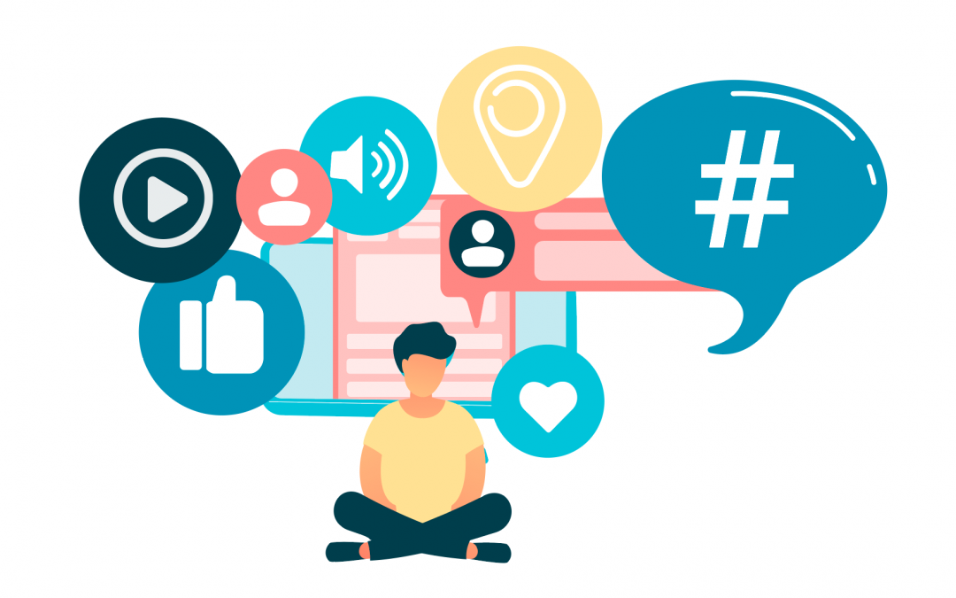
Introduction
Technology is an integral part of our lives; it has positive and negative impacts on our well-being if we use it excessively or mindlessly.
In this module, we will explore the concept of digital habits, and how they affect our mental and physical health, productivity, and relationships.
We will explore some practical strategies to manage our digital habits and cultivate a more mindful and balanced relationship with technology.

Slide 3
The Foundation of Digital Wellness
What is digital wellness?
Digital wellness (also known as digital wellbeing or digital health) is the pursuit of an intentional and healthy relationship with technology, both in the workplace and in personal life.
With many jobs and everyday activities relying on the internet and digital devices, the goal of digital wellness is to promote healthy use habits and assist the user in maintaining a healthy lifestyle in their daily life.

Slide 4
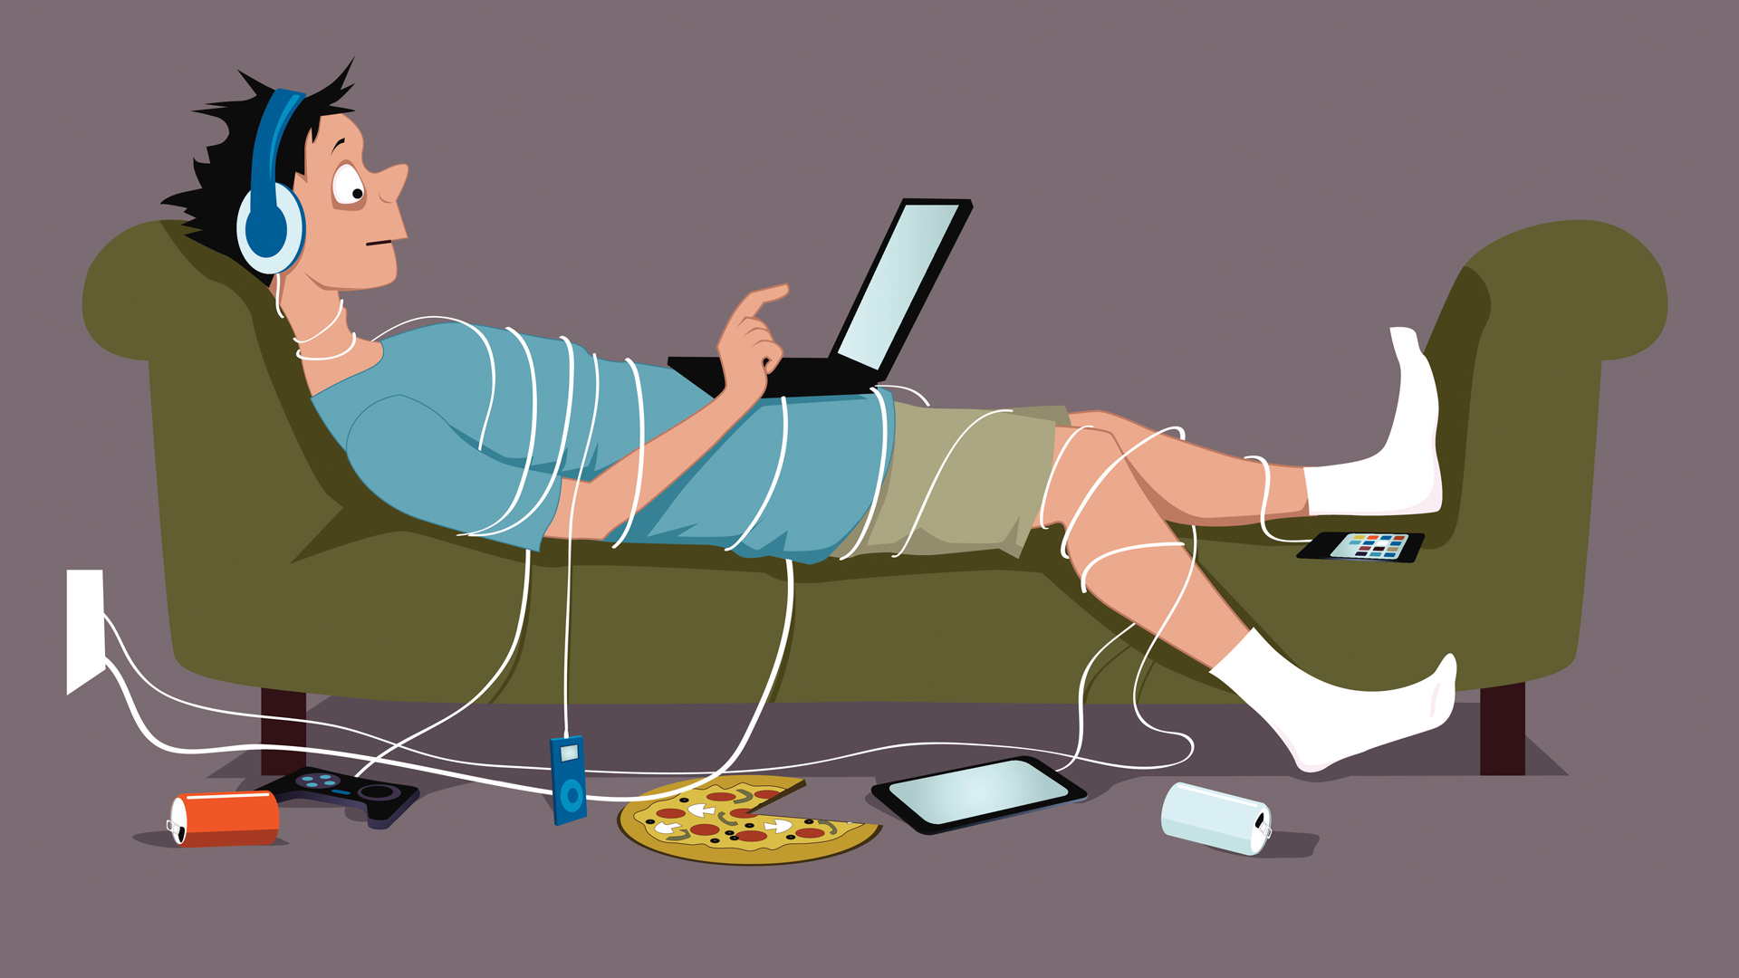
Digital Habits
What are digital habits?
They are the patterns of behavior and attitudes that we develop towards technology, such as how often we use it, what we use it for, and how we feel about it.

Slide 5
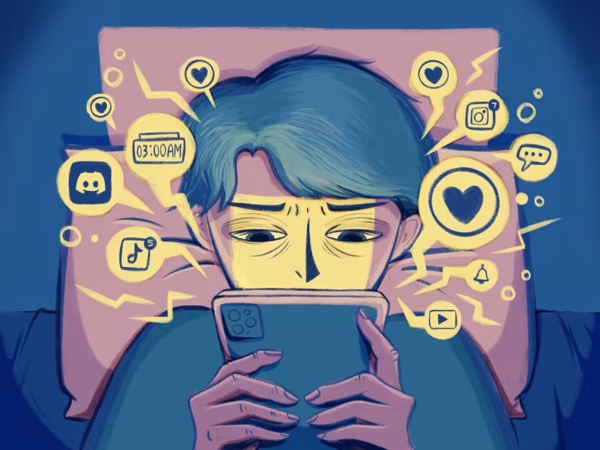
Digital habit alignment
Depending on how they align with our values, goals, and needs, digital habits can be healthy or unhealthy:
Healthy digital habits enhance our well-being, such as using technology for learning, creativity, communication, or entertainment, in a moderate and intentional way.
Unhealthy digital habits harm our well-being, such as using technology for escapism, distraction, addiction, or isolation, in an excessive or compulsive way.

Slide 6
Self-awareness
To build healthy digital habits, we need to start with self-awareness.
Self-awareness is the ability to recognize and understand our own thoughts, feelings, and actions, and how they affect ourselves and others.

Slide 7
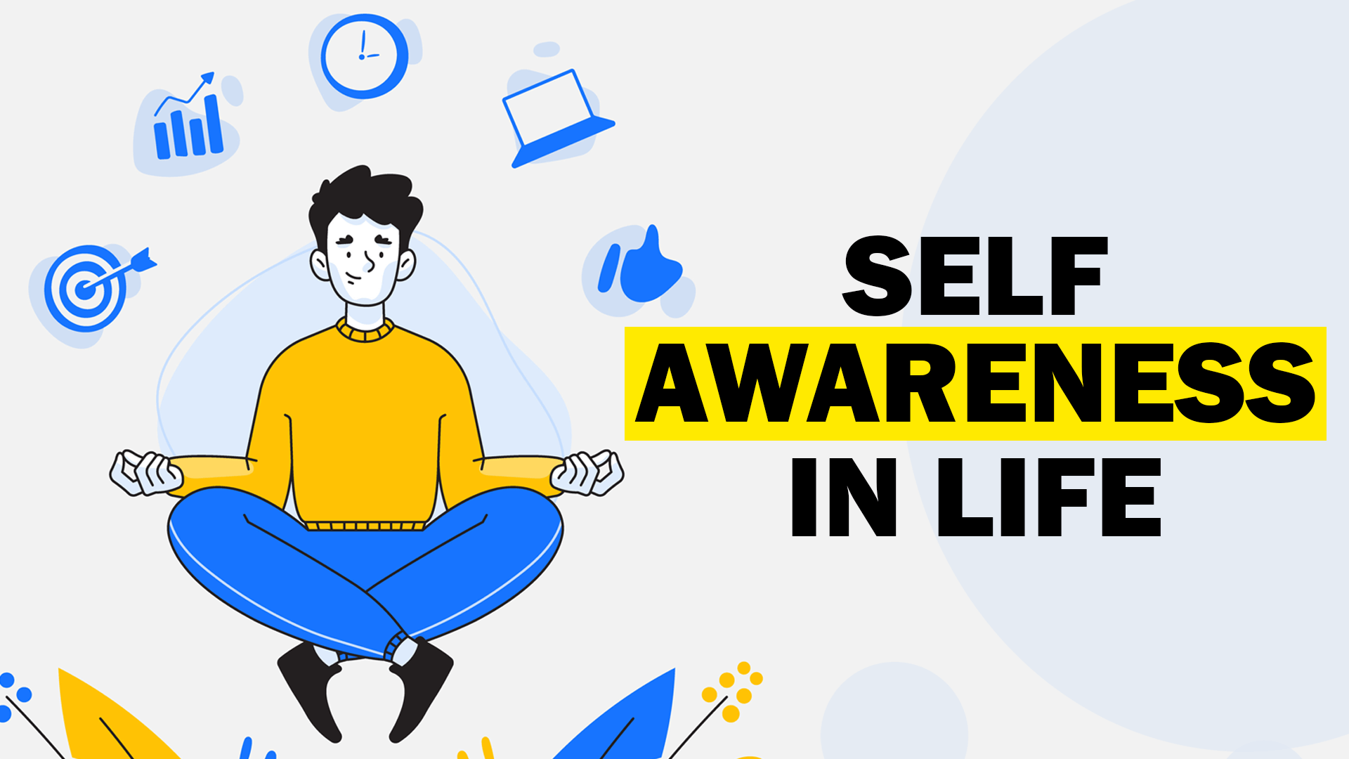
Self-awareness support
We need to identify our digital habits, and evaluate whether they are serving us or not, the triggers, rewards, and consequences of our digital habits, and how they influence our behavior.
Being self aware we can make more conscious and informed choices about our technology use and align it with our personal and professional goals.

Slide 8
Strategies to help you become more self-aware
Reflect on
Reflect on Your Goals:
Consider your personal and professional goals.
Reflect on how your digital habits align with these goals.
Identify any habits that may be hindering your progress.
Keep
Keep a Digital Journal:
Record your digital activities throughout the day.
Note the time spent on different platforms and the purpose of each interaction.
Regularly review your journal to identify patterns and trends.
Set
Set Specific Goals:
Define clear goals for your digital usage.
Establish specific limits on the time spent on social media, email, or other online activities.
Regularly assess your progress toward these goals.

Slide 9
Strategies to help you become more self-aware
Use
Use Productivity Apps:
Consider your personal and professional goals.
Reflect on how your digital habits align with these goals.
Identify any habits that may be hindering your progress.
Conduct
Conduct Digital Detox Periods:
Record your digital activities throughout the day.
Note the time spent on different platforms and the purpose of each interaction.
Regularly review your journal to identify patterns and trends.
Practice
Practice Mindfulness:
Integrate mindfulness techniques into your digital routine.
Be present and fully engaged during online activities.
Notice your emotions and reactions to digital stimuli without judgment.

Slide 10
Strategies to help you become more self-aware
Audit
Audit Your Social Media Accounts:
Review your social media accounts and the content you follow.
Schedule
Schedule Tech-Free Time:
Allocate specific times during the day when you'll be tech-free.
Unfollow accounts that contribute to negative feelings or distract you from your goals.
Curate your online environment to be more positive and intentional.
Use this time for focused work, exercise, or other non-digital activities.
Create tech-free zones in specific areas of your home.

Slide 11
Strategies to help you become more self-aware
Seek
Seek Feedback:
Ask friends, family, or colleagues for feedback on your digital habits.
Educate
Educate Yourself:
Stay informed about the impact of excessive digital use on mental and physical health.
They may provide valuable insights into patterns you might not have noticed.
Be open to constructive criticism and make adjustments accordingly.
Read books, articles, or attend workshops on digital well-being.
Understand the potential benefits and drawbacks of different online platforms.

Slide 12
Balancing act: Screen Time vs Productivity
One of the challenges of managing our digital habits is finding the right balance between screen time and productivity.
Screen time is the amount of time we spend using devices with screens, such as smartphones, tablets, laptops, or TVs.
Screen time can be beneficial or detrimental, depending on how we use it, and how it affects our other activities and responsibilities.

Slide 13
Beneficial vs detrimental screen time
Beneficial screen time is when we use technology for a specific purpose, such as work, education, or leisure, and we can switch off when we are done.
Detrimental screen time is when we use technology for no clear reason, or we lose track of time and neglect our other tasks and obligations.
To balance screen time and productivity, we need to apply some time management techniques

Slide 14
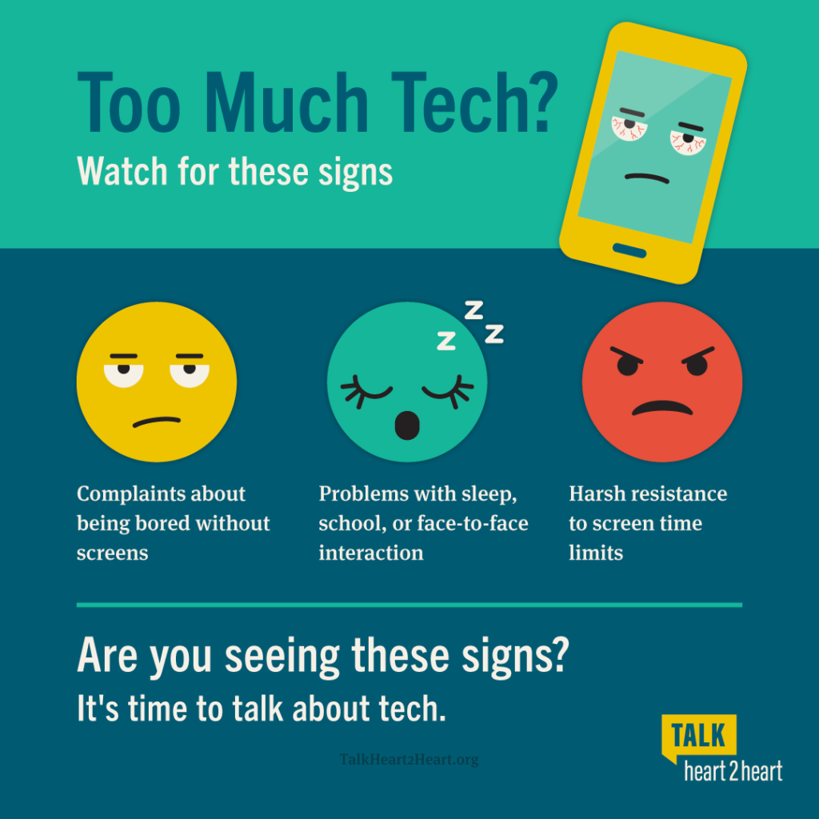
Setting a daily or weekly limit for screen time and tracking it with apps or tools.
Scheduling specific times for using technology, and avoiding it during other times, such as before bed, during meals, or while working.

Slide 15
Prioritizing our most important and urgent tasks and completing them before using technology for leisure or entertainment.
Taking regular breaks from technology and using them to do something else:
Stretching
Walking
Reading
Meditating

Slide 16
Digital Time Management Strategies
Set priorities
Set Priorities:
Utilize the Eisenhower Matrix to prioritize tasks based on urgency and importance.
Daily Schedule
Daily Schedule:
Develop a structured daily schedule that allocates specific time blocks for various digital activities.
Pomodoro Technique
Pomodoro Technique:
Embrace the Pomodoro Technique with 25-minute focused work intervals followed by short breaks.
Ensure a clear understanding of what needs immediate attention versus what can be deferred.
Clearly define when you'll engage in tasks like emails, project work, and breaks.
Leverage this approach to maintain concentration and prevent burnout during digital work.

Slide 17
Digital Time Management Strategies
Limit Multitasking
Limit Multitasking:
Enhance efficiency by focusing on one task at a time rather than attempting to multitask.
Boundaries with Notifications
Boundaries with Notifications:
Improve concentration and minimize interruptions by turning off non-essential notifications.
Batch Similar Tasks
Batch Similar Tasks:
Minimize interruptions and streamline workflow by grouping similar digital tasks together.
This approach helps improve the quality of your work and reduces the mental load.
Schedule specific times to check messages and updates to avoid constant distractions.
This reduces the cognitive load associated with frequent context-switching.

Slide 18
Digital Time Management Strategies
Digital-Free Zones
Digital-Free Zones:
Designate specific areas or times as digital-free zones to promote a healthier work-life balance.
Review and Adjust
Review and Adjust:
Regularly assess and adjust your digital time management strategies based on productivity and well-being.
Create physical spaces or specific hours where digital devices are intentionally not used.
Be flexible and open to tweaking your approach as needed.

Slide 19
Digital Time Management Strategies
Collaborate with Digital Calendar
Collaborate with Digital Calendar:
Efficiently schedule tasks, appointments, and reminders using digital calendars.
Learn to Say No
Learn to Say No:
Prioritize essential tasks by setting clear boundaries and learning to say no to non-essential commitments.
Share calendars with colleagues for collaborative project planning and coordination.
This helps maintain focus on high-priority activities aligned with your goals.

Slide 20
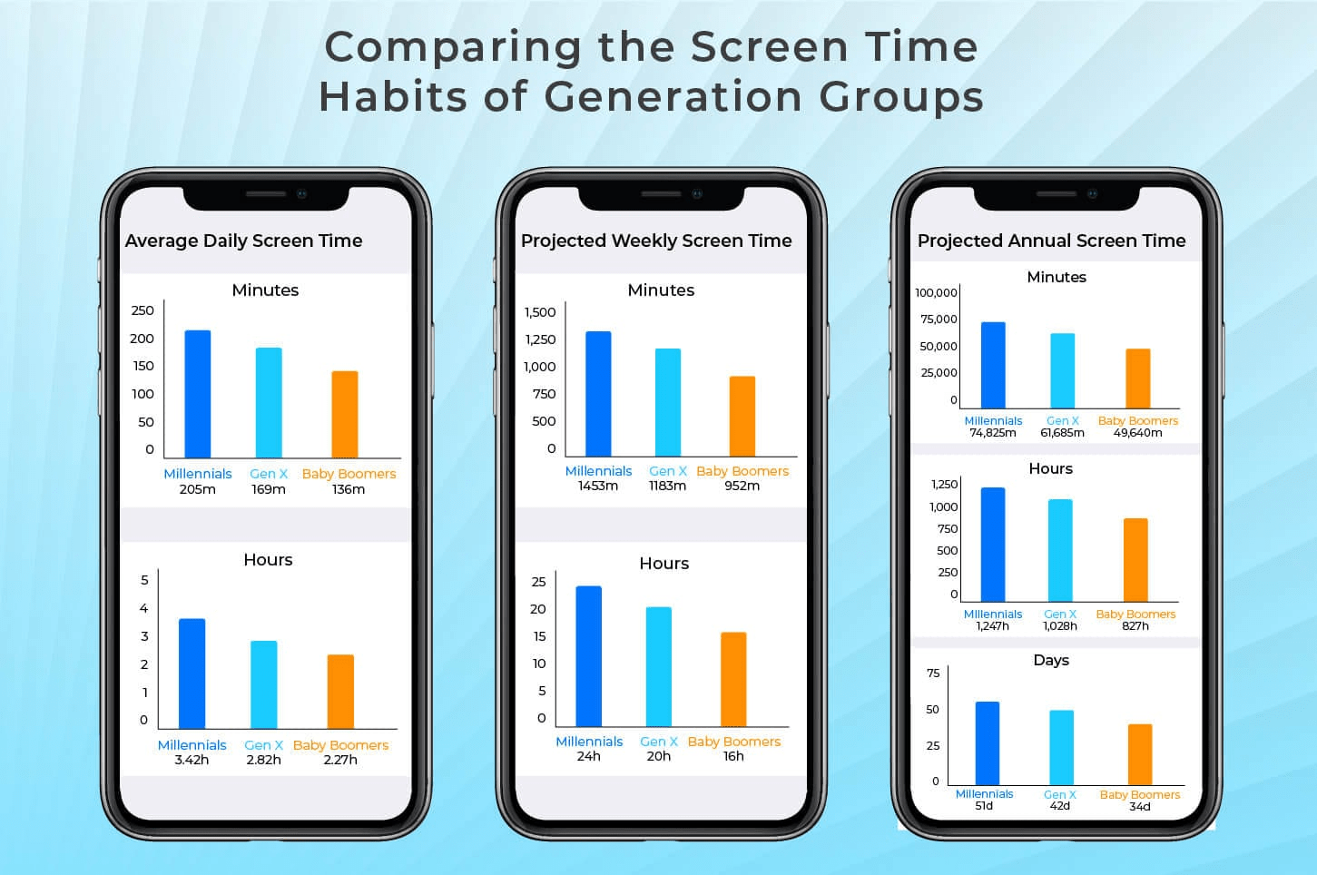
Setting Boundaries
Another challenge of managing our digital habits is setting boundaries.
Boundaries are the limits and rules that we establish for ourselves and others, to protect our well-being, privacy, and autonomy.
Boundaries help us to define what is acceptable and unacceptable, what is comfortable and uncomfortable, and what is respectful and disrespectful, in our interactions with technology and people.

Slide 21
Setting boundaries benefits
Avoid overstimulation and information overload, which can cause stress, anxiety, and fatigue.
Preserve our personal and professional identity, which can be compromised by oversharing, cyberbullying, or identity theft.
Enhance our social and emotional skills, which can be impaired by excessive or inappropriate use of technology, such as texting, gaming, or social media.

Slide 22
Communication of digital boundaries
Telling ourselves when and how we will use technology and sticking to it.
Telling others when and how we prefer to communicate with them and respecting their preferences as well.
Telling others when we need to disconnect or unplug and asking them to respect our decision.

Slide 23
The Power of unplugging
One of the most effective ways to manage our digital habits is to unplug.
Unplugging is the act of disconnecting from technology, either temporarily or permanently, for the sake of our well-being.
Unplugging can have many benefits for our mental and physical health

Slide 24
Unplugging benefits
Reducing stress and anxiety, by lowering our exposure to negative or overwhelming stimuli.
Improving sleep quality and quantity, by avoiding blue light and stimulation before bed.
Boosting creativity and problem-solving, by allowing our brain to rest and recharge.
Enhancing mood and happiness, by increasing our gratitude and appreciation for the present moment.

Slide 25
Plan unplugging
Planning and choosing a suitable time and duration for unplugging, and informing others about it.
Preparing alternatives and activities to fill the time and space that technology usually occupies, such as hobbies, sports, or socializing.
Reflecting on the experience and noticing the changes and benefits that unplugging brings to our life.

Slide 26
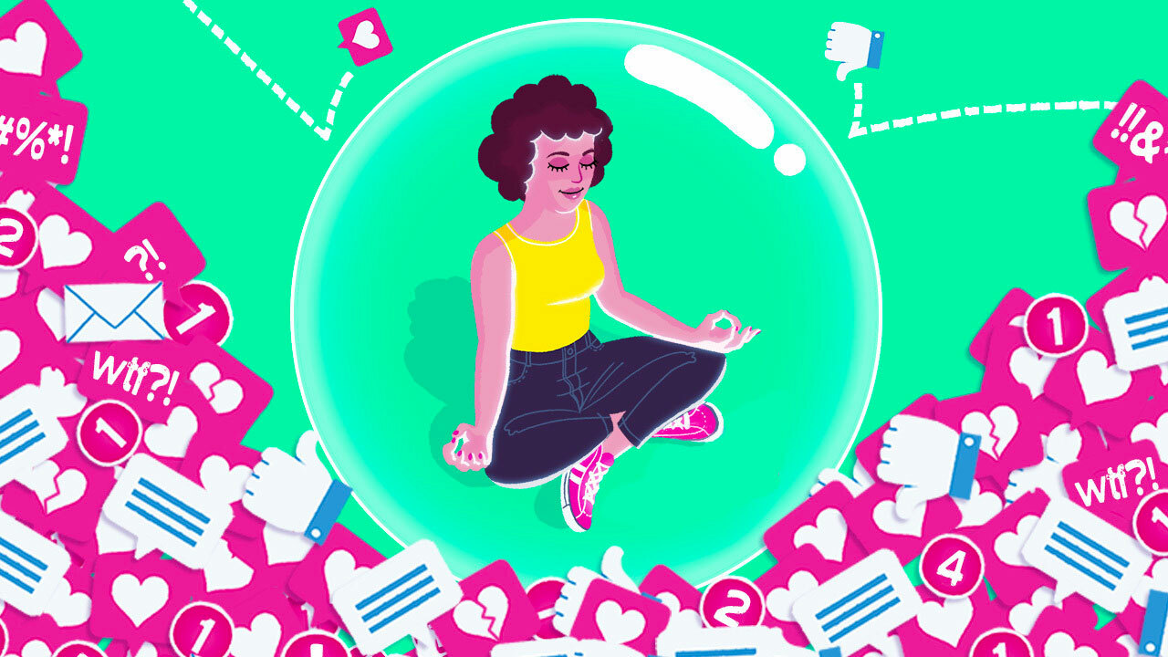
Embracing mindfulness in the digital age
The goal of managing our digital habits is to embrace mindfulness.
Mindfulness is the practice of paying attention to the present moment, with curiosity, openness, and acceptance.
Mindfulness helps us to be more aware and intentional with our technology use, and to enjoy it without being controlled by it.

Slide 27
Breathing deeply and consciously, before, during, and after using technology, to calm our mind and body.
Checking in with ourselves and our emotions, before, during, and after using technology, to understand our needs and motivations.
Asking ourselves questions, before, during, and after using technology, to evaluate its purpose and value, such as:
Why am I using this device or app?
What am I hoping to achieve or gain from it?
How is it affecting my well-being and productivity?
When and how will I stop using it?
Techniques for mindfulness

Slide 28
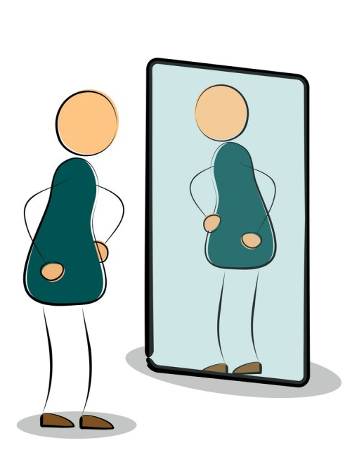
Reflection
In this module we discussed the concept of digital habits, and how they affect our well-being, productivity, and relationships.
We have also learned some practical strategies to manage our digital habits:
Being more self-aware and conscious of our technology use.
Balancing screen time and productivity with time management techniques
Setting healthy digital boundaries with ourselves and others
Unplugging from technology regularly and intentionally.
Embracing mindfulness in the digital age with attention and curiosity.

Slide 29
Start and learn best practices in the next module
We hope that this module has helped you to understand and cultivate healthy digital habits, and to enjoy technology in a more mindful and balanced way.
In the next module, we will explore some best practices for using technology in different domains and contexts, such as education, work, health, and entertainment.

Slide 30
Free License
The product developed here as part of the project "Building Digital Resilience by Making Digital Wellbeing and Security Accessible to All 2022-2-SK01-KA220-ADU-000096888" was developed with the support of the European Commission and reflects exclusively the opinion of the author. The European Commission is not responsible for the content of the documents
The publication obtains the Creative Commons License CC BY- NC SA.
This license allows you to distribute, remix, improve and build on the work, but only non-commercially. When using the work as well as extracts from this must:
be mentioned the source and a link to the license must be given and possible changes have to be mentioned. The copyrights remain with the authors of the documents.
the work may not be used for commercial purposes.
If you recompose, convert or build upon the work, your contributions must be published under the same license as the original.
Disclaimer:
Funded by the European Union. Views and opinions expressed are however those of the author(s) only and do not necessarily reflect those of the European Union or the European Education and Culture Executive Agency (EACEA). Neither the European Union nor EACEA can be held responsible for them.

