Slide 1
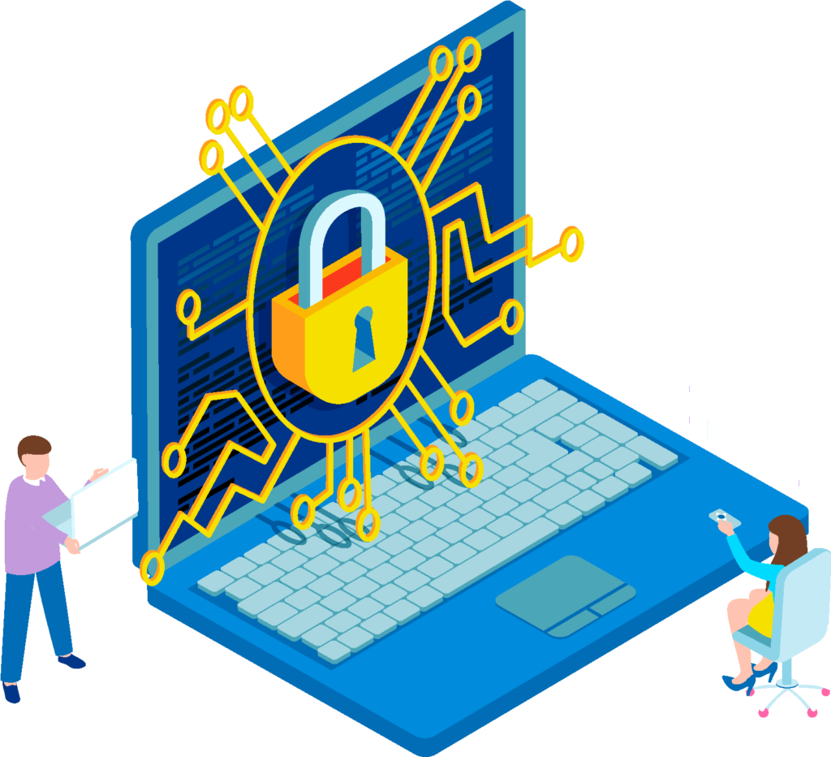
Digital Security - Digital Security Habits
Building Digital Resilience by Making Digital Wellbeing and Security Accessible to All 2022-2-SK01-KA220-ADU-000096888

Slide 2
Sub-section 2: Digital Security Habits
CONTENT
Safe browsing
Persistent logins
Security of devices
Security of mobile devices
Safe usage of mobile applications
Authentication methods

Slide 3
Security Habits on Internet
When you want to make your home secure, you lock the door. When you want to prevent your bike from being stolen, you use a bike lock. When you want to protect your valuable possessions, you keep them in a safe. But what do you do to protect yourself online?
Modern life is fundamentally intertwined with the internet. Nearly every daily task now has opportunity for online integration, and most everyone owns multiple devices, including laptops, phones, tablets, smart watches, smart TVs and more.
The more accounts and devices you have online, the greater the potential is for criminals to access your personal information and take advantage of you.

Slide 4
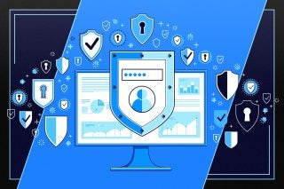
Practice safe browsing!
Safe browsing refers to the practice of navigating the internet in a secure manner to avoid potential risks such as malware infections, phishing attacks, and other online threats. Here are some key points related to safe browsing:
Secure websites
Phishing protection
Malware detection
URL reputation
Download protection
Browser security settings
Educational resources

Slide 5
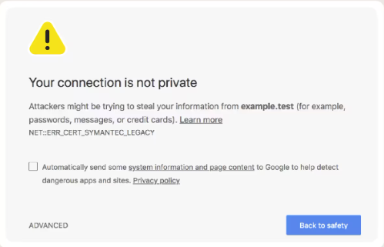
Practice safe browsing! - Secure websites
Safe browsing involves accessing websites that are secure and trustworthy.
This includes websites that use HTTPS encryption to protect data transmission between the user‘s browser and the website's server.
Special tip 1: Do not ignore site warning!
Special tip 2: Use website checker!
https://transparencyreport.google.com/safe-browsing/search

Slide 6
Practice safe browsing! - Phishing protection
Phishing is when a cybercriminal tries to trick you into giving them sensitive information by impersonating a legitimate source.
To phishing protection belongs safe browsing tools and features that help users identify and avoid phishing websites, which attempt to steal sensitive information such as login credentials, credit card numbers, or personal details.
Common warnings:
Unfamiliar greeting or tone
Grammar and spelling errors
Sense of urgency
Q: Have you ever received an email from your bank urgently asking you to input your personal information to secure your account?

Slide 7
Practice safe browsing! - Malware detection
Malware, or malicious software, is any program or file that is intentionally harmful to a computer, network or server.
Safe browsing technologies help detect and block access to websites that contain malware or malicious code, reducing the risk of infecting the user's device with viruses, ransomware, or other forms of malware.
Your device might have been infected with malware if it:
suddenly slows down, crashes, or displays repeated error messages,
won’t shut down or restart,
won’t let you remove software,
sends emails you didn’t write.

Slide 8
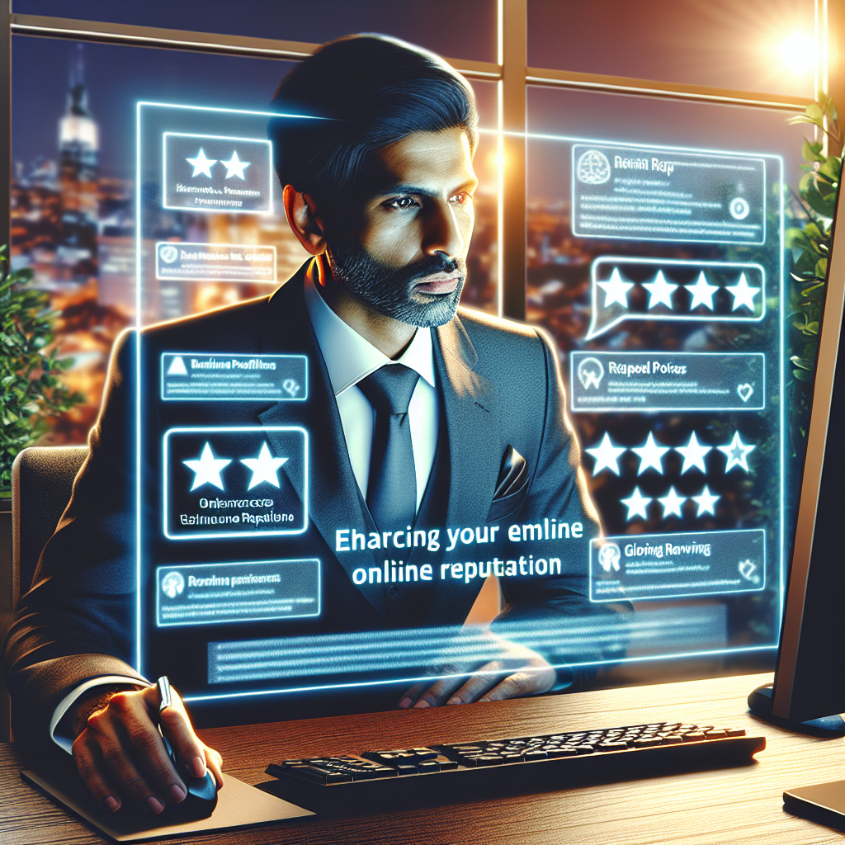
Practice safe browsing! - URL reputation
URL reputation refers to the process of determining the credibility, safety and intention of a Uniform Resource Locator, popularly known as URL.
Safe browsing systems maintain databases of known malicious websites and assess the reputation of URLs to warn users about potential risks before they visit a site.
https://www.virustotal.com/gui/home/search

Slide 9
Practice safe browsing! – Download protection
Download protection works by scanning files for known malware signatures and suspicious behavior.
If a file is flagged as potentially harmful, the antivirus software will either quarantine or delete the file before it is downloaded onto the device.
Use antivirus software
Be cautious of email attachments
Use reliable download sources
Verify file authenticity

Slide 10
Practice safe browsing! – Browser security settings
Browser security is the application of Internet security to web browsers to protect networked data and computer systems from breaches of privacy or malware.
Web browsers often include built-in security settings and features that help users browse safely, such as pop-up blockers, automatic updates, and privacy controls.
Each browser has own options for security settings.
Challenge!
Find the security settings of your favorite browser.

Slide 11
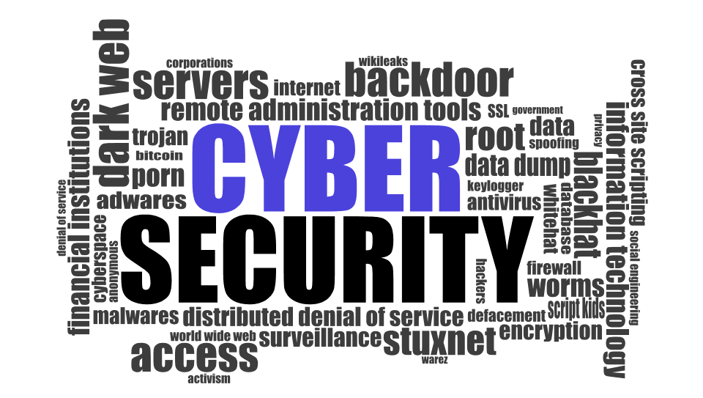
Practice safe browsing! – Educational resources
Safe browsing initiatives may offer educational resources and tips to help users learn how to recognize and avoid online threats, such as suspicious emails, fake websites, and deceptive advertisements.
The Free Cyber Security Basics Program
Learning from major cyber security incidents – free course

Slide 12
Persistent Logins
Have you ever visited a web site and noticed a checkbox that says Remember Me directly underneath the form? This is the most common phrase used to describe this feature to the user, and there are two major implementations:
The user's username is stored in a cookie, so the user only must provide a password in situations where the user would otherwise be required to provide both a username and password.
An authentication cookie is created that allows the user to completely bypass the next authentication. This usually means that the user is automatically logged in on the next visit and often up to a certain number of future visits.

Slide 13
Persistent logins – positives
Convenience - automatic login saves time and effort for users who frequently access the same websites, as they do not need to manually enter their credentials each time they visit.
User Experience - it enhances the overall user experience by providing seamless access to websites and services, reducing friction in the login process.
Increased Engagement - with automatic login, users are more likely to engage with a website or service more frequently, leading to higher user retention and increased usage.
Personalization - websites can personalize the user experience based on login data, such as displaying customized content or remembering user preferences.
Productivity - for businesses and organizations, automatic login can improve productivity by reducing the time spent on repetitive tasks like logging in.

Slide 14
Persistent logins – negatives
Security risks - automatic login can pose security risks, especially if a user's device is lost, stolen, or accessed by unauthorized individuals. Saved login credentials could be exploited to gain unauthorized access to sensitive accounts.
Privacy concerns - automatic login may raise privacy concerns, as it involves storing sensitive login information on the user's device or within the browser's cache. This information could be vulnerable to unauthorized access or exploitation.
Shared devices - automatic login is not suitable for shared devices or public computers, as it could allow unauthorized users to access personal accounts without authentication.
Logout issues - in some cases, users may encounter difficulties logging out or switching accounts when automatic login is enabled, leading to potential privacy or security issues.
User control - automatic login reduces user control over their login credentials, as they may forget their passwords or lose track of which accounts are logged in on their devices.

Slide 15
Persistent Logins - best practices
Use a strong, unique master password to protect your saved passwords – more in Sub-section 1 – Digital security
Regularly review and delete saved passwords for websites you no longer use or trust.
Be cautious when downloading software or browser extensions, and only install from reputable sources.
Keep your browser and operating system up to date with the latest security patches.
Enable two-factor authentication (2FA) whenever possible for an extra layer of security.

Slide 16
Security of devices
It is important to maintain the security of electronic devices such as computers, smartphones, tablets, and other internet-connected devices. To this belongs:
Protection against cyber threats - secure devices are essential for safeguarding against various cyber threats.
Personal privacy - ensuring device security helps protect personal and sensitive information from unauthorized access.
Prevention of identity theft - secure devices mitigate the risk of identity theft.
Financial security - secure devices help prevent financial fraud and unauthorized transactions by protecting online banking credentials.

Slide 17
Best practices for device security
Keep software updated - regularly update operating systems, applications, and antivirus software to patch security vulnerabilities and protect against emerging threats.
Use strong passwords - more in Sub-section 1 – Digital security
Secure network connections - use secure Wi-Fi networks with strong encryption protocols (e.g., WPA2) and avoid connecting to public or unsecured Wi-Fi networks to minimize the risk of data interception.
Practice safe browsing habits – chapter 2.1 in this presentation.
Encrypt data - encrypt sensitive data stored on devices and utilize encryption protocols (e.g., HTTPS) for secure data transmission over the internet.
Regular backups - backup important data regularly to prevent loss in the event of device theft, hardware failure, or ransomware attacks, and store backups securely offline or in the cloud.

Slide 18
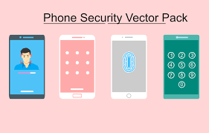
Security of mobile devices
Mobile devices, such as smartphones and tablets, have become an indispensable part of our daily lives.
We use them frequently and store private personal data, photos, notes, contacts, calendar events, etc., in them.
At the same time, mobile devices are equipped with various sensors, through which they can collect additional data.
Unauthorized access to these sensors, loss of private data, or gaining access to data by unauthorized persons would certainly not be a pleasant experience.
Mobile devices need to be protected from malicious software and attackers who may be interested in attacking our device.

Slide 19
Security of mobile devices – best practices
Securing access to the mobile device - it is recommended to have the SIM card protected by a PIN code different from the one predefined by the operator.
Operating system updates - mobile device manufacturers release operating system updates that bring various innovations to the device.
Using antivirus software - antivirus software acts as a "protective shield."
Turning off unused features - by disabling currently unused features, such as NFC or Bluetooth, you can minimize the potential for attacks.
Being cautious with messages received on mobile devices - devices can become infected through messages from chat applications, email, or even SMS messages.

Slide 20
Safe usage of mobile applications
An important element of secure mobile device usage is the safe use of applications installed on the mobile device.
Careless installation and use of various applications can expose the mobile device to various security threats and risks, thereby jeopardizing the user's personal data stored on the mobile device.
By adhering to safe usage practices, it is possible to minimize and prevent risks associated with their careless use.

Slide 21
Safe usage of mobile applications- best practices
Using official applications from official app stores - apps in official app stores are reviewed before being published.
Updating mobile applications - like safe usage of mobile devices and updating the device's operating system, users gain improvements to the mobile application, including the removal of various security flaws.
Permissions of mobile applications - applications may access various device functions and unauthorized data if the user knowingly or unknowingly grants permission to the application. Applications with malicious intentions may request permissions for functions that they should not need according to the description provided.

Slide 22
Safe usage of mobile applications- best practices – cont.
In-app purchases - applications may allow various purchases within the app itself, such as to acquire specific paid features or gaming elements within a game. In-app purchases can also pose a risk to the user, not necessarily in terms of security, but in terms of spending money.
Advertisements in mobile applications - ads appear in applications, especially those provided to users for free. Displayed advertisements in mobile applications can also pose certain security risks. Malicious code may be hidden in an advertisement, which executes upon user interaction with such an ad.
Impersonation apps - this is a method through which attackers can infiltrate a user's mobile device by creating an application that appears like another existing application. The fraudulent application may have a nearly identical name, icon, descriptions, appearance, and functionality.

Slide 23
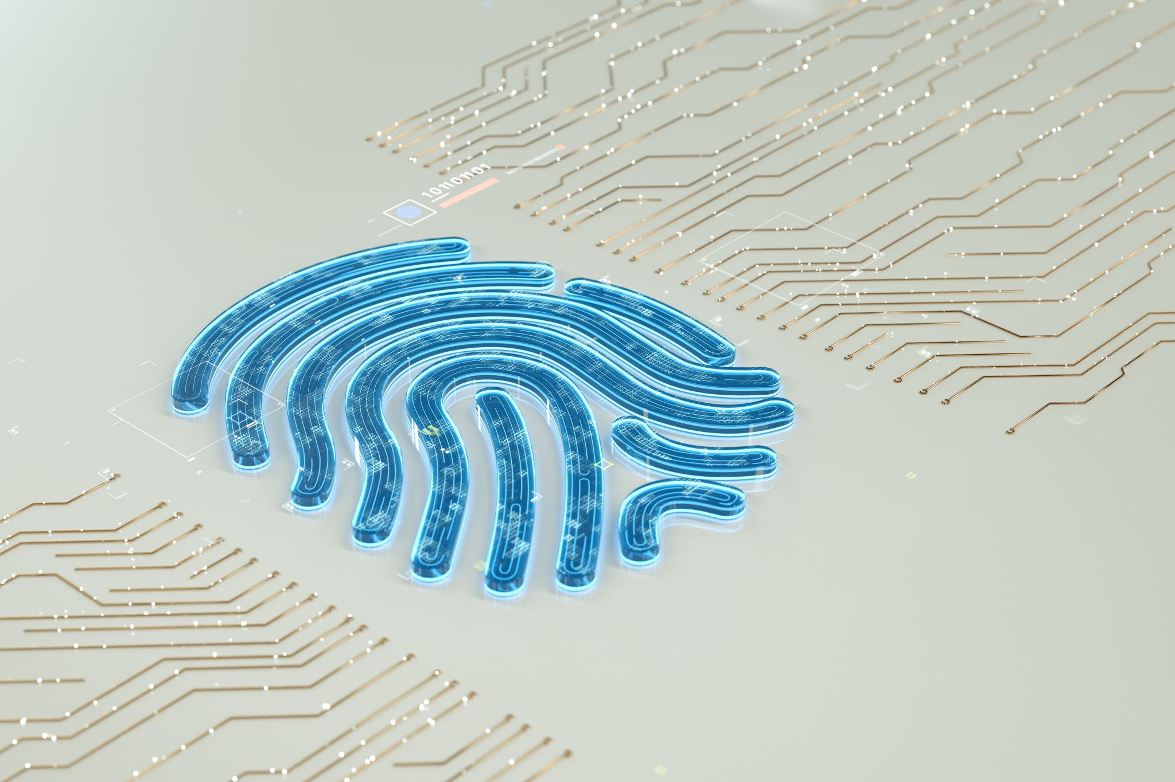
Authentication methods
Different personal requirements demand different security levels, achieved by carefully choosing or combining various authentication methods available.
When it comes to user experience, it plays a significant role in user satisfaction during online payment processing.
Therefore, the authentication method applied must provide convenience and security at the same time.

Slide 24
Top authentication methods
Biometric authentication methods - relies on the unique biological traits of a user in order to verify their identity. This makes biometrics one of the most secure authentication methods as of today.
QR code – this authentication is typically used for user authentication and transaction validation. A typical flow for transaction verification starts with the user logging into their internet banking web application and opening a payment order.
SMS OTP - this simple yet effective authentication method involves sending an SMS message to the user's mobile phone, containing a one-time password used for finalizing the authentication of online payments.
Push notification authentication method - a push-based authentication system sends a notification to an app on a user's device, informing them about an authentication attempt.

Slide 25
Quiz
How can you describe safe browsing?
Which beginning of a website means a secure site?
◻ HTTP ◻ HTTPS ◻ HPTP
How can you describe malware?
Mention two or three positives of persistent logins.
Mention two or three negatives of persistent logins.

Slide 26
Quiz
What belongs to best practices of device security?
What does not belong to the security of mobile device?
◻ Using antivirus system ◻ Operating system updates
◻ Using public Wi-fi ◻ Turning off unused features
Which best practice of safe usage of mobile applications is most important for you?
Is it safe to use applications from official app store?
How can you describe biometric authentication methods?

Slide 27
Free Licence
The product developed here as part of the project "Building Digital Resilience by Making Digital Wellbeing and Security Accessible to All 2022-2-SK01-KA220-ADU-000096888" was developed with the support of the European Commission and reflects exclusively the opinion of the author. The European Commission is not responsible for the content of the documents
The publication obtains the Creative Commons Licence CC BY- NC SA.
This license allows you to distribute, remix, improve and build on the work, but only non-commercially. When using the work as well as extracts from this must:
be mentioned the source and a link to the license must be given and possible changes have to be mentioned. The copyrights remain with the authors of the documents.
the work may not be used for commercial purposes.
If you recompose, convert or build upon the work, your contributions must be published under the same license as the original.
Disclaimer:
Funded by the European Union. Views and opinions expressed are however those of the author(s) only and do not necessarily reflect those of the European Union or the European Education and Culture Executive Agency (EACEA). Neither the European Union nor EACEA can be held responsible for them.

