Slide 1
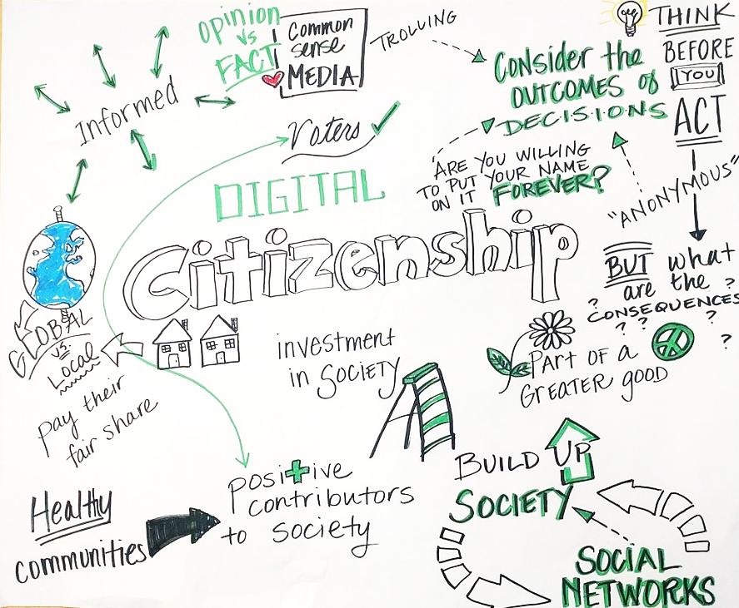
Digital Citizenship – Online Safety & Digital Rights
Building Digital Resilience by Making Digital Wellbeing and Security Accessible to All 2022-2-SK01-KA220-ADU-000096888

Slide 2
Online Safety & Digital Rights
As we navigate the vast digital landscape, understanding and practicing online safety becomes crucial to protecting ourselves and our data from cyber threats.
But it's not just about safety; it's also about knowing and exercising our digital rights, which ensure our freedom and privacy in the digital world.
This module will guide you through the essentials of staying safe online while empowering you with the knowledge to assert your digital rights.
From securing your personal information against hackers to understanding the legal frameworks that protect you, we embark on a journey to become responsible and informed digital citizens.
Together, we'll explore strategies to safeguard your online presence, delve into the rights you hold as a netizen, and uncover the tools that can help you navigate the digital age with confidence and security.
Explore Further: For a deeper dive into your digital rights and tips on staying safe online, visit the Internet Society's webpage on Internet Safety here and the Electronic Frontier Foundation's guide on digital rights here.

Slide 3
The Pillars of Online Safety
Online safety involves protecting your personal information from digital risks. Use strong, unique passwords for different accounts and enable two-factor authentication to add an extra layer of security.
Did You Know? The most common password is still "123456". Choosing a strong password is your first defense against hackers.
Additional Resource: Visit the National Cyber Security Centre's guide on using passwords effectively here.

Slide 4
Your Digital Rights Explained
Digital rights include privacy, freedom of expression, and access to information. These rights are crucial in the digital world to protect individuals from abuse and ensure fair treatment.
Did You Know? The General Data Protection Regulation (GDPR) in the EU gives individuals control over their personal data.
Additional Resource: Learn more about your digital rights under GDPR here.

Slide 5
Protecting Your Privacy Online
Online privacy involves controlling your personal data. Utilize privacy settings on social media and consider using a VPN for secure browsing.
Did You Know? Over 60% of internet users are concerned about how companies use their personal data.
Additional Resource: Explore privacy tools and tips here. The European Union Agency for Network and Information Security (ENISA) is a center of network and information security expertise for the EU.

Slide 6
Navigating the Cyber Threat Landscape
The cyber world is fraught with threats ranging from malware, targeting personal data and system functionalities, to phishing scams that trick users into revealing sensitive information. Ransomware locks files until a ransom is paid, and DDoS attacks disrupt services by overwhelming systems with traffic. Staying ahead involves being vigilant, using updated antivirus software, questioning unsolicited requests for information, employing strong passwords, and regularly backing up data.
Key Points:
Malware & Viruses: Steal or damage data silently.
Ransomware: Holds your files hostage for ransom.
Phishing: Tricks into giving away personal info.
Did You Know? Cybercrime damages are predicted to cost the world $6 trillion annually by 2021, escalating to $10.5 trillion by 2025.
Stay Protected: Adopt proactive security measures—update software, scrutinize emails, secure your passwords, and back up data frequently.
Learn More: Visit Cybersecurity and Infrastructure Security Agency (CISA) for updates on how to protect yourself from the latest threat

Slide 7
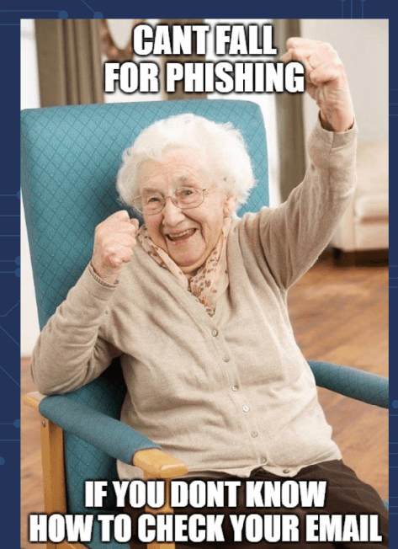
Mastering the Art of Recognizing Phishing
Phishing attacks cleverly disguise as trustworthy entities to steal sensitive information. Always verify the sender's email, avoid clicking on suspicious links, and never share personal information unsolicited. Utilize email filters and security software to detect and block phishing attempts.
Quick Tip: Enable two-factor authentication (2FA) on all your accounts for an added layer of security against phishing.
Expert Opinion: "The best defense against phishing is education. Understanding the common tactics used by phishers is the first step in protecting yourself." - Kevin Mitnick, renowned cybersecurity expert.
Challenge Question: What should you do first if you receive an email requesting urgent action and personal information? A) Respond immediately B) Verify the sender's details C) Ignore the email

Slide 8
Passwords and Authentication
Strong, unique passwords and authentication methods protect against unauthorized access. Use a mix of letters, numbers, and symbols, and consider a password manager to keep track of complex passwords.
Quick Tip: Change passwords regularly and use a passphrase that combines four or more unrelated words for robust security.
What If? Scenario: Imagine your password was the same for all accounts and one got hacked. How quickly could the rest fall?
Expert Opinion: "Passwords are like underwear: don't let people see it, change it very often, and you shouldn't share it with strangers." - Chris Pirillo, tech expert.

Slide 9
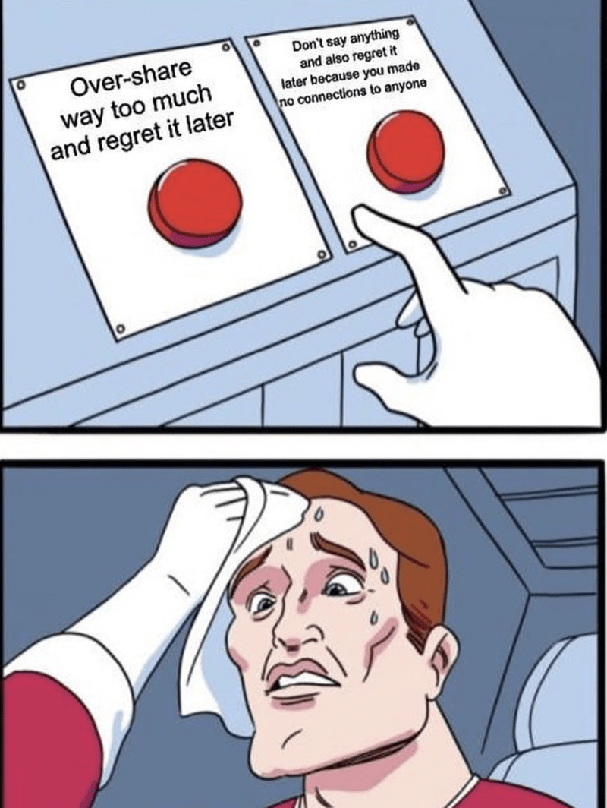
Social Media Smarts: Navigating Social Media with Wisdom
Social media is a double-edged sword, offering connection and community but also privacy risks. Customize your privacy settings, be mindful of what you share, and know how to use platform tools to report and block harassment.
Quick Tip: Regularly review who has access to see your posts and personal information on social media platforms.
Challenge Question: How often should you review and update your social media privacy settings? A) Once a year B) After every update C) Monthly

Slide 10
Understanding Data Collection Demystifying Data Collection
Every click, like, and search can be tracked. Understand and manage the data you share by reading privacy policies, using privacy-focused tools, and controlling cookies and tracking.
What If? Scenario: If all your online searches from the last year were made public, what would they reveal about you?
Expert Opinion: "Privacy is not an option, and it shouldn't be the price we accept for just getting on the internet." - Gary Kovacs, former CEO of Mozilla.

Slide 11
The Right to Be Forgotten: Exercising Your Right to Be Forgotten
The Right to Be Forgotten empowers you to request the deletion of personal information from search engines under certain conditions, allowing control over your digital footprint.
Quick Tip: To invoke the Right to Be Forgotten, identify specific URLs that contain outdated or irrelevant personal information and follow the search engine's process for removal requests.
Challenge Question: What kind of information qualifies for removal under the Right to Be Forgotten? A) Embarrassing photos from social media B) Public records C) Outdated or irrelevant information
Expert Opinion: "The Right to Be Forgotten reflects the claim of an individual to have certain data deleted so that third persons can no longer trace them." - Viviane Reding, former Vice-President of the European Commission.

Slide 12
Digital Harassment and How to Combat It
Digital harassment, from cyberbullying to online stalking, can be emotionally taxing and dangerous. Use platform tools to block, report, and protect your digital wellbeing, and reach out to support networks when needed.
Quick Tip: Document any instances of harassment before blocking or reporting, as they may be needed for evidence.
What If? Scenario: Imagine if every negative online interaction left a physical mark. How would you protect yourself?
Expert Opinion: "Online harassment has an offline impact. Recognizing the signs and knowing how to respond is crucial for our digital health." - Monica Lewinsky, anti-bullying activist

Slide 13
Embracing Encrypted Communication
Encryption ensures that only the intended recipient can read your messages. Use encrypted messaging apps to protect your conversations from eavesdroppers.
Quick Tip: Look for messaging apps that offer end-to-end encryption as a standard feature for all communications.
Challenge Question: Why is end-to-end encryption important for your digital privacy? A) It makes messages look cool B) It prevents anyone but the recipient from reading your messages C) It speeds up your internet connection
Expert Opinion: "In an era where personal data can be misused by scam artists and anyone looking to exploit your personal information, encryption acts as the lock and key." - Edward Snowden, privacy advocate.

Slide 14
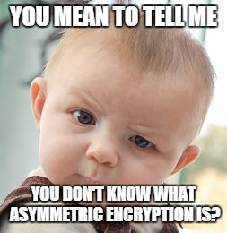
Safe Online Transactions
Online transactions are convenient but can expose you to risks like fraud and identity theft. Ensure websites use HTTPS and be cautious with financial information.
Quick Tip: Use a dedicated credit card with a low limit for online purchases to limit potential fraud exposure.
What If? Scenario: If your online shopping habits were exposed, what would they say about your approach to security?
Expert Opinion: "The security of your personal information is as much about your practices as it is about the website's security." - Bruce Schneier, security technologist.

Slide 15
Digital Literacy for All
Digital literacy is not just about understanding how to use technology but also about recognizing its impact on privacy, security, and society. Support education initiatives to build a safer, more informed digital world.
Quick Tip: Participate in digital literacy workshops and webinars to stay informed about the latest in online safety and digital rights.
Challenge Question: How does improving digital literacy contribute to online safety? A) By increasing screen time B) By enhancing the ability to identify and mitigate cyber threats C) By improving internet speed
Expert Opinion: "Digital literacy goes beyond functionality; it's about critical thinking and making informed choices online." - Danah Boyd, social media scholar.

Slide 16
Shaping the Digital Future: Your Role in the Digital Future
Every online action contributes to the shaping of the digital world. Advocate for policies that protect privacy and promote equality and embrace your power as a digital citizen to influence change.
Quick Tip: Engage with digital rights organizations and participate in campaigns advocating for online privacy and security reforms.
What If? Scenario: What if your digital actions today determined the internet's privacy landscape tomorrow?
Expert Opinion: "We all have a stake in the digital age. How we engage with technology today will shape our collective future." - Tim Berners-Lee, inventor of the World Wide Web.

Slide 17
Free License
The product developed here as part of the project "Building Digital Resilience by Making Digital Wellbeing and Security Accessible to All 2022-2-SK01-KA220-ADU-000096888" was developed with the support of the European Commission and reflects exclusively the opinion of the author. The European Commission is not responsible for the content of the documents
The publication obtains the Creative Commons License CC BY- NC SA.
This license allows you to distribute, remix, improve and build on the work, but only non-commercially. When using the work as well as extracts from this must:
be mentioned the source and a link to the license must be given and possible changes have to be mentioned. The copyrights remain with the authors of the documents.
the work may not be used for commercial purposes.
If you recompose, convert or build upon the work, your contributions must be published under the same license as the original.
Disclaimer:
Funded by the European Union. Views and opinions expressed are however those of the author(s) only and do not necessarily reflect those of the European Union or the European Education and Culture Executive Agency (EACEA). Neither the European Union nor EACEA can be held responsible for them.

