Slide 1
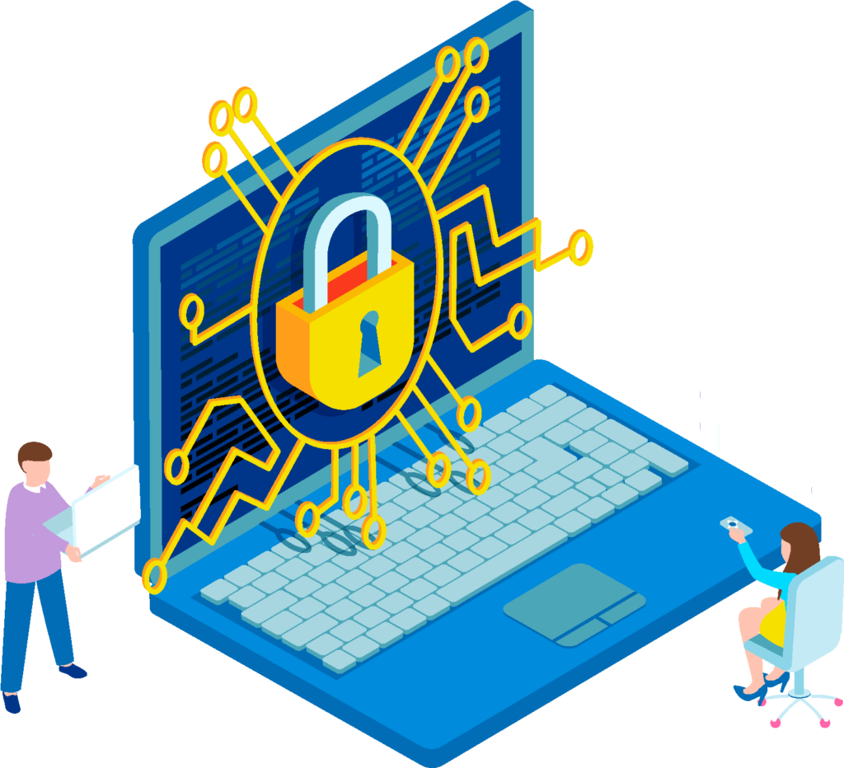
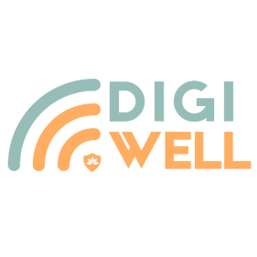
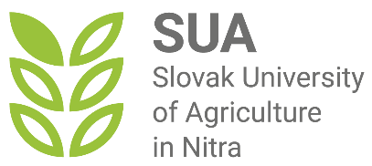
Digital Security - Internet Banking and Social Networks Security
Building Digital Resilience by Making Digital Wellbeing and Security Accessible to All 2022-2-SK01-KA220-ADU-000096888

Slide 2
Sub-section 3: Internet Banking and Social Networks Security
CONTENT
Internet Banking
Pros and Cons of Internet banking
Pos and Cons of Social networks
Social networks securityconclusions
Best practices – Internet banking security
Best practices – Social media security
Social networks
Internet banking security conclusions

Slide 3
Internet Banking
Internet banking is known by many other names such as web banking, net banking, and online banking, which allows clients to conduct transactions using a web browser on desktop and mobile devices and on mobile applications.
Online banking offers customers almost every service traditionally available through a local branch including deposits, transfers, and online bill payments.
Internet banking essentially enables customers to manage their money through electronic means, negating the need to physically walk into a bank branch.
Despite some concerns about the internet banking security, most people rely heavily on the convenience and ease of electronic banking.
But like most things that can be done online, there are several advantages and disadvantages.
Banks guarantee a high level of cyber security of internet banking, but it is necessary and essential to observe online banking security on the part of the client as well.

Slide 4
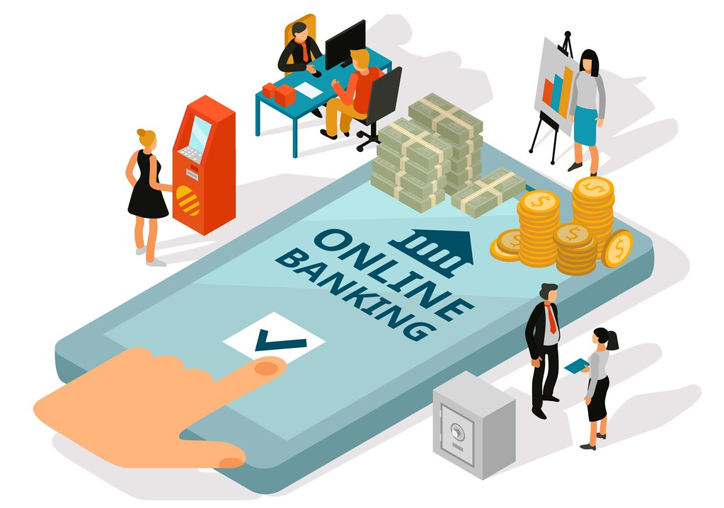
Advantages of online banking
24/7 access to accounts
Simple bill payments
Easy fund transfers
Immediate access to bank records
Better budgeting
Better rates and Lower fees
More features - wider variety of services
Accurate money management

Slide 5
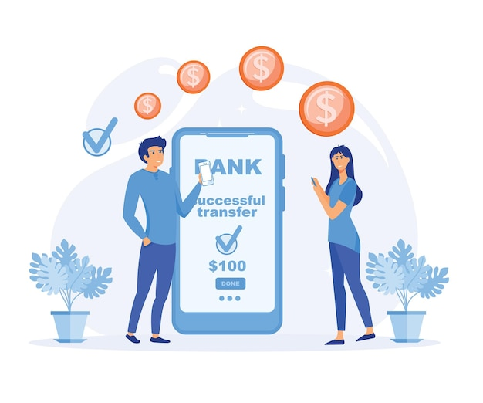
Disadvantages of online banking
Navigation in online banking requires access to the Internet and basic IT skills, which can be limiting for a certain group of people.
Online banking may not be able to handle large or complex transactions.
Based on security protocols, banks often set limits on what customers can do through their online banking portal (daily transfer limits).
Online banking relies on a reliable Internet connection, any connection problems can cause problems with the functionality of the portal.
Bank portals are frequently maintained to be up-to-date and secure, which means that service outages may occur.
Despite high security measures, Internet banking is still vulnerable to cybercrime.

Slide 6
Online banking security practices that you should follow to become Digital Resilient Use only the official website and apps of the bank to access the accounts.
Avoid clicking email links purporting to direct you to a bank’s website.
Type the Bank web address directly into the browser and ensure that you are on the bank’s legitimate, secured site.
Use Mobile banking app downloaded from official hardware retail stores Google Play, App Store, App Gallery.

Slide 7
Use a strong and secure password
One of the most basic and important steps to secure your online banking account is to use a strong a secure password - long, complex, and unique.
not contain any personal information, such as your name, date of birth, or address,
not be the same as any other password you use for other accounts or services,
should include a mix of uppercase and lowercase letters, numbers, and symbols.
If available, use one-time passwords to validate transfers, payments, and changes.
Websites regularly provide the option to save your access data for a faster login. Even though your devices are 100% inaccessible to others, this option is not safe.

Slide 8
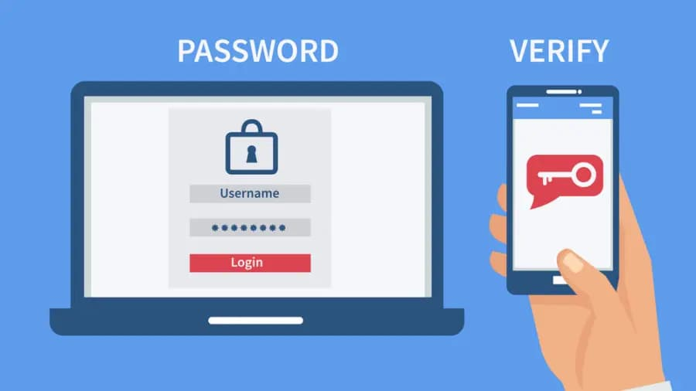
Enable two-factor/multi-factor authentication
Two-factor authentication is a feature that requires you to verify your identity with a second factor such as a code sent to your phone or email.
Use multi-factor or biometric authentication if the bank offers it - authentication method that requires the user to provide two or more verification factors to gain access to bank account.
This adds an extra layer of protection against hackers who may have stolen your password or tried to guess it.

Slide 9
Recommendations:
Use biometric data to log in, as it is extremely difficult for fraudsters to manipulate it.
Passwords are as strong as the security of your network and can easily fall into the hands of criminals through key logging when hardware is compromised by malware.
Be Aware: Do not write down the password and codes in freely readable files (e.g. word, excel, ...) or on pieces of paper.

Slide 10
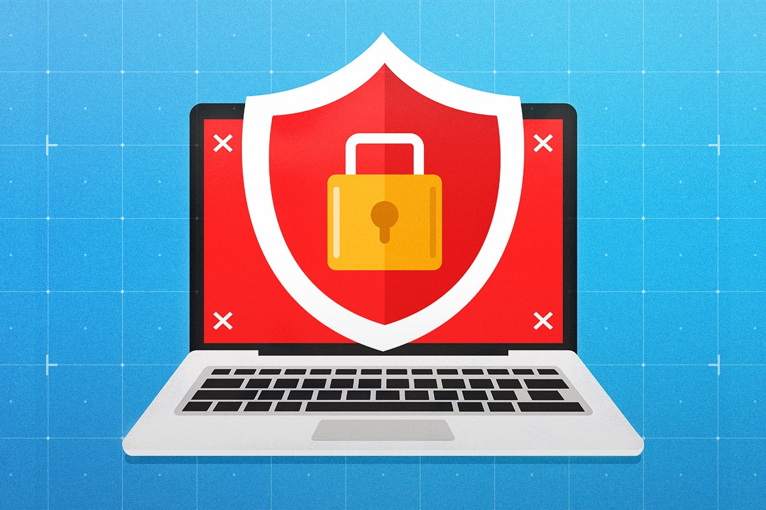
Use a secure device and network
The device and network you use to access your online banking account can also affect your security.
Keep the device from which you access the online banking system carefully secured. Enable password protection or access authentication on all devices.
Make sure all software on devices is updated. User antivirus software for additional security in banking.
Do not access online banking systems through unknown/unsecured networks, such as public WiFi networks.

Slide 11
Monitor your account activity and statements
Regularly monitor the turnover and account statements for suspicious activity, to identify potential threats.
Check your account activity and statements at least once a month and report any problems to your bank as soon as possible.
Enable alerts and notifications for your account, such as emails or text messages to notify you of any changes or transactions in your account.
Active PUSH notifications for your account in internet banking and in mobile app for your account management.
This will help you detect any unauthorized or fraudulent transactions on your account and prevent any potential loss or damage.
Unauthorized charges or transfers report to your bank immediately.

Slide 12
Protect your personal information
Always be wary of bank emails or messages that ask for personal information or redirect you to a bank website.
Never give sensitive information to third parties, such as identity numbers, login or PINs.
Hackers use fake emails or messages, that look like they are from your bank, to steal your bank details (phishing). Hackers often impersonate someone else and ask you to share your account details (scam).
Do not fall for suspicious messages, links or requests for details. Check sender addresses, URLs, and content before opening.
Contact your bank directly if you have any doubts or concerns
Authentic banks will never ask for sensitive information.

Slide 13
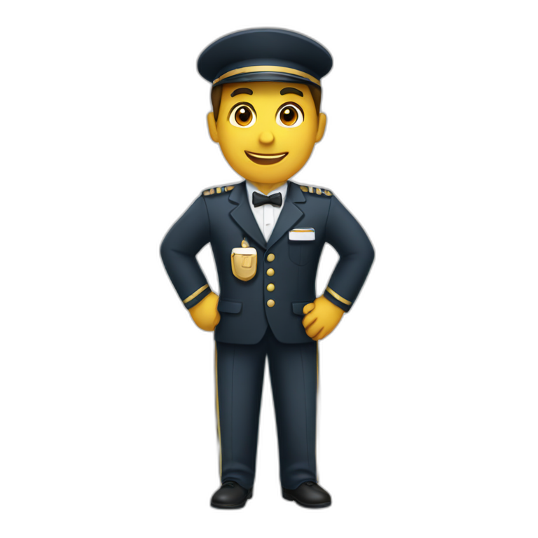
Additional recommendations for Online banking security
Watch for any unexpected activity during an online banking session, such as unusual pop-up windows—disable these immediately.
Always log out of banking sessions, and if it doesn't happen automatically, activate a timed logout.
If possible, sign up for bank alerts – PUSH notifications to be notified of all transactions, password changes, account changes and failed login attempts.
Go Paperless – Receiving paper statements in the mail gives potential attackers an opportunity to steal personal information.

Slide 14
Safe Mobile Payments Pay by Mobile in Store or Online
Pay by mobile in store with the help of Google Pay (Best for Android users) and Apple Pay (Best for iOS and Mac Users), just by attaching it to the payment terminal.
Paying online, just choose the option of payment via Google Pay or Apple Pay.
You don't have to worry about SECURITY - your card number is not used for payment, but a virtual token.
Virtual token or currencies are digital representations of value that can exist only electronically.
PayPal is one of the most widely used online payment system for buyers and sellers, and a trusted payment method for online shopping sites.
The advantage in terms of digital security is that you do not provide full financial data to sellers. Money transfers between accounts are identified only by email address and password.

Slide 15
Internet Banking Conclusion
Banks guarantee a high level of Cyber Security
of Internet Banking, but it is necessary
and essential to observe Online Banking Security
on the part of the Users as well.

Slide 16
Social Networks
Social Network is a platform that enables us to communicate with one another by posting information, comments, and messages.
A network of social interactions and personal relationships.
A dedicated website or other application which enables users to communicate with each other by posting information, comments, messages, images, etc.
A website or mobile application that lets people connect with each other on a common platform.
Platforms that people use to build social networks - social relationships with other people who share similar personal or career interests, activities, backgrounds or real-life connections.
Common examples of social networking sites or platforms include Facebook, Instagram, Twitter, TikTok, WhatsUp and LinkedIn.

Slide 17
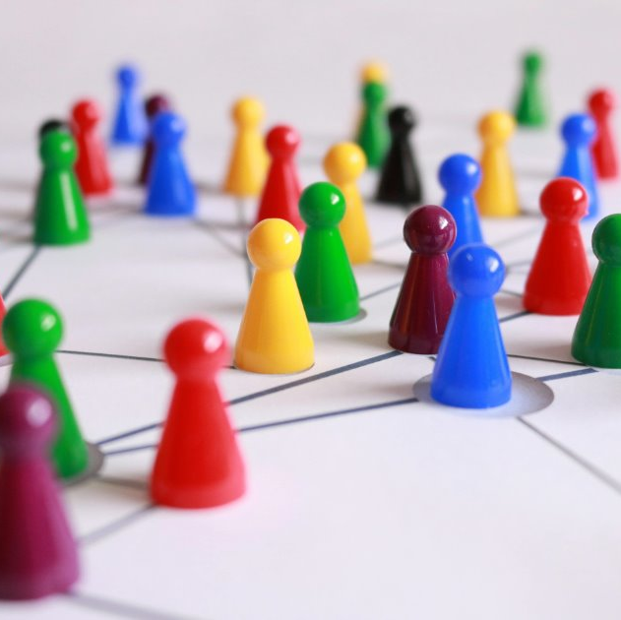
Social Networks Users
Social networks have become an essential part of our lives in today's digital world. They are no longer only used to communicate with friends, but some current information can only be found on social networks.
Users join a social network platform and begin connecting - networking with other users for personal and professional reasons.
Users can choose who they want to receive communications from. In some cases, communication is one-way, while, in others, it's multidirectional.
Users can share information, express opinions, explore mutual interests, search for jobs, promote their businesses, form relationships and otherwise interact with each other.
Social networks are very popular and have become the preferred method of communication for most people.

Slide 18
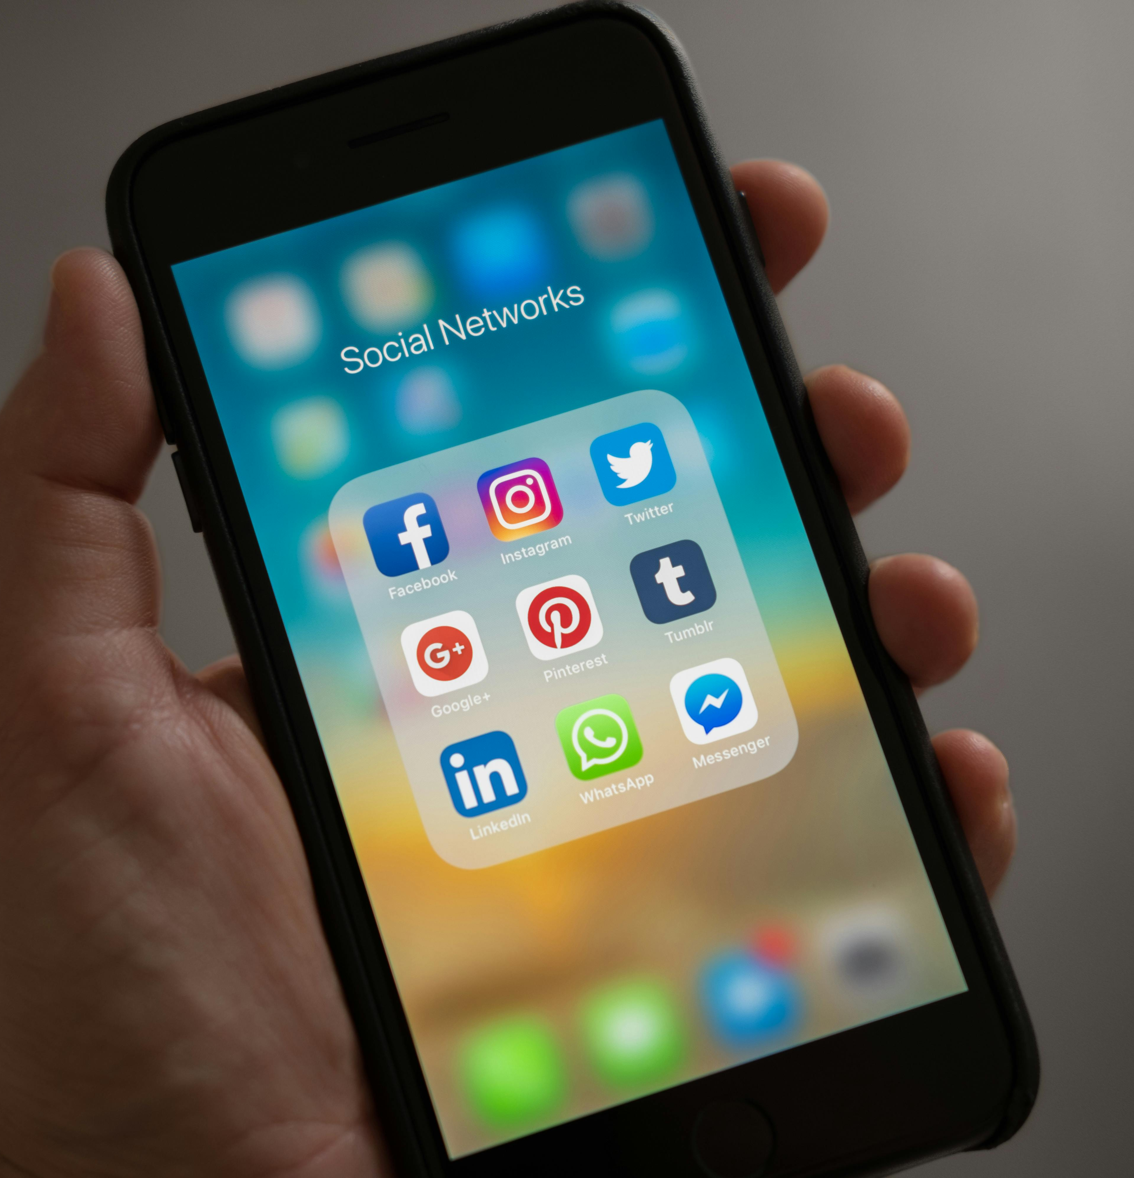
Advantages of social networking
Global connectivity - enable excellent global communication.
Right place for noble causes - charitable work - most significant advantage.
Tool for education - an effective tool for facilitating the learning of new skills and concepts (DigiWELL).
Information & updates - receive up-to-date information and news from across the world.
Sharing of information daily - with your loved ones and a larger community - excellent tool to enhance your creativity and brand identity.
Join a community - individuals from other backgrounds, religions, communities and countries - excellent tool become part of Multicultural Society.
Decrease in quick-witted skill - by restricting face-to-face conversations in real time.
Networking - used for job opportunities searching.

Slide 19
Disadvantages of social networking
Trouble with privacy - tweeting inappropriate information, sharing too much of your daily life with a large audience, unknowingly sharing your online location, any entity around the world have access to any information you post.
Your privacy isn‘t private anymore…
Hacking - gaining access to another individual’s personal information.
There have been many instances where hackers have managed to upset an individual’s financial and social stability.
Lack of emotional connect - emotions & feelings are not easily expressed in online space.
Cyberbullying - to harass, threaten, or humiliate a person by sending defamatory and inappropriate photos, videos or messages.
Psychological addiction - excessive use of social networks cause dissociation from real life.
Spreading of fake news - creating posts on a popular topic without verification that may have a negative impact on people's knowledge.
Don't believe everything you see or read on social networks...

Slide 20
Social Networks Attacks
To better understand the importance of protecting our accounts on social networks, we need to know how prevalent social media hacking is. Let the social media hacking numbers tell the story:
nearly 5 billion people have at least one social networks account,
more than half of the world’s population is at risk of having their social media accounts hacked.
Social networks hacking statistics:
in September 2021, a web hacker tried to sell personal data stolen from 1.5 billion Facebook accounts,
in 2018 at least 30 million Facebook accounts were hacked in a single data breach,
on average 1.4 billion social media accounts are hacked every month,
in years 2021-2022 the number of social media accounts that were hijacked saw an increase of 1 000%,
Google reported that 20% of social networks accounts will be compromised at some point.
Source: https://www.stationx.net/social-media-hacking-statistics/

Slide 21
Who are the targets?
Anyone can be a target for any reason, no matter who you are, what platform you use, how much money you have.
According to Google searches, in 2024 on average 68 000 Facebook users and 36 000 Instagram users have queried Google every month for information regarding how to recover a hacked account.

Slide 22
Negative Practice: My social media account got hacked. It was a nightmare.
It was June of 2022 when Heather Dempsey discovered that her Facebook and Instagram accounts had been hacked. Since then, she has been living the ongoing nightmare of trying to recover her accounts and seeking an explanation for what happened.
Heather does not work in a large company, nor does her work relate to the tech industry, the sectors often hit with cyberattacks. Heather is the proud owner of Self-Care Center in Southwest Florida and the founder of Elite Spa Pros Academy. But her social media account takeover is costing her much more than she expected.
“The hack resulted in a lifetime ban from Facebook and Instagram,” Heather explained.
Both social media platforms were vital for Heather’s business, as she used them to get clients, often running ads on the sites.
“I was left jobless with no income and had to think fast,” Heather said. “I ended up opening a local business because I wouldn’t have been able to find anything to make ends meet.”

Slide 23
Negative Practice: Fraud Identity Theft
I recently caught an influencer on the Facebook as she became a victim of financial fraud. I was totally intrigued by it. So, I listened to her story in Shots:
She had a financial advisor friend, one day she approached her through a social network and recommended her a profitable investment opportunity.
It seems that someone has created the same identity as her friend, and it never occurred to her that there could be someone else on the other end of the cable.
She consulted with him for a long time about where to invest the money, and finally sent it to the agreed account with great faith that her friend would take care of it.
The next day, the friend was already disconnected from the account, and she became suspicious. Too late unfortunately.
The money was already with the scammer, and she only had eyes for crying.

Slide 24
Social Networks Security - Start
Creating a profile on a social network is a matter of a few minutes. At the very beginning, we must observe the basic security or update as soon as possible:
1. Implement Strong Passwords
Note: Regularly update them to strengthen against evolving security threats.
2. Enable two-factor authentication
Note: Most social networks platforms like Instagram, LinkedIn, Facebook, TikTok, and Twitter have this security measure.
3. Set up and update security settings across platforms
Manage your social network account privacy, safety and security settings.
Note: Social networks platforms nowadays provide tools and guides to increase the security of your account.
Facebook: "We care about the safety of our global community, which is why we provide tools to help keep your account secure and your privacy protected."
Privacy, safety and security settings - go to Help center: Computer - Click your profile picture in the top right
Mobile – Tap "hamburger„ menu in the top right

Slide 25
Social Networks Security - recommended practices
4. Regularly Updates Passwords - to fortify defences against evolving security threats.
5. Do not re-use passwords – to avoid using the same passwords in social networks accounts.
Creating strong passwords means using a combination of alphanumeric characters that aren't easy to guess, but hard to remember all of them. Use a password management tool.
6. Use third-party applications with caution
Many apps and games these days ask you for permission to access your social media profiles, especially if you have downloaded them through a link on social media. Most apps are authentic, but some collect your account details.
Access to apps which have been verified and are free from malware or viruses:
Use Google Play Protect or Apple security controls, which runs a safety check on the app before downloading.
Example: a woman lost nearly $30,000 after downloading a third-party app through a WhatsApp link.
The recommended practice is to only download apps that we trust based on our own experience or reviews and restrict permissions to untrusted apps by going through the Settings section on your devices.

Slide 26
Social Networks Security - recommended practices
7. Maintain access control - check your linked email account regularly.
Social networks platforms are usually linked to your emails.
Warning: If the platform detects unusual activity on your profile or thinks someone other than you is trying to access your account, you'll receive a security alert email. Always check if the email address from which is coming is official.
8. Be cautious about social engineering attacks
Beware of phishing attacks that encourage you to reveal sensitive information.
Do not post or store sensitive information or give authorizations online, even in private messages.
Please verify the authenticity of the user profile before clicking on any link included in the post.
Social networks platforms, like any other, are full of fake news and misinformation.
See if any trusted news authority has reported the same news.
Look for grammatical errors and special characters in the link.
In the event of a data leak, hackers could use this information to infiltrate your acount.

Slide 27
Social Networks Conclusion
Protecting personal data and minimizing security risk is key task of all users as social networks platforms grow in popularity and interconnectedness.
Securing your Social Network Account from privacy, safety and security threats isn't too difficult if you will follow recommended basic practices to alert you to suspicious activity and protect from cyber fraud.

Slide 28
Free Licence
The product developed here as part of the project "Building Digital Resilience by Making Digital Wellbeing and Security Accessible to All 2022-2-SK01-KA220-ADU-000096888" was developed with the support of the European Commission and reflects exclusively the opinion of the author. The European Commission is not responsible for the content of the documents
The publication obtains the Creative Commons Licence CC BY- NC SA.
This license allows you to distribute, remix, improve and build on the work, but only non-commercially. When using the work as well as extracts from this must:
be mentioned the source and a link to the license must be given and possible changes have to be mentioned. The copyrights remain with the authors of the documents.
the work may not be used for commercial purposes.
If you recompose, convert or build upon the work, your contributions must be published under the same license as the original.
Disclaimer:
Funded by the European Union. Views and opinions expressed are however those of the author(s) only and do not necessarily reflect those of the European Union or the European Education and Culture Executive Agency (EACEA). Neither the European Union nor EACEA can be held responsible for them.

