Slide 1
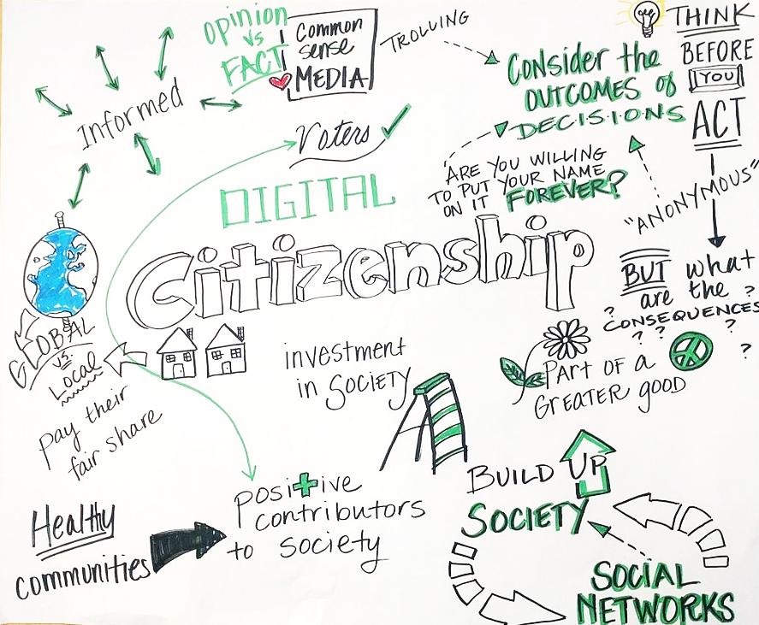
Digital Citizenship – Ethical Use of Digital Technology
Building Digital Resilience by Making Digital Wellbeing and Security Accessible to All 2022-2-SK01-KA220-ADU-000096888

Slide 2
Ethical Use of Digital Technology
Introductory Video

Slide 3
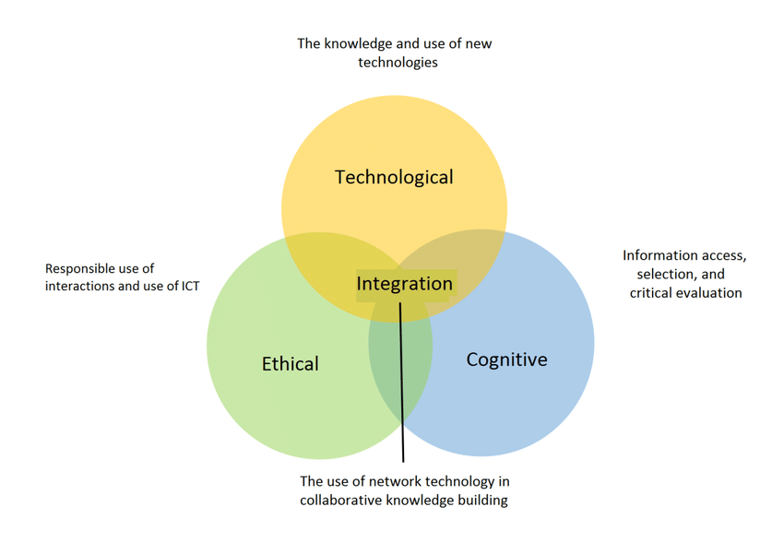
The Components of Digital Competence
IT Literacy or Computer Literacy: this is the technical component of digital competence as it refers to learning technical skills on how to use hardware and software.
Information Literacy: this introduces cognitive aspects of digital technologies such as critical thinking, problem solving, etc.
Media Literacy (Media Education): this refers to the ethical aspects of using digital technologies and social media. It implies the capacity to comprehend, interpret and evaluate critically the meaning of digital tools and contents.

Slide 4
What is Media Education?
Media education is the process through which individuals become media literate and able to critically understand the nature, techniques and impacts of media messages and productions.
Critically evaluating and understanding social media messages, symbols and languages.
Becoming conscious of one’s behaviours and communication online.
Understanding how social media platforms work and, in whose interests.
How social media produce meaning and represent reality.
How these representations of reality are interpreted by the public.

Slide 5
Why Media Education?
We live in Post-Truth Society
Objective facts are less influential in forming public opinion than are appeals to emotions and personal/cultural beliefs.

Slide 6
Introduction to Social Psychology
Social psychology aims to understand individuals' thoughts, emotions and actions in relation to the implicit presence of others, therefore in relation to the social structure.
This holds true also online!

Slide 7
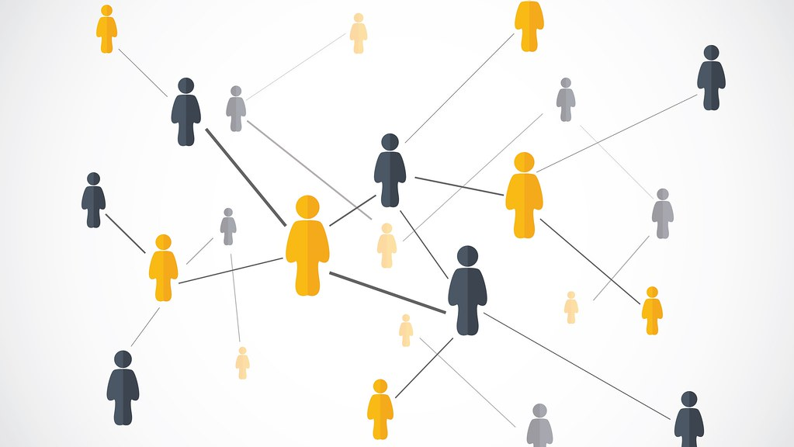
Introduction to Social Psychology
According to the constructionist approach, the social and cultural dimensions are constitutive of the mind, and of its cognitive and emotional processes.
Reality is intended as a socially shared and negotiated vision.
Knowledge of reality is intended as a continuous process of collective organization and assignment of meaning.

Slide 8
Introduction to Social Psychology
What is Culture?
Culture refers to as a set of shared meanings, symbols, knowledge and languages through which a cultural group relates to reality.
What is a Cultural Group?
A cultural group is defined as a collection of individuals who share a core set of beliefs, patterns of behaviour, and values.
It refers to groups that we are born into, such as race, national origin, gender, class, or religion.
It can also include groups we become part of. For example, it is possible to acquire a new culture by moving to a new country/neighbourhood, by joining a new occupation and/or a sport/cultural club, by a change in economic status, by becoming disabled, etc.

Slide 9
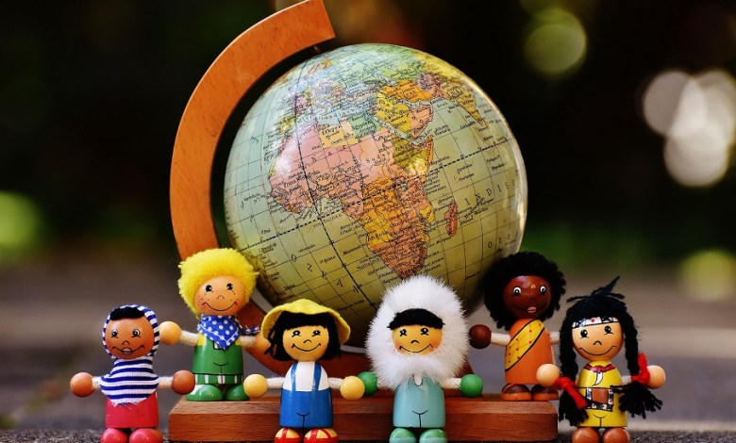
Introduction to Social Psychology Social Categorization
Social categorization is the process through which we group individuals based upon social information.
The “Big Three” are sex, race, and age, but other dimensions are categorized as well, such as social status, occupation, and even sexual orientation.
Once determined, social categorizations of others shape our evaluation and behaviours, often without awareness.

Slide 10
Introduction to Social Psychology What is Social Categorization?
Why? To reduce the complexity of reality.
Risk? To lose the specificity of each individual.

Slide 11
Introduction to Social Psychology How to Overcome Social Categorization?
Creating a new common cultural in-group.
Quick tip: Consider individuals belonging to a different cultural group than yours. For instance, different religion and/or etnicity. Can you think of a common cultural in-group with these individuals?
Consider cultural groups you became part of!

Slide 12
Introduction to Social Psychology Robbers Cave’s experiment, conducted by Muzafer Sherif in the 1950s, involving 22 boys in Oklahoma’s summer camps
Groups were formed by separating those who showed affinity.
When intergroup competition was introduced, group identity overcame individual affinities.
Later, cooperative tasks reduced this conflict, highlighting the role of shared goals in resolving group tensions.
Quick Tip: can you think of any example of online cooperation that helped to overcome prejudice and intergroup’s conflict?

Slide 13
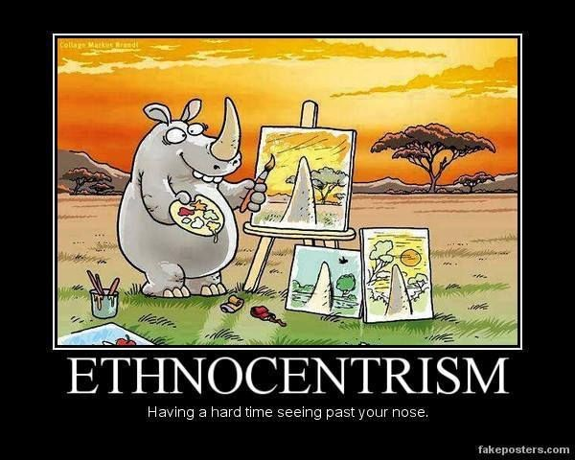
Introduction to Social Psychology
What is Ethnocentrism? A tendency to consider the values of one's cultural group as superior and absolute.
What is Prejudice? A tendency to judge negatively individuals belonging to other cultural groups.

Slide 14
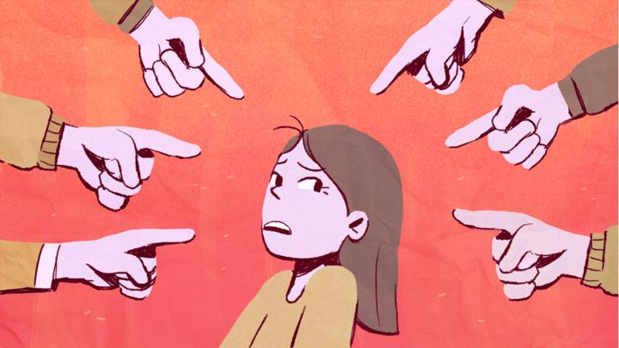
Introduction to Social Psychology The Components of Prejudice
Stereotype: this is the cognitive element, that refers to the information related to a cultural group.
Emotions: this is the key element of prejudice, from which a negative judgment arises.
Discrimination: this is the behavioural element, that leads to actions being taken against the target cultural group.

Slide 15
Introduction to Social Psychology An Example of Prejudice
Stereotype: “All Romani people are thieves”.
Emotions: “This makes me angry and resentful”.
Discrimination: “Hence, I insult them on the bus”.
Quick Tip: can you think of any example of prejudice happening on social media?

Slide 16
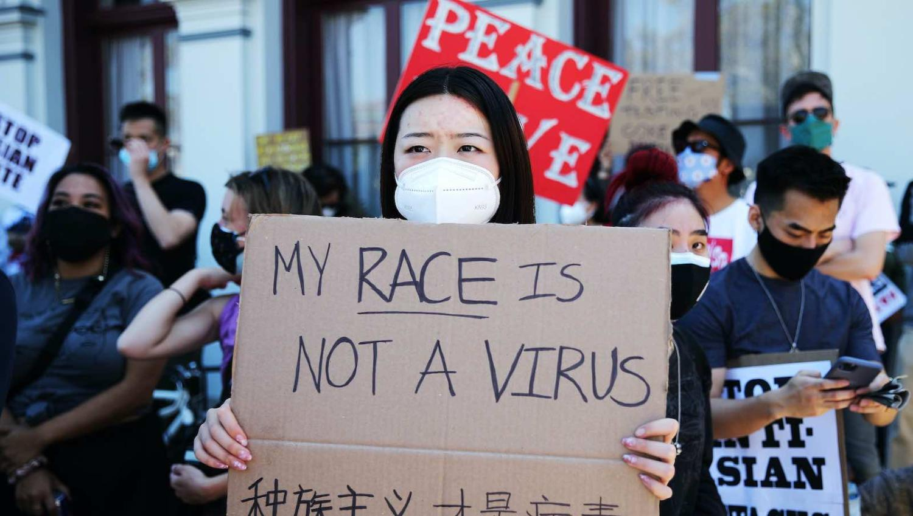
Introduction to Social Psychology An Example of Prejudice Online
Prejudice Toward Asian Americans in the Covid-19 Pandemics
The Covid-19 outbreak brought increased incidents of racism, discrimination, and violence against “Asians”. Since January 2020, many Asian Americans reported suffering racial slurs, wrongful workplace termination, being spat on, physical violence, extreme physical distancing, etc.
Croucher S.M., Nguyen T. and Rahmani D. (2020). Prejudice Toward Asian Americans in the Covid-19 Pandemic: The Effects of Social Media Use in the United States.

Slide 17
Introduction to Social Psychology What was the role of Media and Social Media in spreading Prejudice?
Misleading Media Headlines
“Chinese virus pandemonium”
“China kids stay home”
Social Media Hashtag
#WuhanVirus
#KungFlu

Slide 18
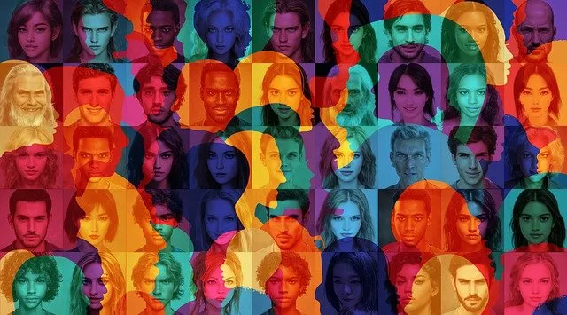
Introduction to Social Psychology Cultural Models
Cultural Assimilations: the cultural differences are slowly removed.
Multi-Culturality: cultures are considered as rigid and stable sets.
Inter-Culturality: this implies the hybridization of cultural processes. The cultural boundary unites and does not divide different groups.
Quick Tip: Which cultural model do you consider to be desirable?

Slide 19
Introduction to Social Psychology Cultural Models
Cultural Assimilations: the cultural differences are slowly removed.
Multi-Culturality: cultures are considered as rigid and stable sets.
Inter-Culturality: this implies the hybridization of cultural processes. The cultural boundary unites and does not divide different groups.

Slide 20
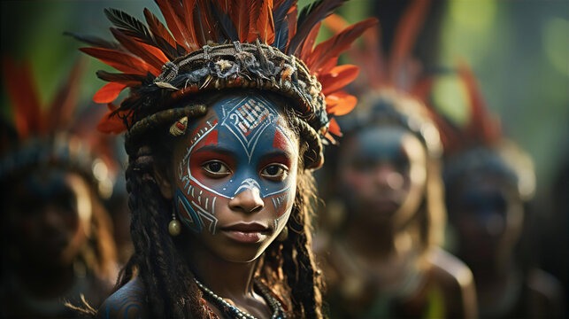
Introduction to Social Psychology Ethical Dilemma - Cultural Relativism
Cultural relativism is the position that there is no universal standard to measure cultures by, and that all cultural values and beliefs must be understood relative to their cultural context, and not judged based on outside norms and values.

Slide 21
Introduction to Social Psychology Ethical Dilemma - Cultural Relativism
Does cultural relativism imply the absence of absolute human rights and moral values? No, but the boundary between violating human rights and cultural plurality is thin.
Quick Tip: Does child marriage in some countries violate human rights or reflect cultural diversity?

Slide 22
Free License
The product developed here as part of the project "Building Digital Resilience by Making Digital Wellbeing and Security Accessible to All 2022-2-SK01-KA220-ADU-000096888" was developed with the support of the European Commission and reflects exclusively the opinion of the author. The European Commission is not responsible for the content of the documents
The publication obtains the Creative Commons License CC BY- NC SA.
This license allows you to distribute, remix, improve and build on the work, but only non-commercially. When using the work as well as extracts from this must:
be mentioned the source and a link to the license must be given and possible changes have to be mentioned. The copyrights remain with the authors of the documents.
the work may not be used for commercial purposes.
If you recompose, convert or build upon the work, your contributions must be published under the same license as the original.
Disclaimer:
Funded by the European Union. Views and opinions expressed are however those of the author(s) only and do not necessarily reflect those of the European Union or the European Education and Culture Executive Agency (EACEA). Neither the European Union nor EACEA can be held responsible for them.

