Slide 1
Digital Wellbeing – Conclusions
Building Digital Resilience by Making Digital Wellbeing and Security Accessible to All 2022-2-SK01-KA220-ADU-000096888

Slide 2
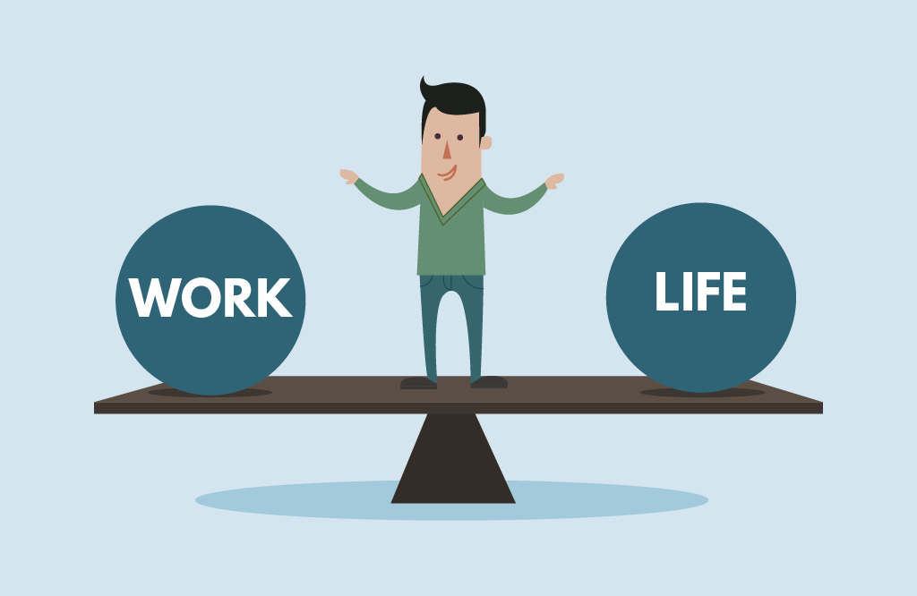
Understanding Digital Wellbeing
Understanding the essence of digital wellbeing is finding sweet spot where technology enhances our lives without overshadowing our well-being.
From tracking our walks with fitness apps to staying connected with loved ones via video calls, we've seen how small adjustments can lead to profound improvements.
Notes:
Discuss the concept of digital well-being and its relevance in today's digital age.
Emphasize the need for balance in using technology to enhance our lives without sacrificing our well-being.
"Let's start by understanding what digital well-being really means. It's all about finding that balance between using technology to enhance our lives and making sure it doesn't take over. We'll be exploring practical ways to achieve this balance."

Slide 3
Digital Wellbeing is vital for adults
For adults, digital well-being is a necessity.
Safeguarding our physical health by reducing eye strain,
nurturing our psychological wellbeing by lowering stress levels, and
enriching our social lives by fostering genuine connections beyond the screen.
Notes:
Highlight the specific challenges adults face in maintaining digital well-being, such as work-related stress and digital overload.
Stress the importance of prioritizing physical health, psychological well-being, and social connections in the digital realm.
"As adults, we face unique challenges when it comes to digital well-being. From work-related stress to the constant stream of information, it's easy to feel overwhelmed. Today, we'll discuss why it's crucial for us to prioritize our physical and mental health in the digital world."

Slide 4
Balanced perspective on technology
View technology through a balanced lens, because it offers unparalleled convenience and connectivity, but also poses challenges such as digital overload and dependency.
By acknowledging both technology benefits and drawbacks, we empower ourselves to engage with technology in a more mindful and intentional manner.
Notes:
Discuss the benefits and drawbacks of technology, acknowledging its positive impacts while cautioning against over-reliance and misuse.
Encourage attendees to approach technology with mindfulness and intentionality, recognizing its role as a tool rather than a necessity.
"Technology is a powerful tool, but it's essential to approach it with a balanced perspective. We'll be looking at both the positive and negative impacts of technology and discussing how we can use it mindfully to improve our lives."

Slide 5
Accessible and engaging learning formats
Our course materials are designed with your learning experience.
From visually captivating PowerPoint presentations to interactive quizzes,
we've strived to make the journey towards digital wellbeing both accessible and enjoyable for users of all ages and backgrounds.
Notes:
Explain the user-friendly and engaging format of the course materials, including PowerPoint presentations, videos, and quizzes.
Encourage attendees to actively participate in the learning process and make use of the interactive elements provided.
"Our course materials are designed to be user-friendly and engaging. From PowerPoint presentations to interactive quizzes, we've made sure that learning about digital well-being is both informative and enjoyable."

Slide 6
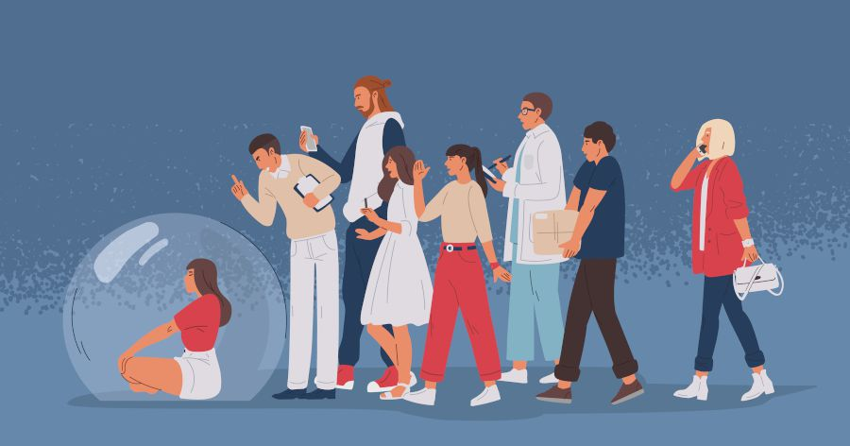
Practical strategies for sustainable change
Changing habits is no easy feat, but with the right strategies, it becomes manageable.
We've provided actionable steps to help you gradually integrate healthier digital habits into your daily routine.
By fostering a supportive community environment, we ensure that no one embarks on this journey alone.
Notes:
Outline practical strategies for implementing sustainable changes in digital habits, such as setting boundaries, practicing mindfulness, and seeking social support.
Emphasize the importance of consistency and gradual progress in adopting healthier digital habits.
"Now, let's get into the nitty-gritty of implementing change. We'll be discussing practical strategies for adopting healthier digital habits, such as setting boundaries and practicing mindfulness. These small changes can make a big difference in our overall well-being."

Slide 7
Conclusions
Our course encapsulates the essence of digital wellbeing: comprehensive, practical, and engaging.
It equips individuals with the knowledge, tools, and support needed to navigate the digital world with confidence and mindfulness.
Notes:
Summarize the key points covered in the presentation, emphasizing the importance of digital well-being in today's society.
Encourage attendees to reflect on their own digital habits and consider how they can incorporate the lessons learned into their daily lives.
"As we wrap up, let's reflect on what we've learned today. Digital well-being isn't just a buzzword—it's a crucial aspect of our lives in the digital age. I encourage each of you to take what you've learned and apply it to your own digital habits."

Slide 8
The value of the course
Our courses offer a holistic approach to digital wellbeing, combining interactive content, practical strategies, and personalized guidance.
By taking small but meaningful steps, each individual can embark on a transformative journey towards a healthier relationship with technology.
Notes:
Highlight the value of the courses in providing comprehensive, practical, and engaging content on digital well-being.
Invite attendees to explore the courses further and take advantage of the resources available to them.
"Our courses offer a wealth of resources to help you on your digital well-being journey. Whether it's PowerPoint presentations or interactive quizzes, we've got everything you need to succeed. I encourage you to explore the courses further and take advantage of these valuable resources."

Slide 9
User experience
Our materials are designed to be intuitive and user-friendly, ensuring that users can seamlessly integrate them into their learning experience.
Notes:
Assure attendees that the course materials are designed to be user-friendly and accessible to individuals of all backgrounds and skill levels.
Encourage attendees to engage with the materials actively and provide feedback for improvement.
"Don't worry about getting lost in the course materials—we've made sure they're easy to navigate and understand. Whether you're a tech novice or a seasoned pro, you'll find something valuable in our courses."

Slide 10
Empowering change
Changing habits requires self-awareness, patience, and support.
By embracing these principles and fostering a sense of community, we empower individuals to take control of their digital lives and create lasting change for the better.
Notes:
Empower attendees to take ownership of their digital well-being journey and make positive changes in their habits.
Remind attendees that small steps can lead to significant improvements and encourage them to support each other in their efforts.
"Remember, change doesn't happen overnight. It's all about taking small steps and staying consistent. By supporting each other along the way, we can all achieve our goals for a healthier digital lifestyle."

Slide 11
Sharing experiences and inspiring others
We encourage you to share your experiences and insights with others.
Your story has the power to inspire and motivate, sparking positive change not only in your own life but also in the lives of those around you.
Notes:
Encourage attendees to share their experiences with digital well-being and inspire others with their stories.
Emphasize the power of community support in fostering motivation and accountability for maintaining digital well-being.
"I want to hear from each of you about your experiences with digital well-being. Your stories can inspire others and create a supportive community. Let's work together to make digital well-being a priority in our lives."

Slide 12
Free License
The product developed here as part of the project "Building Digital Resilience by Making Digital Wellbeing and Security Accessible to All 2022-2-SK01-KA220-ADU-000096888" was developed with the support of the European Commission and reflects exclusively the opinion of the author. The European Commission is not responsible for the content of the documents
The publication obtains the Creative Commons License CC BY- NC SA.
This license allows you to distribute, remix, improve and build on the work, but only non-commercially. When using the work as well as extracts from this must:
be mentioned the source and a link to the license must be given and possible changes have to be mentioned. The copyrights remain with the authors of the documents.
the work may not be used for commercial purposes.
If you recompose, convert or build upon the work, your contributions must be published under the same license as the original.
Disclaimer:
Funded by the European Union. Views and opinions expressed are however those of the author(s) only and do not necessarily reflect those of the European Union or the European Education and Culture Executive Agency (EACEA). Neither the European Union nor EACEA can be held responsible for them.

