Slide 1
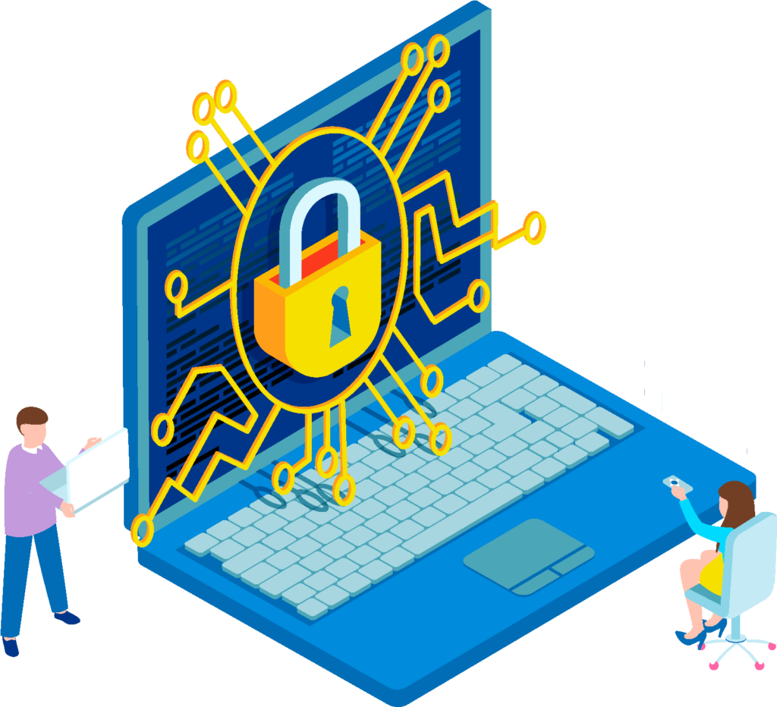
Digital Security - Conclusions
Building Digital Resilience by Making Digital Wellbeing and Security Accessible to All 2022-2-SK01-KA220-ADU-000096888

Slide 2
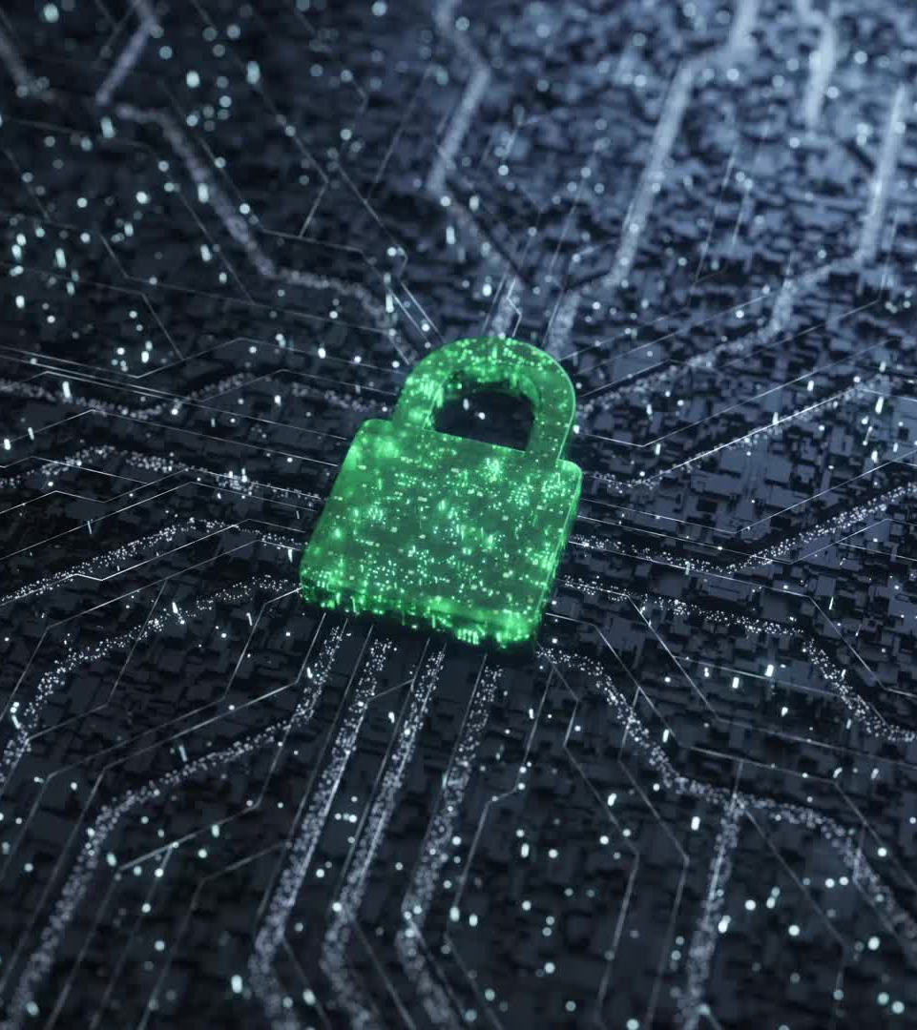
Digital Security
Security in the online environment is one of the biggest issues facing individuals in today's modern world.
Protecting your identity, your data and your devices is an inevitable challenge that cannot be taken lightly.
Notes:
"Let's start by understanding what digital well-being really means. It's all about finding that balance between using technology to enhance our lives and making sure it doesn't take over. We'll be exploring practical ways to achieve this balance."

Slide 3
Sub-section 1 Digital Identity and Digital Footprint
Digital identity is our online presence we create when we use digital tools.
Digital foot print is "permanent record„ of our digital presence and our using of online services.
Knowledge and effective management of digital identity and digital foot print are the key to our digital privacy and digital security in the digital world.

Slide 4
Digital Identity and Digital Footprint – tips and tricks
Use search engines to check your digital footprint - by your name, accounts, emails.
Check your online activity
Removing negative digital footprint from search engines.
Delete and minimize cookies.
Clear search and browsing history.
Do not store login name and passwords in browser.
Use tools to minimise your digital footprint to obfuscate your identity.

Slide 5
Sub-section 2 Digital Security Habits
In today's interconnected world, digital security habits are more crucial than ever.
By cultivating strong digital security habits, such as using robust passwords, enabling two-factor authentication and regularly updating software, we can significantly reduce the risk of cyberattacks.

Slide 6
Digital Security Habits – tips and tricks
Ensure
Ensure that each of your online accounts has a strong, unique password.
Update
Regularly update your operating system, browsers, and other software.
Be
Be cautious when clicking on links or downloading attachments from unknown or suspicious emails.
Use
Use a strong password for your home Wi-Fi network and avoid using the default router name and password.
Back up
Regularly back up your important data to an external hard drive or a secure cloud service.
Check
Regularly check your bank statements, credit reports, and online accounts for any suspicious activity.
BE
Be cautious about the amount of personal information you share on social media and other online platforms.

Slide 7
Free Licence
The product developed here as part of the project "Building Digital Resilience by Making Digital Wellbeing and Security Accessible to All 2022-2-SK01-KA220-ADU-000096888" was developed with the support of the European Commission and reflects exclusively the opinion of the author. The European Commission is not responsible for the content of the documents
The publication obtains the Creative Commons Licence CC BY- NC SA.
This license allows you to distribute, remix, improve and build on the work, but only non-commercially. When using the work as well as extracts from this must:
be mentioned the source and a link to the license must be given and possible changes have to be mentioned. The copyrights remain with the authors of the documents.
the work may not be used for commercial purposes.
If you recompose, convert or build upon the work, your contributions must be published under the same license as the original.
Disclaimer:
Funded by the European Union. Views and opinions expressed are however those of the author(s) only and do not necessarily reflect those of the European Union or the European Education and Culture Executive Agency (EACEA). Neither the European Union nor EACEA can be held responsible for them.

