Slide 1
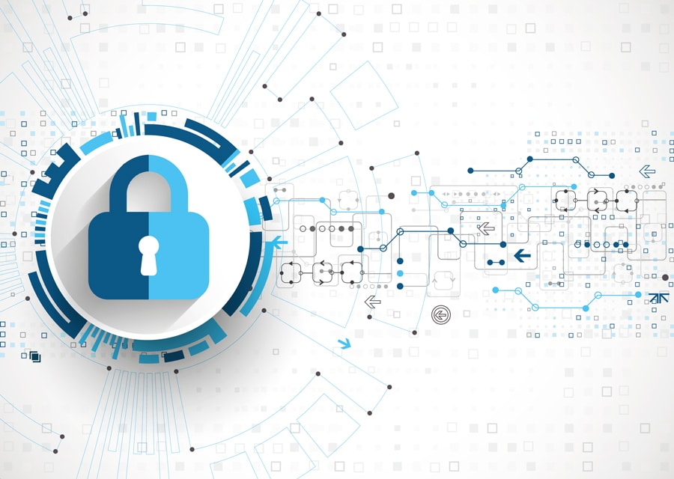
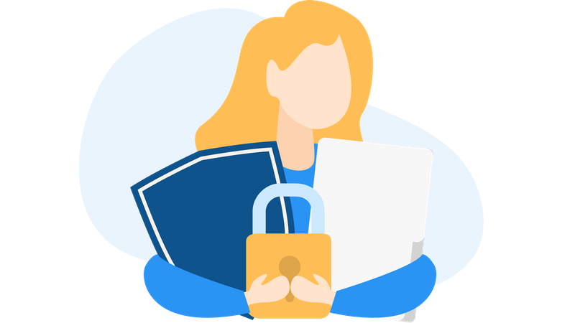
Digital Privacy – Conclusions
Building Digital Resilience by Making Digital Wellbeing and Security Accessible to All 2022-2-SK01-KA220-ADU-000096888

Slide 2
Summary of the Course
Understanding Digital Privacy
Phishing
Types of Digital Privacy and Teaching Digital Privacy

Slide 3
Recap Course N°1 - Understanding Digital Privacy
Defining Digital Privacy
What? The ability of an individual to control and protect the access and use of their personal information when they navigate the internet.
Impact: Not an abstract concept, it is crucial to understand it to keep their personal information safe from unauthorized use.
Why? In an interconnected world, the division between personal / private and general / public is always thinner. Digital Privacy (DP) is a protection.
Measure? In the EU, the GDPR (General Data Protection Regulation) guarantee the protection of your personal information data whenever they are collected.

Slide 4
Recap Course N°1 - Understanding Digital Privacy
Defining Digital Privacy
Law? The right of privacy is protected by the article 8 of the Charter of Fundamental Rights of the European Union.
Benefits DP? Ability to protect personal information, prevention of identity theft, prevention of unauthorized access, avoiding targeted ads.
Without DP? Risk of cyberattacks, identity theft & fraud, data breaches, loss of trust, surveillance & monitoring, psychological impacts.
Issues? Strategies (education, anti-viruses etc.) to mitigate risks & vulnerabilities (phishing, malware, ransomware etc.).

Slide 5
Recap Course N°1 - Understanding Digital Privacy
Key elements Digital Privacy
Personal Data? Any information that relates to an identified living individual.
Data Security? Installing security programs (anti-viruses, personal servers for companies etc.) to protect against data breaches.
Informed consent? Use of cookies (technical / analytical /profiling).
User education? Internet users have the right skills to safely manage their content.

Slide 6
Recap Course N°2 - Phishing
Defining Phishing
What? Phishing is a common type of cyber attack that targets individuals through email, text messages, phone calls, and other forms of communication.
Why? It is a technique for attempting to acquire sensitive data, such as bank account numbers, through a fraudulent solicitation in email or on a web site, in which the perpetrator masquerades as a legitimate business or reputable person.
Different types? Email phishing, spear phishing, clone phishing, voice phishing, SMS phishing

Slide 7
Recap Course N°2 - Phishing
List of different types of phishing
Clone phishing? Criminals clone e-mails, or messages from the past, redirecting people to fake sites, which are often identical copies of the original sites.
Voice phishing? Scam technique that involves the use of telephone calls to trick people into obtaining confidential information. These scammers often impersonate legitimate businesses, such as banks.
SMS phishing? Like voice phishing, SMS phishing is conducted through text messages. These messages typically contain malicious links or urgent requests for sensitive information.

Slide 8
Recap Course N°3 - Types of Digital Privacy
Information privacy: sensitive data
What? Sensitive data can be defined as a subset of personal data such as data revealing racial or ethnic origin, religious or philosophical beliefs etc.
Right? The article 8 gives the ritght to the protection of his or her personal data on the article 5 of the European Regulation 2016/679.
Principles? Correction and Transparency, Limitation (limited to the purpose), Preservation (retained during a limited time), Responsibility.
How? Knowing the right safeguards to protect the personal information and to ensure lawful treatment when people are in contact with other people’s data.

Slide 9
Recap Course N°3 - Types of Digital Privacy
Digital Privacy on mobile phones
Use secure apps (apps with end-to-end encryption).
Strong and unique passwords (long > minimum of 16 characters + specific symbol).
Two-factor authentication.
Update software (regular updates including security patches).
Avoid unsecured public public Wi-Fi networks (vulnerable networks to man-in-the-middle attacks).
Do not click on suspicious links (may contain malware or phishing).
Review privacy settings (limiting access to your personal data).
Keep communication open (if any suspicious activity, report ot immediately!).

Slide 10
Free License
The product developed here as part of the project "Building Digital Resilience by Making Digital Wellbeing and Security Accessible to All 2022-2-SK01-KA220-ADU-000096888" was developed with the support of the European Commission and reflects exclusively the opinion of the author. The European Commission is not responsible for the content of the documents
The publication obtains the Creative Commons License CC BY- NC SA.
This license allows you to distribute, remix, improve and build on the work, but only non-commercially. When using the work as well as extracts from this must:
be mentioned the source and a link to the license must be given and possible changes have to be mentioned. The copyrights remain with the authors of the documents.
the work may not be used for commercial purposes.
If you recompose, convert or build upon the work, your contributions must be published under the same license as the original.
Disclaimer:
Funded by the European Union. Views and opinions expressed are however those of the author(s) only and do not necessarily reflect those of the European Union or the European Education and Culture Executive Agency (EACEA). Neither the European Union nor EACEA can be held responsible for them.

