Slide 1
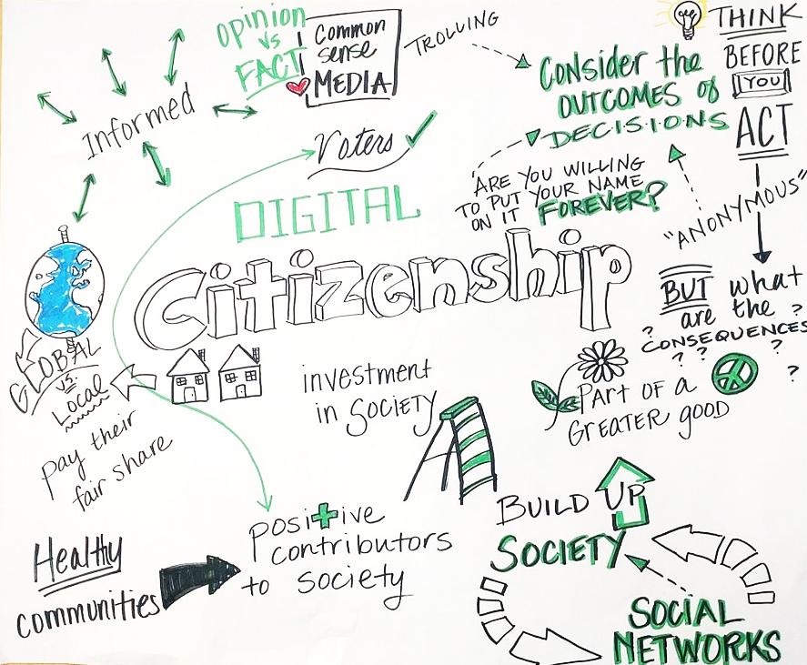
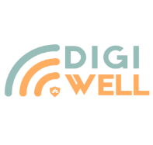
Digital Citizenship - Conclusion
Building Digital Resilience by Making Digital Wellbeing and Security Accessible to All 2022-2-SK01-KA220-ADU-000096888

Slide 2
Key Takeaways from Digital Citizenship
Summarizing the essential points from each subsection:
Understanding digital tools and platforms enhances our ability to navigate the digital world safely and effectively.
Online safety and digital rights are fundamental to protecting our digital identities and exercising our freedoms online.
The ethical use of digital technology underpins responsible digital citizenship, promoting fairness, respect, and understanding in digital interactions.
Notes:
Discuss the concept of digital well-being and its relevance in today's digital age.
Emphasize the need for balance in using technology to enhance our lives without sacrificing our well-being.
"Let's start by understanding what digital well-being really means. It's all about finding that balance between using technology to enhance our lives and making sure it doesn't take over. We'll be exploring practical ways to achieve this balance."

Slide 3
Reflection on Digital Citizenship
As we wrap up our exploration of Digital Citizenship, it's important to reflect on how the insights gained can be applied to our digital lives. This journey through understanding digital tools and platforms, prioritizing online safety and digital rights, and committing to the ethical use of digital technology has equipped us with the knowledge to navigate the digital world more thoughtfully and responsibly.
Understanding Digital Tools & Platforms: Consider how the digital tools and platforms you use influence your daily life. Has this module inspired you to explore new tools or rethink how you use existing ones?
Online Safety & Digital Rights: Reflect on your current practices for safeguarding your online safety and exercising your digital rights. Are there changes you plan to implement based on what you've learned?
Ethical Use of Digital Technology: Think about the ethical considerations of your online interactions and content sharing. How will you apply ethical principles to ensure your digital presence contributes positively to the online community?
Notes:
Explain the user-friendly and engaging format of the course materials, including PowerPoint presentations, videos, and quizzes.
Encourage attendees to actively participate in the learning process and make use of the interactive elements provided.
"Our course materials are designed to be user-friendly and engaging. From PowerPoint presentations to interactive quizzes, we've made sure that learning about digital well-being is both informative and enjoyable."

Slide 4
Questions for Reflection
Personal Impact: How will the concepts of digital governance and bureaucracy you've learned impact your approach to engaging with digital services provided by governments or organizations?
Community Engagement: Considering the discussions on social media and activism, how do you see your role in using digital platforms for social change?
Advocacy for Rights: Given the importance of online safety and digital rights, how can you advocate for yourself and others in the digital space?
Ethical Dilemmas: Can you think of a time when you faced an ethical dilemma online? How would you handle it differently now?
Call to Action: Use this moment of reflection to set personal goals for your continued growth as a digital citizen. Identify one area you'd like to learn more about or a specific habit you plan to change. Remember, the journey of digital citizenship is ongoing, and each step you take towards being more informed, cautious, and ethical online strengthens not only your digital presence but also the digital community at large.
Notes:
Explain the user-friendly and engaging format of the course materials, including PowerPoint presentations, videos, and quizzes.
Encourage attendees to actively participate in the learning process and make use of the interactive elements provided.
"Our course materials are designed to be user-friendly and engaging. From PowerPoint presentations to interactive quizzes, we've made sure that learning about digital well-being is both informative and enjoyable."

Slide 5
Applying Your Knowledge
Now that we've navigated through the core concepts of Digital Citizenship, it's time to put your knowledge into action. This slide challenges you to apply what you've learned in practical, real-world contexts. Engaging with digital governance, protecting your online presence, and advocating for ethical digital practices are all vital components of a responsible digital citizen.
Digital Governance Interaction: Identify a digital service provided by your local government—such as online bill payments, public service requests, or digital libraries. Plan to use this service within the next month, if you haven't already, and reflect on how digital governance makes civic engagement more accessible.
Social Media for Social Change: Think of a cause you're passionate about. Use social media to raise awareness or support this cause. This could be through sharing informative posts, participating in or creating a hashtag campaign, or highlighting organizations doing meaningful work.
Safeguarding Online Safety: Review the privacy settings on one of your social media accounts or digital services. Adjust enhance your privacy and security based on best practices learned. Share your experience with friends or family to spread awareness about online safety.
Notes:
Explain the user-friendly and engaging format of the course materials, including PowerPoint presentations, videos, and quizzes.
Encourage attendees to actively participate in the learning process and make use of the interactive elements provided.
"Our course materials are designed to be user-friendly and engaging. From PowerPoint presentations to interactive quizzes, we've made sure that learning about digital well-being is both informative and enjoyable."

Slide 6
Applying Your Knowledge
Challenge Questions:
Describe how using a digital platform for community engagement can offer advantages over traditional in-person methods. What are potential drawbacks?
Reflect on a time when you or someone you know may have shared personal information online without considering the potential risks. How would you approach this situation differently now?
Ethical Dilemma Discussion: Consider an ethical dilemma in the use of digital technology (e.g., the debate over digital surveillance for public safety versus privacy). Write a brief argument or discussion post presenting your viewpoint, incorporating ethical principles discussed in this module.
Call to Action: Digital citizenship requires more than understanding; it demands action. Choose one of the activities above and commit to completing it within the next week. Share your plan with a peer or mentor for accountability and be prepared to discuss your experience in our next session.
Notes:
Explain the user-friendly and engaging format of the course materials, including PowerPoint presentations, videos, and quizzes.
Encourage attendees to actively participate in the learning process and make use of the interactive elements provided.
"Our course materials are designed to be user-friendly and engaging. From PowerPoint presentations to interactive quizzes, we've made sure that learning about digital well-being is both informative and enjoyable."

Slide 7
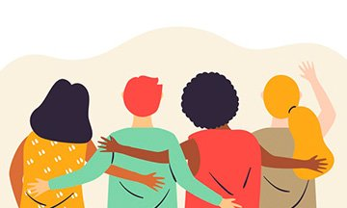
Conclusions – 1
Today, to practice a digital citizenship, it is necessary to educate citizens on how to interpret the new languages, messages and symbols, that are hybrid, continually evolving and intercultural, to interpret the new social representations and socially constructed meanings. This to avoid manipulation and social control.
Notes:
Discuss the concept of digital well-being and its relevance in today's digital age.
Emphasize the need for balance in using technology to enhance our lives without sacrificing our well-being.
"Let's start by understanding what digital well-being really means. It's all about finding that balance between using technology to enhance our lives and making sure it doesn't take over. We'll be exploring practical ways to achieve this balance."

Slide 8
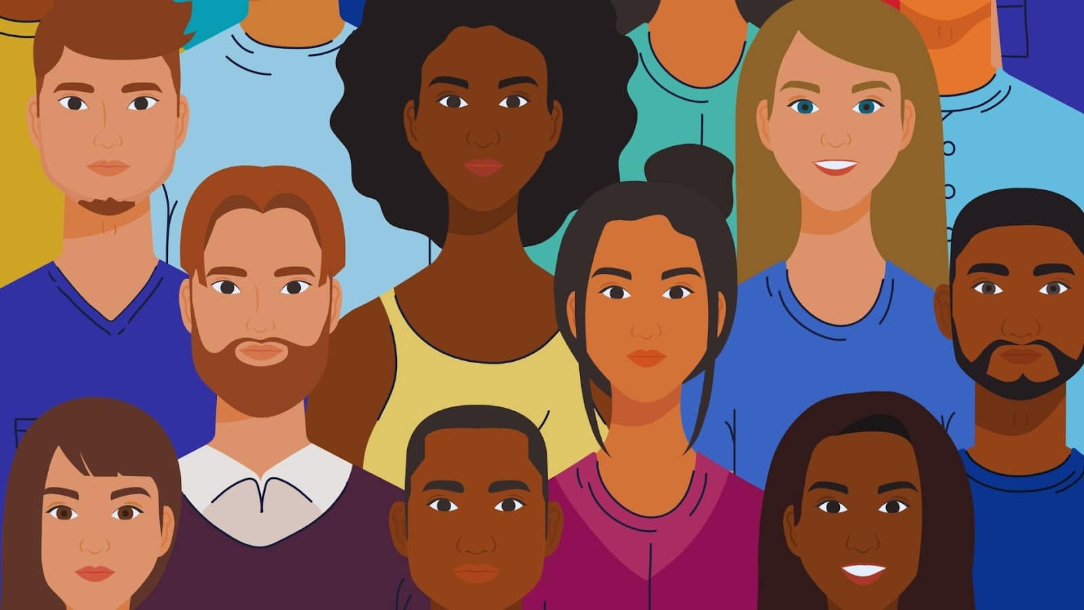
Conclusions – 2
Citizens need to develop a multiliteracy, referring to both the ability to communicate through different media and to the ability to communicate in an intercultural society.
Citizens need to learn how to produce digital contents according to each digital environment, considering the ethical implications of their actions, the target group and audience of their message, the appropriate communication style, distinguishing between formal and informal digital context.
Notes:
Discuss the concept of digital well-being and its relevance in today's digital age.
Emphasize the need for balance in using technology to enhance our lives without sacrificing our well-being.
"Let's start by understanding what digital well-being really means. It's all about finding that balance between using technology to enhance our lives and making sure it doesn't take over. We'll be exploring practical ways to achieve this balance."

Slide 9
Conclusions – 3
Due to the media being on life, that is being constantly connected through various devices, it is necessary to be conscious so to maintain a self-integrity, as it can be difficult to manage oneself identity and social roles in multiple digital environments. In this respect, it is often difficult to manage the overlapping of the formal and informal self.
Notes:
Discuss the concept of digital well-being and its relevance in today's digital age.
Emphasize the need for balance in using technology to enhance our lives without sacrificing our well-being.
"Let's start by understanding what digital well-being really means. It's all about finding that balance between using technology to enhance our lives and making sure it doesn't take over. We'll be exploring practical ways to achieve this balance."

Slide 10
Conclusions – 4
Through media education it is possible to reach individual empowerment, so that citizens can achieve a true emancipation for digital citizenship.
Through media education, citizens can learn to use digital tools critically and responsibly, in a proactive and participatory manner, for positive political and civic dialogue, and to discriminate what it is worth and not.
Notes:
Discuss the concept of digital well-being and its relevance in today's digital age.
Emphasize the need for balance in using technology to enhance our lives without sacrificing our well-being.
"Let's start by understanding what digital well-being really means. It's all about finding that balance between using technology to enhance our lives and making sure it doesn't take over. We'll be exploring practical ways to achieve this balance."

Slide 11
Free License
The product developed here as part of the project "Building Digital Resilience by Making Digital Wellbeing and Security Accessible to All 2022-2-SK01-KA220-ADU-000096888" was developed with the support of the European Commission and reflects exclusively the opinion of the author. The European Commission is not responsible for the content of the documents
The publication obtains the Creative Commons License CC BY- NC SA.
This license allows you to distribute, remix, improve and build on the work, but only non-commercially. When using the work as well as extracts from this must:
be mentioned the source and a link to the license must be given and possible changes have to be mentioned. The copyrights remain with the authors of the documents.
the work may not be used for commercial purposes.
If you recompose, convert or build upon the work, your contributions must be published under the same license as the original.
Disclaimer:
Funded by the European Union. Views and opinions expressed are however those of the author(s) only and do not necessarily reflect those of the European Union or the European Education and Culture Executive Agency (EACEA). Neither the European Union nor EACEA can be held responsible for them.

