Slide 1
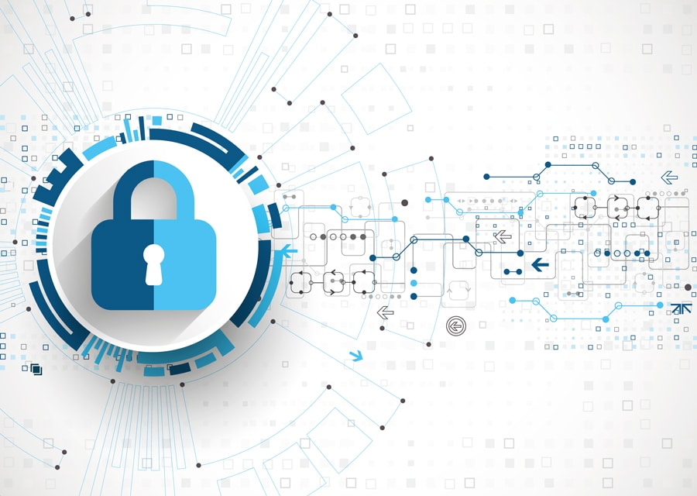
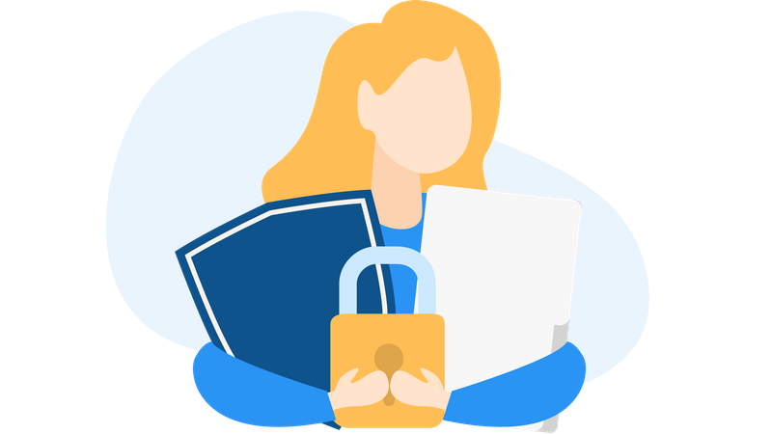
Digital Privacy - Introduction
Building Digital Resilience by Making Digital Wellbeing and Security Accessible to All 2022-2-SK01-KA220-ADU-000096888

Slide 2
DIGITAL PRIVACY: PROTECTION OF PRIVATE INFORMATION
CONTENT
Introduction
Understanding Digital Privacy
Digital Privacy: Phishing
Types of Digital Privacy
Recap

Slide 3
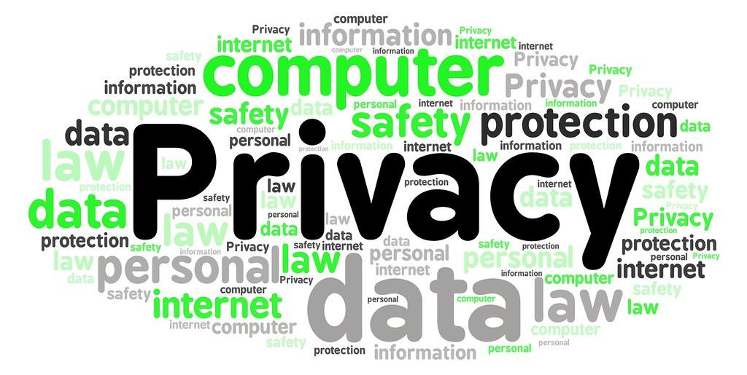
INTRODUCTION
In a world dominated by technology, preserving our digital privacy is crucial for our well-being.
“Digital Well-being: Discussing Digital Privacy” is an immersive course designed to empower individuals to navigate the digital realm while safeguarding their privacy.
Whether you are an individual looking to protect your personal data, an educator aiming to instil digital privacy awareness, or a professional concerned about digital security, this course equips you with the knowledge and skills you need.

Slide 4
Digital privacy is not just a concept, but a fundamental right in our interconnected world (Article 8 of the Charter of Fundamentals Rights of the European Union).
We will dive into the critical significance of digital privacy in our daily lives.
Look at your phone for a moment, think about how much private information is inside it, from social chats all the way to bank accounts. With this comes the need to protect your data effectively and securely.

Slide 5
Aim of Module
This module aims to improve comprehension of digital privacy, provide practical skills, and foster a sense of responsibility in today’s digital era.
At the end of the course, participants will be able to make well-informed choices and educate others on the importance of digital privacy.
Furthermore, participants will be prepared to share and disseminate information about the importance of digital privacy with the rest of society.

Slide 6
LEARNING OBJECTIVES
1
2
3
Understand the impact of technology in the digital age.
Understand the various techniques used in phishing attacks and to be equipped with knowledge to identify and protect against these cyber threats effectively.
Understand the importance of both information privacy and communication privacy in the digital realm, and to acquire knowledge and strategies for safeguarding personal information.

Slide 7
LEARNING OUTCOMES
AT THE END OF THIS MODULE, PARTICIPANTS WILL BE ABLE TO:
UNDERSTAND THE IMPORTANCE OF DIGITAL PRIVACY IN THE TECHNOLOGICAL WORLD.
RECOGNIZE SOME RISKS INVOLVED IN DIGITAL PRIVACY (SUCH AS PHISHING).
IDENTIFY AND APPLY STRATEGIES TO PROTECT YOUR INFORMATION ONLINE.
THE MODULE WILL HAVE AN IMPORTANT PSYCHOLOGICAL IMPACT ON OUR LIVES, BECAUSE IT WILL BENEFIT BOTH PROFESSIONALLY, PROVIDING NEW SKILLS EXPENDABLE IN THE JOB MARKET, AND PERSONALLY.

Slide 8
Expectations from Learners
Tasks and responsibilities of learners
Examples:
You are expected to spend approximately ... hours to complete this module.
To fully complete this course, the participants must:
Watch the videos
View the presentations
Complete the quizzes and questions
Submit the final test

Slide 9
Expectations from Learners
What we expect from you fall into three categories:
Before the module: The only need is to have basic skills in the use of technology, and to know in a very general way what digital privacy is.
During the module: Active participation in discussions and completion of assigned tasks are essential for making significant progress in digital privacy.
After the module: The acquired knowledge can be applied in both personal and professional life.

Slide 10
Free License
The product developed here as part of the project "Building Digital Resilience by Making Digital Wellbeing and Security Accessible to All 2022-2-SK01-KA220-ADU-000096888" was developed with the support of the European Commission and reflects exclusively the opinion of the author. The European Commission is not responsible for the content of the documents
The publication obtains the Creative Commons License CC BY- NC SA.
This license allows you to distribute, remix, improve and build on the work, but only non-commercially. When using the work as well as extracts from this must:
be mentioned the source and a link to the license must be given and possible changes have to be mentioned. The copyrights remain with the authors of the documents.
the work may not be used for commercial purposes.
If you recompose, convert or build upon the work, your contributions must be published under the same license as the original.
Disclaimer:
Funded by the European Union. Views and opinions expressed are however those of the author(s) only and do not necessarily reflect those of the European Union or the European Education and Culture Executive Agency (EACEA). Neither the European Union nor EACEA can be held responsible for them.

