Slide 1

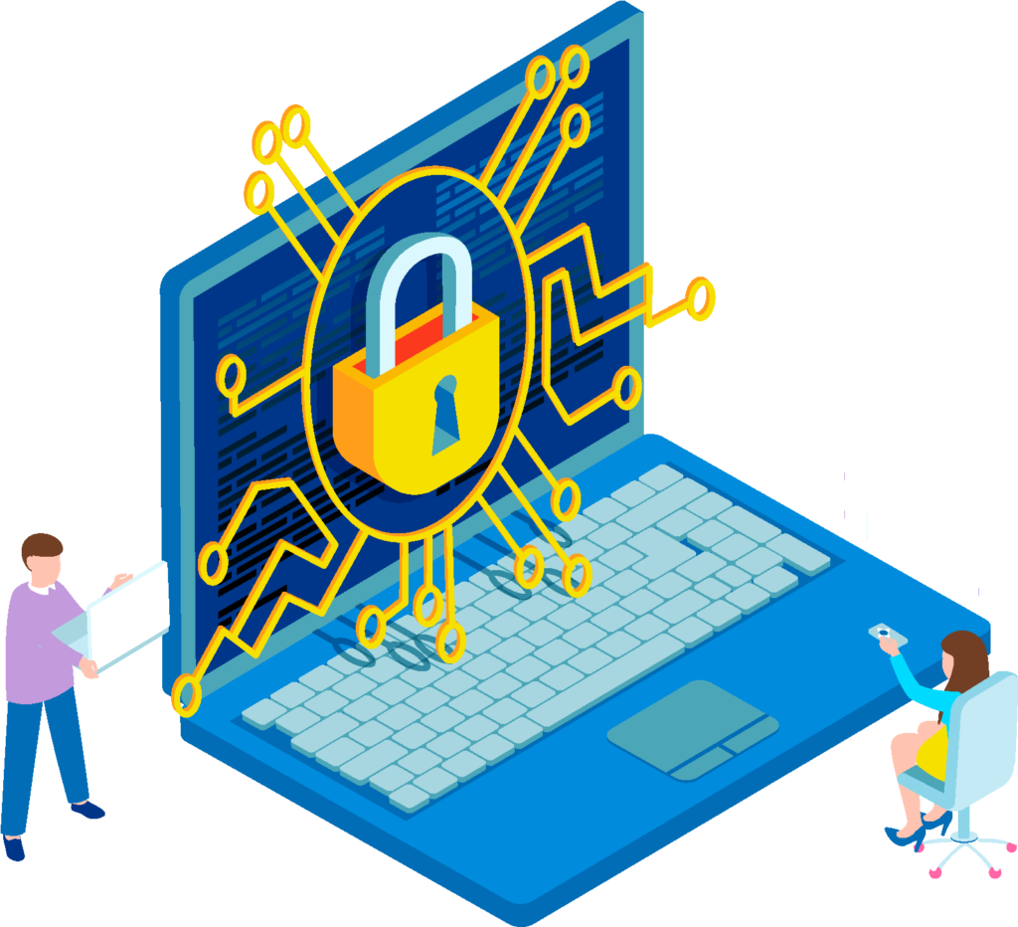









Digital Security - Introduction
Building Digital Resilience
by Making Digital Wellbeing
and Security Accessible to All
2022-2-SK01-KA220-ADU-000096888

Slide 2
DIGITAL SECURITY:
ACTIVELY STAY SAFE ONLINE
CONTENT
Introduction to Digital security
Digital Identity and Digital Footprint
Digital Security Habits
Social Networks Security
Recap - conclusions
Internet Banking Security

Slide 3
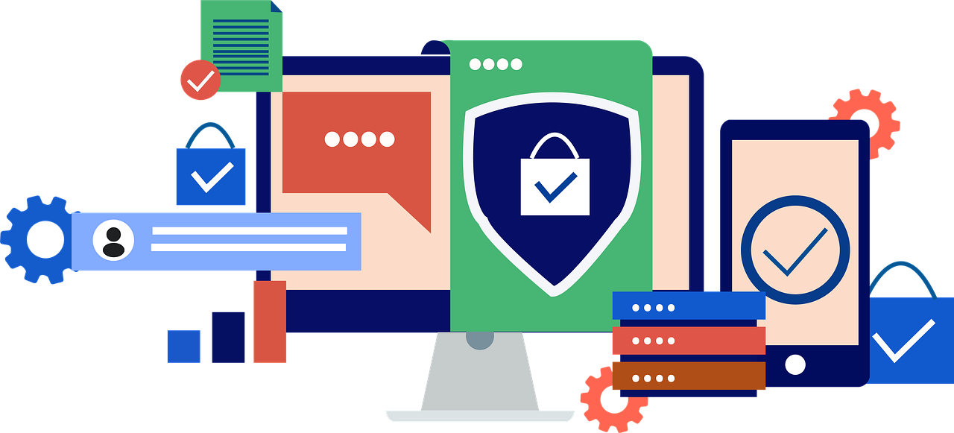
INTRODUCTION
This training module is developed to provide adults with knowledge and skills about safe behavior in the online space, to set up higher level of their digital security.

Slide 4
What is the Difference Between Cyber Security and Digital Security?
Cyber ​​Security and Digital Security sound very similar and people often use them interchangeably, but they have different concepts.
Cybersecurity is a broader term that includes everything a business can do to protect itself online - network security, data and process protection.
Digital security is a subset of cyber security. It focuses on the capabilities and efforts that individuals can take to protect themselves and their data and devices.

Slide 5
What is Digital Security?
In this digital age, everything is based on data and your personal information is critical to your life.
Attackers are constantly finding new ways to access personal information and attack your online presence.
Protecting yourself in your online life has never been more important!!!
Digital security ensures that you not only have an awareness of the threats you face as an individual, but that you have the tools and knowledge to combat these attacks.
Digital security: the difference between getting an email claiming to be from your boss who wants the absurd thing from you, and realizing the address it's coming from is fake.

Slide 6
Aim of Module
The aim of Digital Security Module is to equip adults with the competences necessary to behave responsibly in the online world.
The module is designed to help adults understand basic digital security concepts to reduce the risk of online attack and provide ways to increase their digital resilience.

Slide 7
LEARNING OBJECTIVES
To have a general knowledge of the digital security concept.
1
To understand the issue of digital identity and digital footprint.
2
To explore practical strategies to digital security habits.
3
To learn ways of using social networks and internet banking safely.
4
To discover digital security best practices and tips.
5

Slide 8
LEARNING OUTCOMES
At the and of this module, you will be able to:
define digital identity and digital footprint and understand its relationship with concept of digital security
develop a personal strategy of digital security habits
behave safely on social networks and in internet banking
identify and benefit from best practices of digital security
decrease risk of online attacks and threats

Slide 9
Expectations from Learners
Tasks and responsibilities of learners
To maximize the benefit that you will have from the module and to have
all the learning outcomes, you as a learner are expected the followings:
Please;
Allocate at least approximately three hours to complete this module.
Watch all the assigned videos to have a general understanding of digital wellbeing.
Review all presentations attentively to explore important issues related to the topic.
Complete all the quizzes to check your understanding and to turn back when necessary.

Slide 10

Free Licence
The product developed here as part of the project "Building Digital Resilience by Making Digital Wellbeing and Security Accessible to All 2022-2-SK01-KA220-ADU-000096888" was developed with the support of the European Commission and reflects exclusively the opinion of the author. The European Commission is not responsible for the content of the documents
The publication obtains the Creative Commons Licence CC BY- NC SA.
This license allows you to distribute, remix, improve and build on the work, but only non-commercially. When using the work as well as extracts from this must:
  be mentioned the source and a link to the license must be given and possible changes have to be mentioned. The copyrights remain with the authors of the documents.
  the work may not be used for commercial purposes.
  If you recompose, convert or build upon the work, your contributions must be published under the same license as the original.
Disclaimer:
Funded by the European Union. Views and opinions expressed are however those of the author(s) only and do not necessarily reflect those of the European Union or the European Education and Culture Executive Agency (EACEA). Neither the European Union nor EACEA can be held responsible for them.

