Slide 1
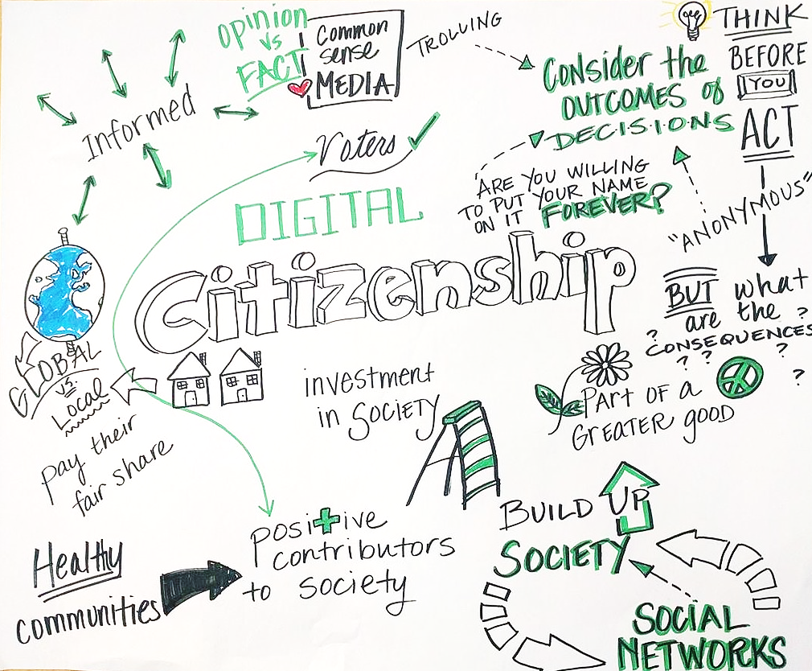
Digital Citizenship - Introduction
Building Digital Resilience by Making Digital Wellbeing and Security Accessible to All 2022-2-SK01-KA220-ADU-000096888

Slide 2
DIGITAL CITIZENSHIP
CONTENT
Introduction
Understanding Digital Citizenship
Online Safety & Digital Rights
Ethical Use of Digital Technology
Recap

Slide 3
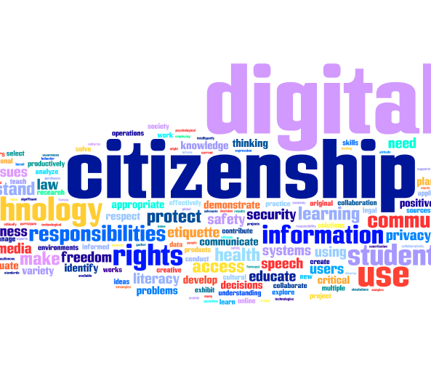
INTRODUCTION
Welcome to the "Digital Citizenship" module, an engaging journey designed to empower you with the essential skills and knowledge for navigating the digital world safely and ethically.
In this module, we will explore key concepts of digital citizenship, including your rights and responsibilities online, how to protect your digital identity, and the importance of digital ethics.

Slide 4
Aim of Module
Our aim is to equip you with the competencies necessary for digital wellbeing and security, fostering digital resilience for all.
We look forward to your active participation and the unique perspectives you bring to our learning community.
Let's embark on this transformative journey together, enhancing our digital literacy and promoting a safer, more inclusive digital environment for everyone.

Slide 5
LEARNING OBJECTIVES
1
2
3
Understanding Digital Citizenship
Learners will be able to define digital citizenship and explain its importance in the context of today’s digital society.
Online Safety and Digital Rights
Learners will understand how to protect their personal information online and identify their digital rights and responsibilities.
Ethical Use of Digital Technology
Learners will be able to recognize ethical dilemmas in digital spaces and apply ethical decision-making processes to resolve them.

Slide 6
LEARNING OUTCOMES
PARTICIPANTS WILL BE ABLE TO ARTICULATE THE CONCEPT OF DIGITAL CITIZENSHIP, DEMONSTRATING AN UNDERSTANDING OF ITS SIGNIFICANCE IN FOSTERING A RESPONSIBLE, ETHICAL, AND SAFE ONLINE COMMUNITY.
PARTICIPANTS WILL BE ABLE TO IMPLEMENT STRATEGIES FOR SAFEGUARDING PERSONAL INFORMATION ONLINE, WHILE RECOGNIZING AND ADVOCATING FOR THEIR DIGITAL RIGHTS IN VARIOUS ONLINE SPACES.
PARTICIPANTS WILL BE ABLE TO APPLY ETHICAL PRINCIPLES AND DECISION-MAKING PROCESSES TO ADDRESS AND RESOLVE DIGITAL DILEMMAS, PROMOTING INTEGRITY AND RESPECT IN DIGITAL INTERACTIONS.

Slide 7
Expectations from Learners
To successfully engage with the "Digital Citizenship" module and achieve the learning outcomes, you as a learner are expected to:
Dedicate approximately 10 hours to complete this module, ensuring a comprehensive understanding of the content.
Watch all assigned videos to gain a deeper insight into the digital citizenship principles.
Review all presentations attentively to grasp the key concepts and strategies discussed.
Complete all quizzes to self-assess your understanding and retention of the module information.
Engage actively in discussions and contribute to the shared learning environment with respect and consideration for others.
Your active participation and completion of these tasks are crucial in building a solid foundation in digital citizenship.

Slide 8
Free License
The product developed here as part of the project "Building Digital Resilience by Making Digital Wellbeing and Security Accessible to All 2022-2-SK01-KA220-ADU-000096888" was developed with the support of the European Commission and reflects exclusively the opinion of the author. The European Commission is not responsible for the content of the documents
The publication obtains the Creative Commons License CC BY- NC SA.
This license allows you to distribute, remix, improve and build on the work, but only non-commercially. When using the work as well as extracts from this must:
be mentioned the source and a link to the license must be given and possible changes have to be mentioned. The copyrights remain with the authors of the documents.
the work may not be used for commercial purposes.
If you recompose, convert or build upon the work, your contributions must be published under the same license as the original.
Disclaimer:
Funded by the European Union. Views and opinions expressed are however those of the author(s) only and do not necessarily reflect those of the European Union or the European Education and Culture Executive Agency (EACEA). Neither the European Union nor EACEA can be held responsible for them.

