Slide 1
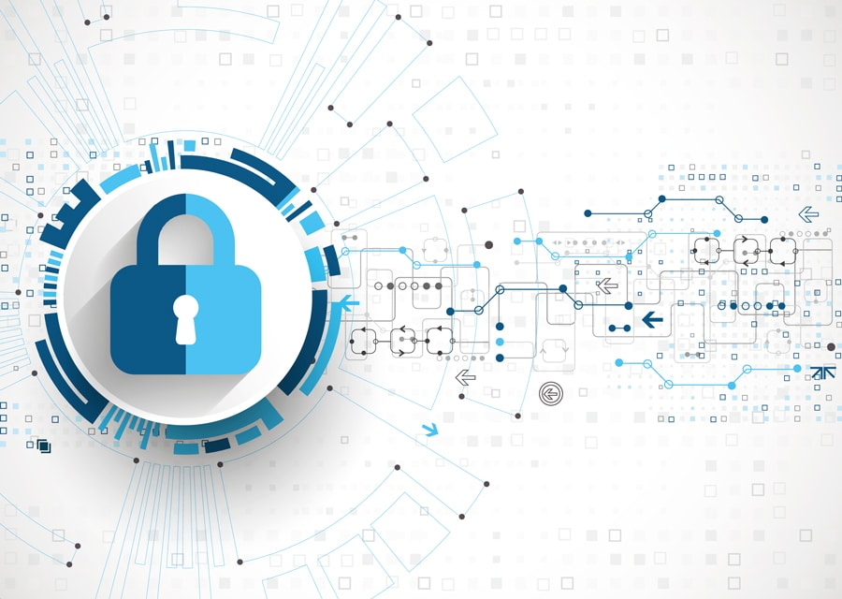
Digital Privacy – Phishing
Building Digital Resilience by Making Digital Wellbeing and Security Accessible to All 2022-2-SK01-KA220-ADU-000096888

Slide 2
INTRODUCTORY QUESTIONS
What do you think phishing is?
What clues usually alert you that a message might be a phishing attempt?
Have you ever been a victim of phishing or do you know someone who has?
Do you have any recent examples of phishing that you would like to share?

Slide 3
PHISHING
The term phishing probably derives from the English word “fishing”, thus referring to the activity of fishing and referring to when the fish takes the bait thrown overboard, just as the user takes the bait.

Slide 4
What Does the Term Phishing Mean?
Phishing is a common type of cyber-attack that targets individuals through email, text messages, phone calls, and other forms of communication.
It is a technique for attempting to acquire sensitive data, such as bank account numbers, through a fraudulent solicitation in email or on a web site, in which the perpetrator masquerades as a legitimate business or reputable person.

Slide 5
What Does the Term Phishing Mean?
Phishing is one of the simplest techniques used by cybercriminals but remains one of the most effective.
It consists of contacting an individual by making him or her believe that he or she is in danger, for instance by saying that his or her bank account is under attack, then convincing him or her in various ways to provide his or her personal data, such as cards, accounts or passwords, thus giving hackers access to private data.

Slide 6
When did it Start?
The first phishing attempts in history were recorded in the late 1990s against the company America Online, which at the time was the largest provider of Internet access.
The consistency of the scams prompted the multinational company to send an e-mail to all users explaining that the company would never contact them for payment or to find out passwords.
Subsequently, in the early 2000s, the attention of the hackers shifted to online payment systems, as it was common for criminals to clone sites such as E-BAY or PAY-PAL.

Slide 7
TYPES OF PHISHING
There are several types of phishing:
Email Phishing
Spear Phishing
Clone Phishing
Voice Phishing
SMS Phishing

Slide 8
EMAIL PHISHING
Within the digital sphere, email phishing is a major threat whose origin lies in the fact that cybercriminals try to trick people with spam or fake emails.
Among the types of email phishing we find a great variety, such as spear phishing and clone phishing, which direct threats to much more specific and organized victims and organizations.

Slide 9
SPEAR PHISHING
Email phishing is a prevalent threat in the digital realm, with spear phishing taking it to a more targeted level.
This strategy consists of precisely identifying the victim of the attack to create an e-mail as truthful as possible.

Slide 10
What is it used for?
According to the report 'Average Cost of a Spear Phishing Incident: $1.6Mn' conducted by Vanson Bourne and sponsored by Cloudmark, spear phishing in 2015 was responsible for 38 per cent of the cyber-attacks of the companies investigated.
In many cases, this strategy is used for political purposes, with the Chinese government itself reportedly using a phishing campaign against US and South Korean officials in 2011.

Slide 11
CLONE PHISHING
Criminals clone e-mails
Clone phishing is a cunning tactic employed by cybercriminals.
In this technique, criminals clone e-mails, or messages from the past, redirecting people to fake sites, which are often identical copies of the original sites.
Then the user, feeling secure, enters their access data, which are then used by the hackers.
Redirecting people to fake sites

Slide 12
VOICE PHISHING
Voice phishing, or vishing, is a scam technique that involves the use of telephone calls to trick people into obtaining confidential information, such as credit card numbers, passwords or other personal information.
These scammers often impersonate legitimate businesses, such as banks, phone companies, insurance companies, etc.

Slide 13
SMS PHISHING
SMS phishing, or smishing, is the same as voice phishing, only it is conducted via SMS text messages.
These messages often contain malicious links or instructions for the victim to respond with personal information.

Slide 14
THE NIGERIAN SCAM
One of the most famous phishing technique is The Nigerian scam.
Is a classic scam already known in the 1990s.
HOW DID THIS SCAM APPEAR?

Slide 15
In the 1990s in which a self-styled Nigerian prince (hence the name) contacts random people by mail claiming to need to move large amounts of money abroad but doing so discreetly. He then asks for an account in exchange for a large percentage of the money moved, which is usually in the millions of euros.
These scams typically involve someone posing as a wealthy individual who needs assistance transferring a large sum of money out of the country. They promise the victim a significant share of the funds in exchange for a small advance payment to cover various fees and expenses. However, once the victim sends the money, the scammer disappears.

Slide 16
WHAT HAPPENS TO THE UNWARY WHO TAKE THE BAIT?
The scammers start asking for money for phantom lawyers' and notaries' fees and continue until the victim stops paying or realises that he or she has been scammed.

Slide 19
FINAL TEST
What is the difference between phishing and spear phishing, and how can we avoid them?

Slide 20
Free License
The product developed here as part of the project "Building Digital Resilience by Making Digital Wellbeing and Security Accessible to All 2022-2-SK01-KA220-ADU-000096888" was developed with the support of the European Commission and reflects exclusively the opinion of the author. The European Commission is not responsible for the content of the documents
The publication obtains the Creative Commons License CC BY- NC SA.
This license allows you to distribute, remix, improve and build on the work, but only non-commercially. When using the work as well as extracts from this must:
be mentioned the source and a link to the license must be given and possible changes have to be mentioned. The copyrights remain with the authors of the documents.
the work may not be used for commercial purposes.
If you recompose, convert or build upon the work, your contributions must be published under the same license as the original.
Disclaimer:
Funded by the European Union. Views and opinions expressed are however those of the author(s) only and do not necessarily reflect those of the European Union or the European Education and Culture Executive Agency (EACEA). Neither the European Union nor EACEA can be held responsible for them.

