Slide 1
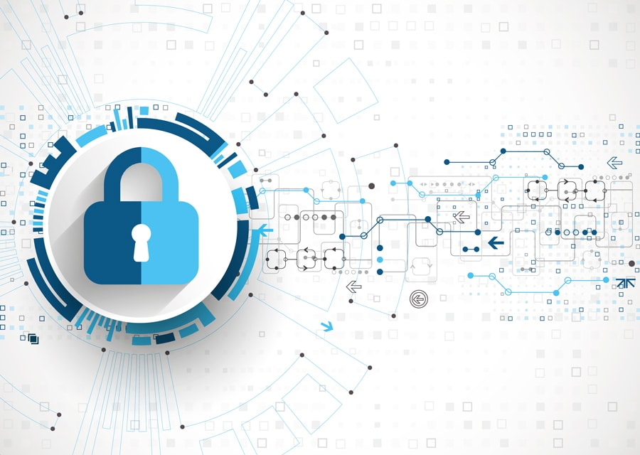
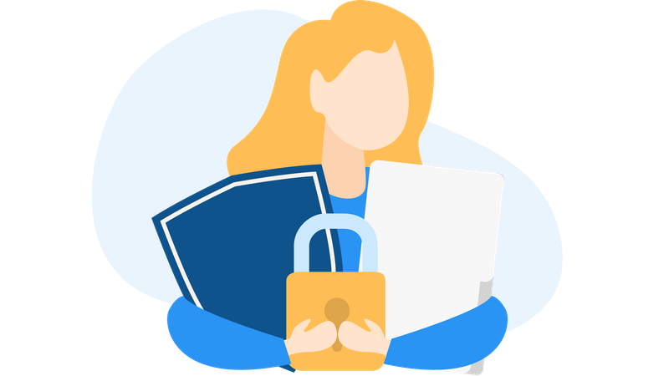
Digital Privacy – Types of Digital Privacy
Building Digital Resilience by Making Digital Wellbeing and Security Accessible to All 2022-2-SK01-KA220-ADU-000096888

Slide 2
TYPES OF DIGITAL PRIVACY
Privacy is not an absolute concept but is filled with many nuances, in this module there are two different types of digital privacy:
INFORMATION
PRIVACY
COMMUNICATION
PRIVACY

Slide 3
INFORMATION PRIVACY
Personal information: how to protect our personal information online.
But before starting, did you know that there are laws to protect us?
Firstly, it is important to understand what is meant by personal information and sensitive data. According to the law, Regulation 2016/679 defines personal data in its article 4 as any information that can be used to directly or indirectly identify a natural person.
ART. 4. REGULATION 2016/679

Slide 4
Sensitive data can be defined as a subset of personal data, collecting particularly important data such as data revealing racial or ethnic origin, religious or philosophical beliefs, political opinions, trade union membership, data concerning health or sex life, as well as genetic data, biometric data and data concerning sexual orientation.

Slide 5
A story to help understanding the harm that can be caused by a lack of data protection.
In 1930 Dutch citizens freely chose to provide their personal data to the government, data on name, origin and, of course, ethnicity; when the Nazis invaded the country, about a decade later, they took over the registry and found it very easy to identify Jews and Gypsies, leading to their death.

Slide 6
Example of a lack of data protection:
Imagine a young woman who recently started a new job at a local company, and she had to provide personal information such as her address, phone number, and social security number.
The company's data protection measures were lax, and their database was vulnerable to cyberattacks. Her personal information, along with that of her colleagues, was stolen by hackers. A few weeks later, she started receiving strange phone calls from unknown numbers. Then, she began receiving unsolicited emails and letters advertising various products and services. She realized that her personal information was being used without her consent. Her identity was stolen, and fraudulent accounts were opened in her name.
She experienced anxiety and fear about her financial security and privacy.
The lack of proper data protection measures not only caused her financial harm, but it also affects her mental well-being. This story underscores the importance of robust data security measures to safeguard personal information.

Slide 7
Due to experiences like this, the EUROPEAN CHARTER OF HUMAN RIGHTS mentions in its article 8 that everyone has the right to the protection of his or her personal data. This protection according to article 5 of the European Regulation 2016/679 must be done respecting the following principles:
ART. 8.
EUROPEAN CHARTER OF HUMAN RIGHT
ART. 5.
REGULATION 2016/679

Slide 8
THE FOLLOWING PRINCIPLES:
Correction and transparency:
the data subject must be aware of the data they provide, hence the illegitimacy of some COOKIES.
Limitation:
Data must be collected limited to the purpose; it is forbidden to collect unnecessary data.

Slide 9
Preservation: Information must be stored using techniques that allow it to be retained only for as long as necessary.
Responsibility: Users who collect data must ensure an adequate level of security.

Slide 10
TIPS
In a fast-moving technological world, it is important to know the right safeguards to properly protect the personal information, but also to ensure lawful treatment when people are in contact with other people’s personal data.

Slide 11
COMMUNICATION PRIVACY
Privacy in communication is very important to ensure that the digital conversations are kept confidential and protected from unauthorized action.
Digital communication refers to any type of information exchange whether it is by email, text messages, online chats, phone calls, etc.

Slide 12
By protecting the confidentiality of the conversations, people are ensuring that the information they are sharing is not exposed to unauthorized third parties. This is important in a digital world where personal and business information is constantly being transmitted through online networks and platforms.
With every technological advance, new risks arise, especially when it comes to the protection of our personal information.

Slide 13
Today people face many cyber scams, computer viruses and other digital dangers that can affect their online security and privacy.
It is therefore essential to take appropriate security measures to reduce these risks, by using strong passwords, VPNs to protect your internet connection, etc. These precautions are important to protect our privacy and keep us safe in the digital world.

Slide 14
TEACHING DIGITAL PRIVACY
HOW TO INCORPORATE DIGITAL PRIVACY INTO TRAINING
A good way to learn how to protect the personal information involves not only knowing and understanding the basics of digital privacy, but also learning how to apply that knowledge to protect your privacy online.

Slide 15
To engage in this process, a series of questions will be posed to prompt consideration of everyday practices, followed by participation in various activities:
Do you lock your bag when you go out?
Do you lock your house in the same way you lock your mobile phone?
Have you ever left your keys with a neighbor in case of emergency?
Don't you think that sharing your passwords with a stranger is tantamount to letting a stranger have access to your home?

Slide 16
These questions address aspects of people’s daily lives to which they tend to attach importance, such as the security of their personal belongings and access to their home. In the same way, digital privacy should be a constant concern.

Slide 17
Crossword puzzle

Slide 18
One of the activities will be to do a crossword puzzle of the basic concepts we should know about digital privacy.
Action needed to protect your information online: Password
Web site used to exchange messages in real time: Chat
Encryption method to protect your Internet connection: VPN
Malicious software that installs itself on your device without your consent: Virus
A set of rules and procedures that protect the privacy of personal data: Privacy
Technique used to verify a person's identity online: Authentication
Website or application that stores personal information and allows access from anywhere with an internet connection: Cloud

Slide 19
ANOTHER ACTIVITY: PRIVACY SETTINGS WORKSHOPS
How can you create a secure password?
By using a combination of letters, numbers and special characters (=; %; $...).
A secure password must have a minimum of 16 characters.
It is good to have a different password for each site, for that use, a password manager.
Write a sentence can be a good way to have a strong password.
Exercise: Create a strong password for an imaginary account.

Slide 20
DIGITAL PRIVACY ON MOBILE PHONES
As an adult:
what can you do to protect other adults’ mobile data?
To ensure the protection of data shared via mobile by a friend, family member, or colleague, it’s essential to emphasize that the recipient has the option to implement multiple security measures:

Slide 21
Use secure apps: use messaging and email apps that offer end-to-end encryption to protect data during transmission. Popular apps such as Whatsapp, Telegram and Signal offer this type of encryption to ensure the privacy of messages.
Strong and unique passwords: ensure that both the sender and receiver use strong and unique passwords for their email accounts and messaging apps. Passwords should be difficult to guess and should not be shared with anyone else.
Two-factor authentication: enable two-factor authentication whenever possible on accounts associated with the mobile. This adds an additional layer of security by requiring a second method of verification, such as a code sent to a trusted device.

Slide 22
Update software: keep both the mobile device’s operating system and the applications used to send and receive data up to date. Regular updates usually include security patches that fix known vulnerabilities.
Avoid unsecured public Wi-Fi networks: it is important to be cautious when sending sensitive data over unsecured public Wi-Fi networks, as these networks can be vulnerable to man-in-the-middle attacks. Instead, use secure Wi-Fi networks or a mobile data connection.
Do not click on suspicious links: avoid clicking on suspicious links or opening attachments from unknown senders, as they may contain malware or phishing.

Slide 23
Review privacy settings: review and adjust the privacy settings of messaging and email applications to limit who can see and access shared data. This includes setting privacy options on accounts to control who can contact the person and who can see their personal information.
Keep communication open: maintain open and transparent communication between the sender and receiver of data to address any security concerns and take preventative measures together. If any suspicious activity is detected or a security incident is experienced, report it immediately and take the necessary steps to protect the data.

Slide 24
FINAL TEST
What is the difference between information privacy and communication privacy ?

Slide 25
Free License
The product developed here as part of the project "Building Digital Resilience by Making Digital Wellbeing and Security Accessible to All 2022-2-SK01-KA220-ADU-000096888" was developed with the support of the European Commission and reflects exclusively the opinion of the author. The European Commission is not responsible for the content of the documents
The publication obtains the Creative Commons License CC BY- NC SA.
This license allows you to distribute, remix, improve and build on the work, but only non-commercially. When using the work as well as extracts from this must:
be mentioned the source and a link to the license must be given and possible changes have to be mentioned. The copyrights remain with the authors of the documents.
the work may not be used for commercial purposes.
If you recompose, convert or build upon the work, your contributions must be published under the same license as the original.
Disclaimer:
Funded by the European Union. Views and opinions expressed are however those of the author(s) only and do not necessarily reflect those of the European Union or the European Education and Culture Executive Agency (EACEA). Neither the European Union nor EACEA can be held responsible for them.

